Slide 1
Alice
Mathematical Expressions, Conditional Statements, Control Structures

Slide 2
Coverage
Arithmetic Expressions
Built-in Functions
Conditional Execution
If/Then Statements
Control Structures
Loops

Slide 3
Functions
Alice provides a set of built-in functions
Similar to methods but like a mathematical function
Takes some input and computes some output
E.g. SquareRoot(25)
We say the function returns the value 5 and has an input parameter of 25
Built-in functions give us information about properties of objects and relationship to other objects (e.g. distance, position in world, width)

Slide 4
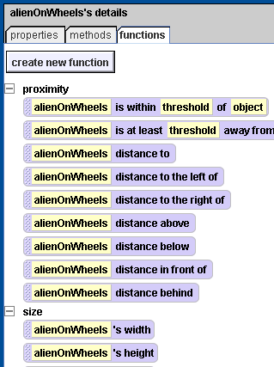
Functions
Click on the functions tab after selecting an object

Slide 5
Arithmetic Function Example
Make the alien on wheels move to another object
If we use are not careful it will move right through the object
We can experiment to find a good number
More generally, we could change the distance it moves to the function that computes the distance between the two objects
Drag the distance function over the “1 meter” box

Slide 6
Arithmetic Function Example
Now the alien moves to the middle of the object; how to fix this?

Slide 7
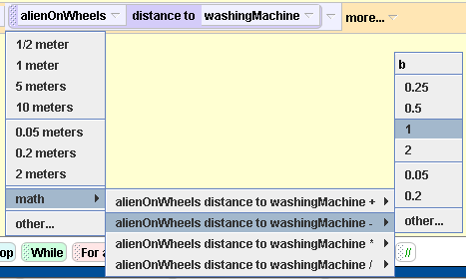
Arithmetic Function Example
Should move a distance:
(distance to object) – (Object width)/2 –
(alien width)/2
We can perform the math by clicking on the down arrow

Slide 8
If-Then
To create, drag “If/Else” from bottom to the code window
Is Condition True?
True
False
Do This Action
Single Path If Statement

Slide 9
If-Then-Else
Is Condition True?
True
False
Do This Action
Do Something Else
If / Else Statement

Slide 10
If/Else Example
If the alien is smaller than the object
Move around it
Else
Move right through it
Can resize the object to check both cases

Slide 11
Relational Operators
Relational operators are functions of the world object
A == B A is equal to B
A != B A is not equal to B
A > B A greater than B
A < B A less than B
A >= B A gte B
A <= B A lte B

Slide 12
If/Else Example
If the alien’s height < 2 then
Move around it
Else
Move right through it
Change the number 2 to test both cases

Slide 13
Repetition
Sometimes you want to repeat some code multiple times
Example: Make a flying cow
Should wiggle front legs together as it flies, like a dolphin kick
Remember how to do this?

Slide 14
Flying Cow
Problem: We would like the cow to wiggle her legs a total of 5 times, but it is a pain to copy the turn code 4 more times

Slide 15
Repetition
We can use a loop to repeat any block as many times as we like
Use LOOP to repeat something some known number of times
Use WHILE to repeat something while some condition is true
Once the condition becomes false, the loop will stop

Slide 16
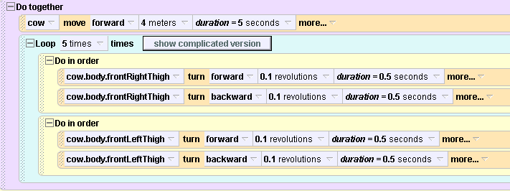
Version 1
Off a bit, why? Consider that we want the legs to
move together like a dolphin kick, not running

Slide 17
Version 2
The leg turning is done at the same time; requires another “Do Together” block
To try: Change Number of times to Infinity

Slide 18
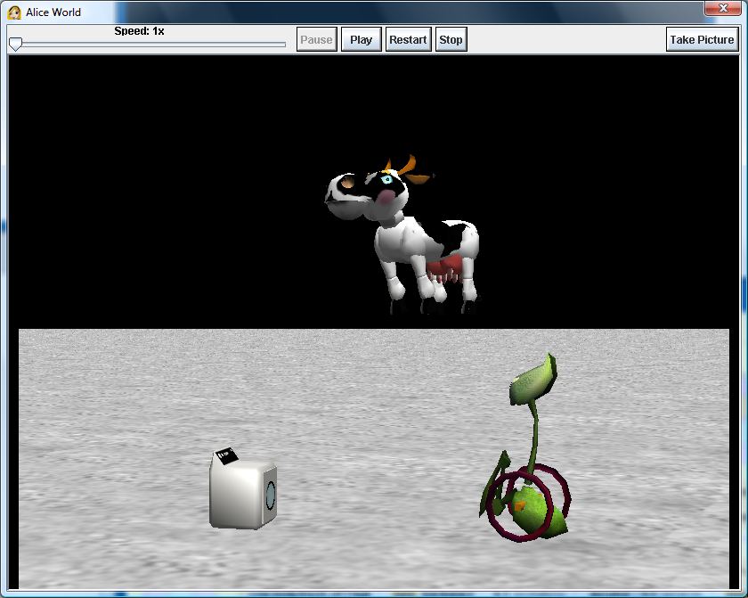
Flying Cow
Reminder: Can also move camera around in the scene

Slide 19
While Loop
Is Condition True?
True
False
Do This Action

Slide 20
While Loop Example
Make the alien try to randomly get close to the object
While (alien’s distance to the object > some value)
Turn some random amount
Go forward 1 meter
Say “Found it!”

Slide 21
Random Roll
While Loop code
Many other versions possible

Slide 22
More Complex Loop
If we click on the “Complex” loop then it shows additional loop options
Most notably there is a loop “index”
This is a variable that holds a number for the current iteration of the loop
Sometimes we may want to do processing based on the index
Loop index from NUM1 to NUM2
Loop body

Slide 23
More Complex Loop Example
The opacity property sets how transparent an object is
0 = invisible
1 = fully solid
Use the complicated loop to make the cow
Fade from invisible to visible
Fade from visible to invisible

Slide 24
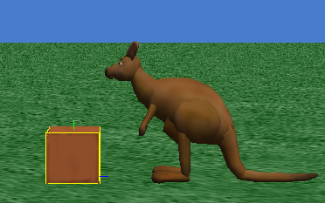
Class Exercise
Make a kangaroo jump onto a crate. The legs should make a hopping motion. Use the height/width of the objects to guide the forward and upward movements.

Slide 25
Class Exercise 2
Create a new event
Let the mouse move any object
Create a loop so the kangaroo turns toward the crate and moves toward it ½ meter until it is close to the crate, then it stops and says “GOT IT”
Use the mouse to move the crate around; the kangaroo should chase it

