Slide 1
Alice
Inheritance and Event Handling

Slide 2
Inheritance Concept
Consider this hierarchy; parents describe properties of children
Animals
Vertebrates
Fish
Mammals
Carnivores
Dogs
Cats
Bears

Slide 3
Introduction to Inheritance
Inheritance is one of the main techniques of object-oriented programming (OOP)
Using this technique, a very general form of a class is first defined and compiled, and then more specialized versions of the class are defined by adding properties and methods
The specialized classes are said to inherit the methods and properties of the general class

Slide 4
Introduction to Inheritance
Inheritance is the process by which a new class is created from another class
The new class is called a derived class
The original class is called the base class
A derived class automatically has all the properties and methods that the base class has, and it can have additional methods and/or properties as well
Inheritance is especially advantageous because it allows code to be reused, without having to copy it into the definitions of the derived classes

Slide 5
Derived Classes
When designing certain classes, there is often a natural hierarchy for grouping them
In a record-keeping program for the employees of a company, there are hourly employees and salaried employees
Hourly employees can be divided into full time and part time workers
Salaried employees can be divided into those on technical staff, and those on the executive staff

Slide 6
Derived Classes
All employees share certain characteristics in common
All employees have a name and a hire date
The methods for setting and changing names and hire dates would be the same for all employees
Some employees have specialized characteristics
Hourly employees are paid an hourly wage, while salaried employees are paid a fixed wage
The methods for calculating wages for these two different groups would be different

Slide 7
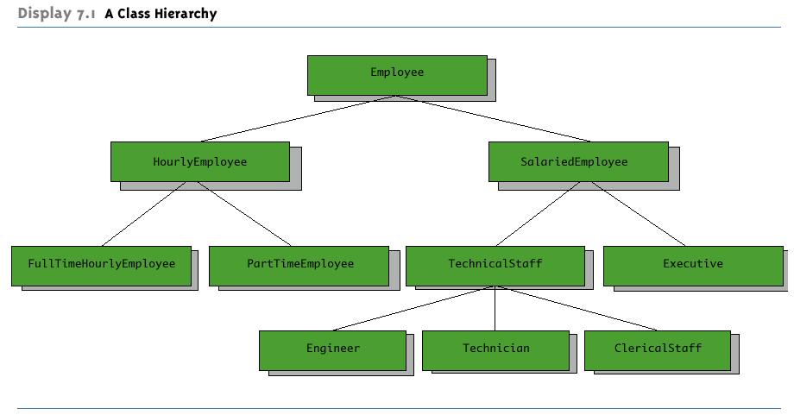
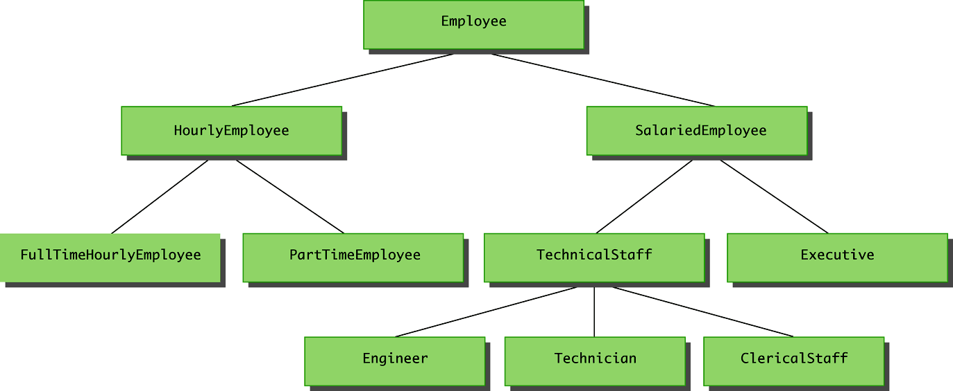
A Class Hierarchy

Slide 8
Inheritance in Alice
Alice supports a rather weak form of inheritance; a more powerful/complex version exists in most OOP languages like Java, C++, or C#
Add existing class to the project
Create new methods for the class
Save out as a new class using a different name
Can now Import the new class and it has the properties/methods of the parent along with the new methods
TO DO: Demonstrate creating and saving new class
The process is more dynamic and seamless in other OOP languages

Slide 9
Guidelines for Class-Level Methods
Create many different class level methods and study methods already written for some objects (e.g. see animal classes)
Play a sound in a class level method only if the sound has been imported for the object, instead of the world
Not loaded if imported into another world
Do not call world level methods from class level methods
Do not use instructions for other objects from within a class level method
Possible exceptions include camera, world objects

Slide 10
Interaction: Events and Event Handling
To date, most of our programs have been movie-centric
Many programs are user-centric, requiring user input
One way to get user input is through events
An event is when something happens, like a particular condition is met, the user clicks the mouse, hits a key, or some other action is performed
We can write methods that react to events, such methods are called event handlers

Slide 11
Event Example
Create keyboard control for a biplane
Up turns backward, down turns forward, left turns left, right turns right
Loop for always moving forward

Slide 12
Create Methods and Events
Create separate methods for turning left, right, up, and down
Click to create an event and pick the method and key that will activate the method
Complete the events to control the biplane
Can experiment with rolling

Slide 13
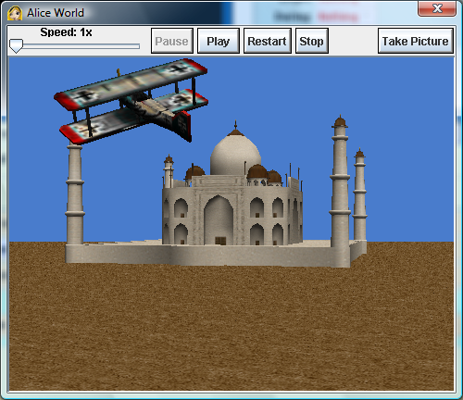
Example

Slide 14
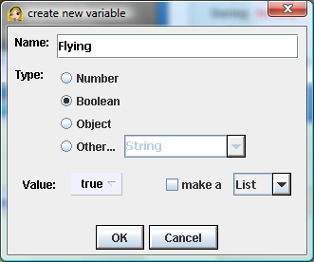
To Do:
Add another event that completes a barrel roll when the spacebar is pressed
Simulate a plane crash into the building
Create a new Biplane variable under its Properties named “Flying” and set to True
While true, the plane is flying, if false, it has crashed

Slide 15
Plane Crash
In the world method, the plane should only go forward if it is flying
Make a new biplane method, Crashed, that moves the plane to the ground and sets flying to false

Slide 16
Plane Crash
Add event : while some condition, do event handler. In this case, crash if the plane is close enough to the building

Slide 17
Events and Parameters
Event handlers can also take parameters, just like any other method
For example, we can create a method that takes an Object parameter, then the object to send in can be specified in the Event
Example: Zap Euripides and Socrates with lightning when clicked
Add Euripides, Socrates, Lightning, Animated Fire but set lightning and fire’s visible property to false

Slide 18
Lightning
Create a world method, LightningZap
Should take a parameter, the object to zap
Position the lightning above the object
Make the lightning visible
Move the lightning to the object
Make the lightning not visible
Move the fire to the object
Make the fire visible
Make the fire invisible
Make the object spin and disappear

Slide 19
LightningZap Method
Can test by invoking it from the Main method

Slide 20
Using LightningZap in a Click Event
Create a new click event for whatever the mouse is under
Send in the object clicked as the parameter for LightningZap

Slide 21
Class Exercise
Penguin Slide
Create a world with a lake scene and three penguins. Allow the user to click on a penguin and make it slide down the slope into the water then disappear. Add a parameter to control how many times the penguin spins as it slides.
Hint: Use an invisible object as the target

