Slide 1
Programming with Alice

Slide 2
Getting Started with Alice
Alice is a free programming language
Named in honor of Lewis Carroll
See web page for download URL
Different than most languages
Visual, focus on 3D animation
Same programming concepts as you would find in an object-oriented language but without obscure text commands or the mundane calculations in most intro-level courses
You play the role of a director in making a movie

Slide 3
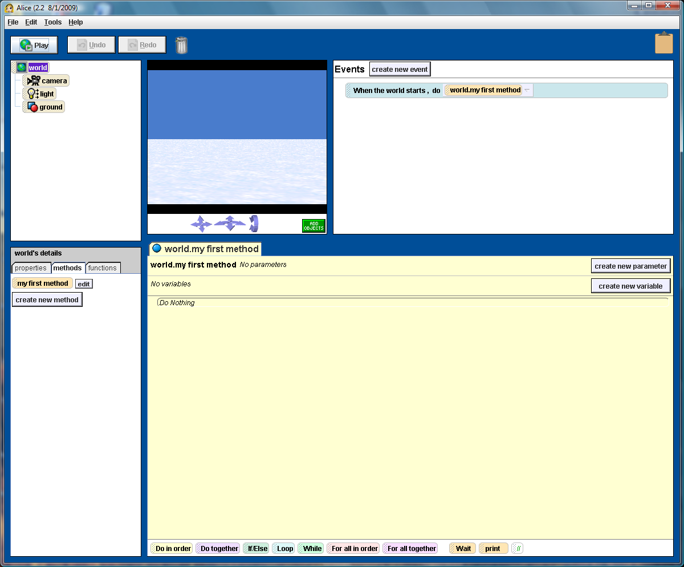

Slide 4
Programming Fundamentals
List of instructions
Sequential processing
If Statements
IF it is raining THEN take an umbrella
Conditional execution
Repeating Behavior
WHILE angry (stomp feet)
Looping or Iteration

Slide 5
Programming Fundamentals
Breaking things up into smaller pieces
Cleaning house: clean kitchen, clean living room, clean bathroom
Each room: pick up toys, vacuum, dust furniture
Procedures, Problem Decomposition, Top-down design
Compute a result
Perform sequence of steps to obtain a result that is an answer to a question
Determining and implementing an algorithm

Slide 6
Key to Programming
Most computers “understand” around 100 instructions; the complexity is in the different orders and combinations
Consider chess
Learning how to think about arranging a sequence of instructions to carry out a task is the most valuable part of learning how to program

Slide 7
Flowcharting
The book uses some flowchart symbols
Terminal
Input/Output
Processing
Call
Decision

Slide 8
Sample Flowchart
Start
Read Value
Multiply value by 2 and store in X
Display value in X
Stop

Slide 9
Alice Concepts
In class: Give demo of objects in 3D world
3D Virtual World
Objects in three dimensions
Place object with mouse; hold shift to move up/down
Objects have properties
Height, width, depth in virtual meters
Up, Down, Left, Right, Forward, Back all from the perspective of the object
Objects have center
May be center of mass or an end (e.g. bat)
Initial placement is usually on the ground
2D Graphics
Can create a “billboard” from a 2D image

Slide 10
Animation
Sequence of frames, each with a slightly different scene
Scene redrawn with objects positioned in a slightly different place
Alice creates (renders) the sequence of frames for you to make the animation based on instructions you give it

Slide 11
Methods
Methods are actions with respect to some object
It is the group of code, or a procedure, that accomplishes some specific task
Objects come with a number of built-in actions
Can right-click to see methods, or drag a method to the code window

Slide 12
Example
Add magician, Socrates to the world
Have each walk forward
Magician offers to do a trick
Magician disappears
Magician reappears in a different place
Socrates is amazed

