Slide 1
Computer Architecture and Data Manipulation
Chapter 3

Slide 2
Von Neumann Architecture
Today’s stored-program computers have the following characteristics:
  Three hardware systems:
    A central processing unit (CPU)
      Arithmetic and Logic Unit (ALU)
      Control Unit
      Registers
    A main memory system
    An I/O system
  The capacity to carry out sequential instruction processing.
  A single data path between the CPU and main memory.

Slide 3
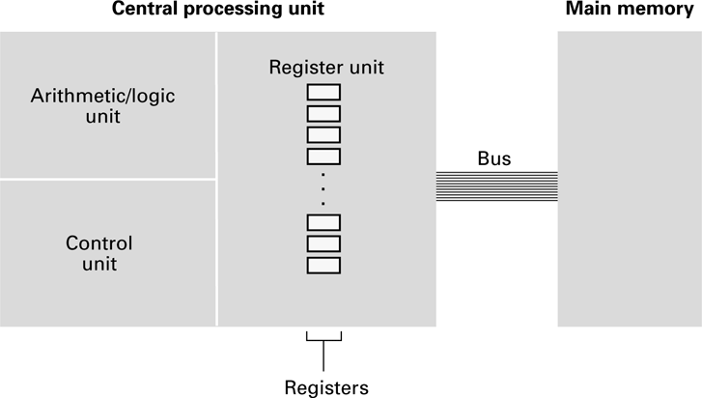
CPU and main memory connected via a bus

Slide 4
Stored Program Concept
A program can be encoded as bit patterns and stored in main memory. From there, the CPU can then extract the instructions and execute them. In turn, the program to be executed can be altered easily.

Slide 5
Terminology
Machine instruction: An instruction (or command) encoded as a bit pattern recognizable by the CPU
Machine language: The set of all instructions recognized by a machine

Slide 6
Machine Language Philosophies
Reduced Instruction Set Computing (RISC)
  Few, simple, efficient, and fast instructions
  Examples: PowerPC from Apple/IBM/Motorola
  and SPARC from Sun Microsystems
Complex Instruction Set Computing (CISC)
  Many, convenient, and powerful instructions
  Example: Pentium from Intel

Slide 7
Machine Instruction Types
Data Transfer: copy data from one location to another
Arithmetic/Logic: use existing bit patterns to compute a new bit patterns
Control: direct the execution of the program

Slide 8
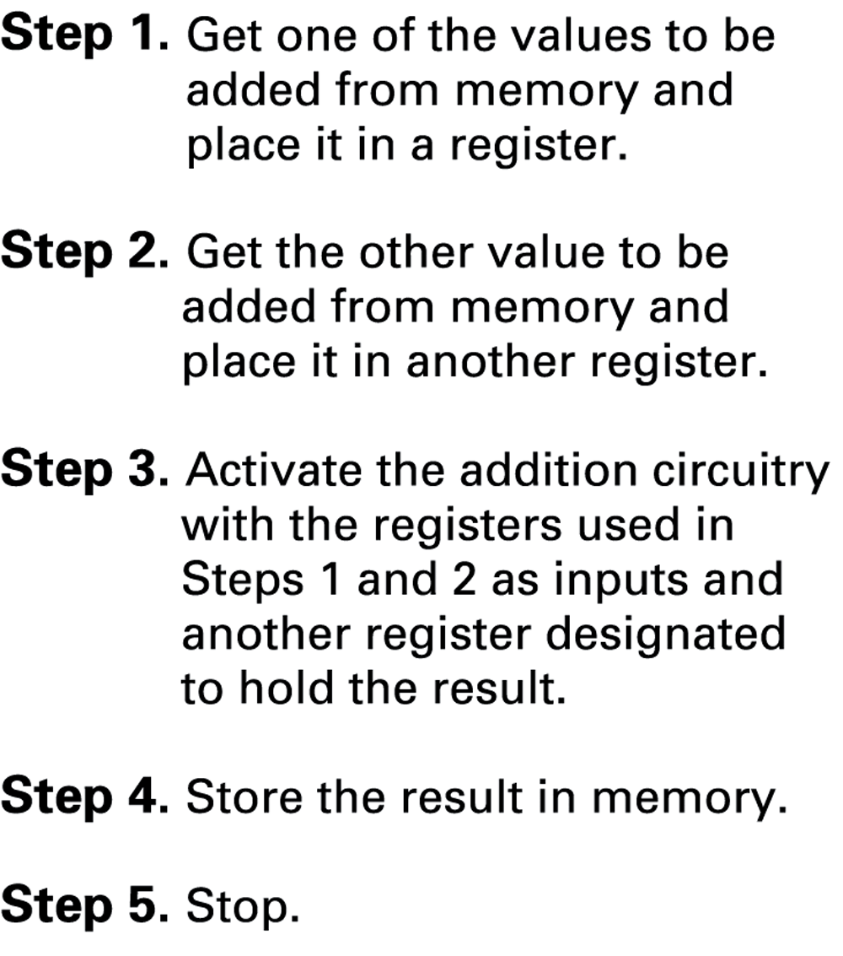
Example - Adding values stored in memory

Slide 9
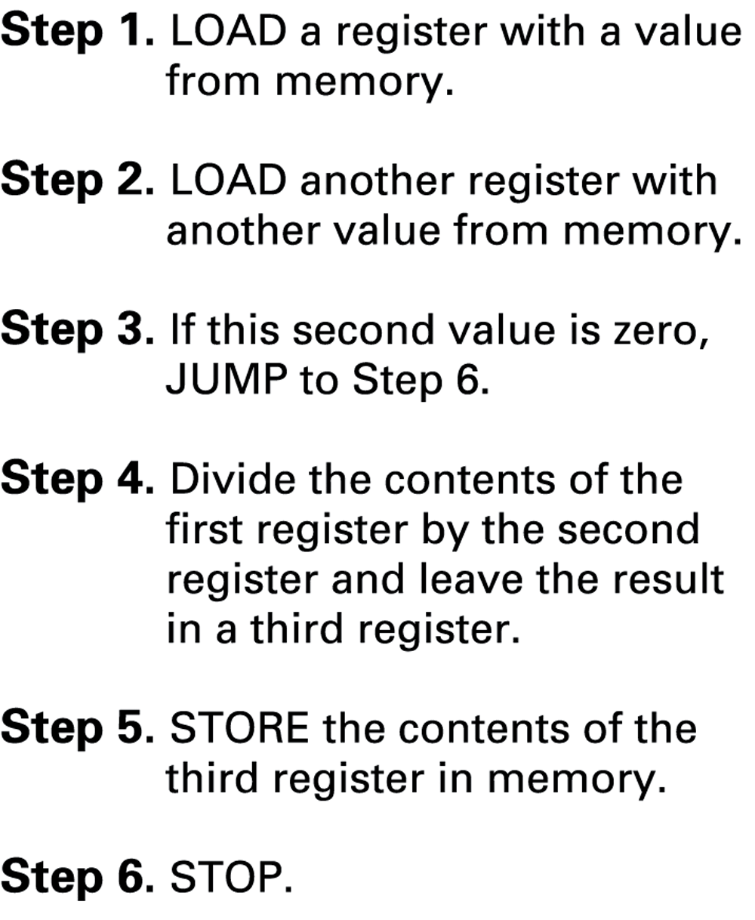
Example - Dividing values stored in memory

Slide 10
Program Execution
Controlled by two special-purpose registers
  Program Counter: address of next instruction
  Instruction Register: current instruction
Machine Cycle
  Fetch
  Decode
  Execute

Slide 11
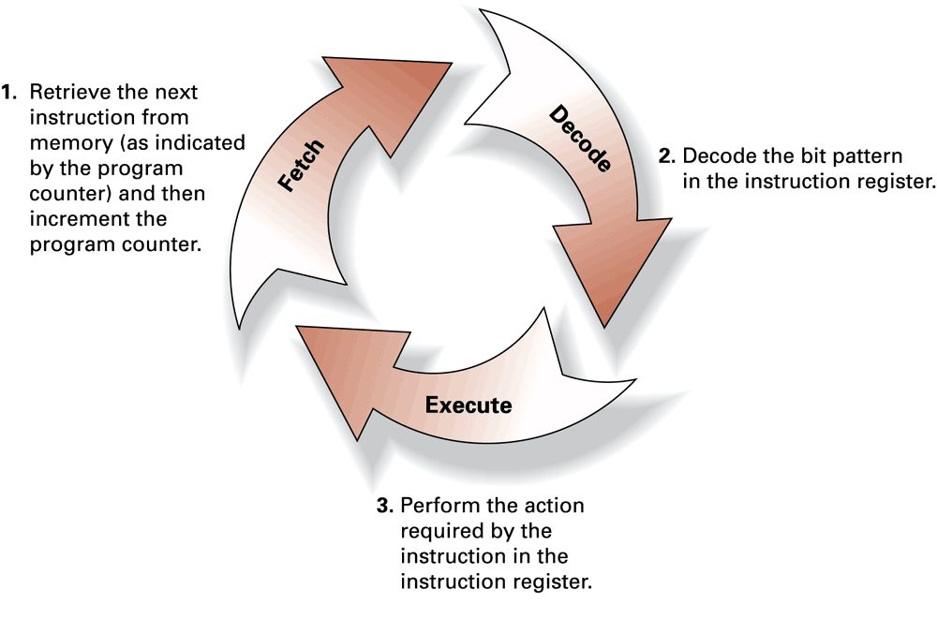
The machine cycle

Slide 12
Program Execution
Controlled by two special-purpose registers
  Program counter: address of next instruction
  Instruction register: current instruction
Machine Cycle
  Fetch
  Decode
  Execute

Slide 13
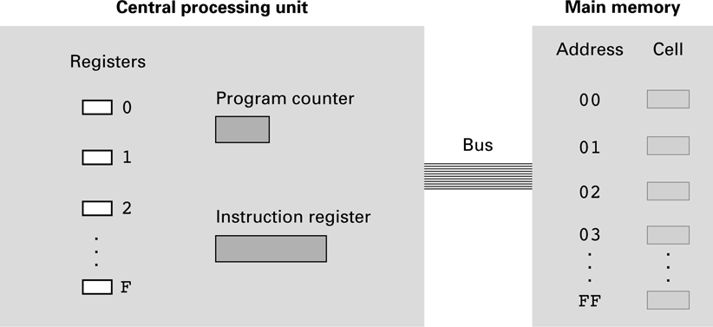
The architecture of the machine described in Appendix C

Slide 14
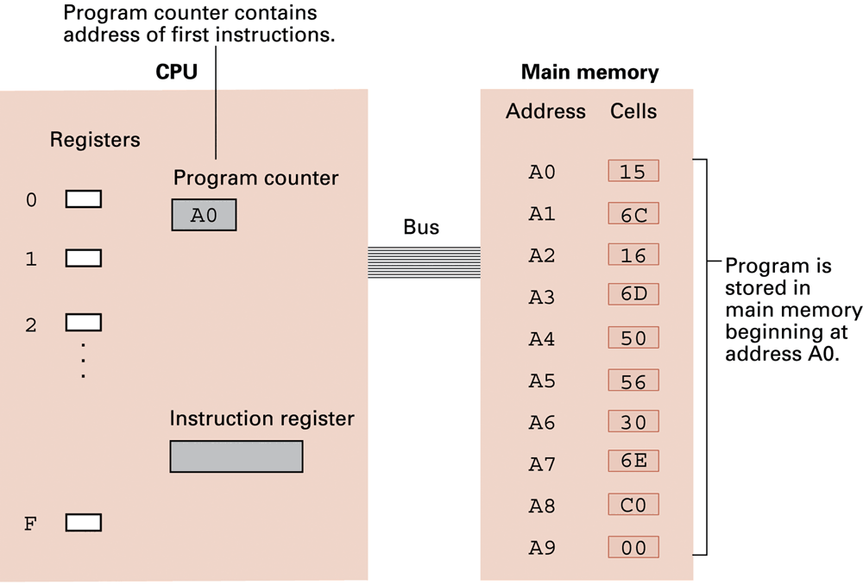
Start of the Fetch Execute cycle
All of the instructions were fetched and executed as part of the machine cycle

Slide 15
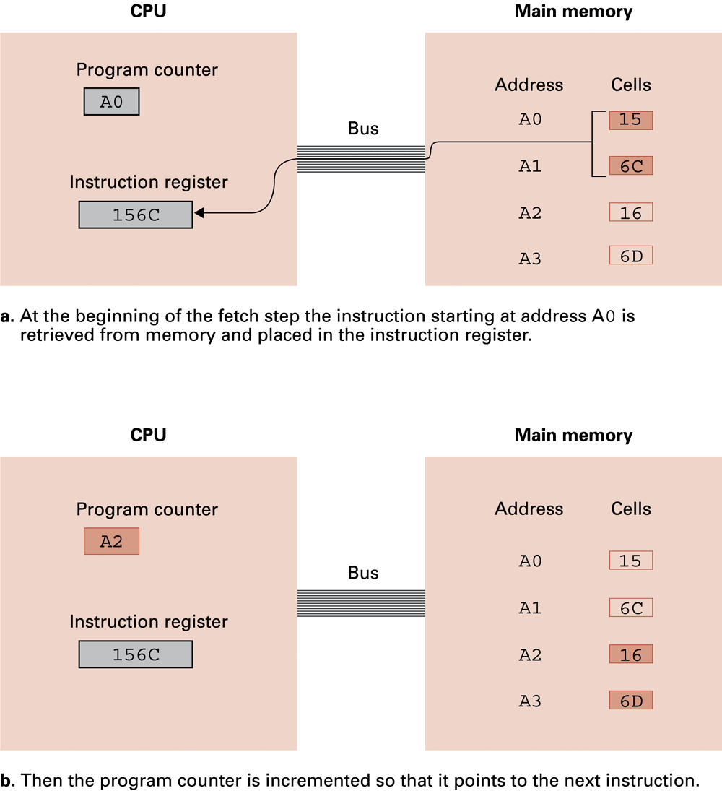
Performing the fetch step of the machine cycle

Slide 16
Performing the fetch step of the machine cycle (cont’d)

Slide 17
Parts of a Machine Instruction
Op-code: Specifies which operation to execute
Operand: Gives more detailed information about the operation
  Interpretation of operand varies depending on op-code

Slide 18
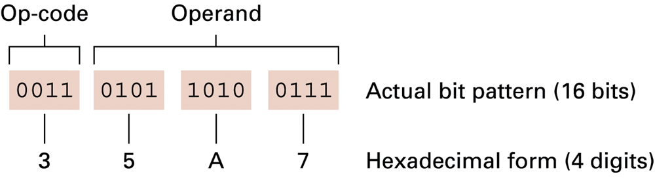
The composition of an instruction for the machine in Appendix C
3 means to
store the contents
of a register to memory
From register
5
To memory address A7

Slide 19
Appendix C: A Simple Machine Language
Op-code Operand Description
1 RXY LOAD reg. R from cell XY.
2 RXY LOAD reg. R with XY.
3 RXY STORE reg. R at XY.
4 0RS MOVE R to S.
5 RST ADD S and T into R. (2’s comp.)
6 RST ADD S and T into R. (floating pt.)
7 RST OR S and T into R.
8 RST AND S and T into R.
9 RST XOR S and T into R.
A R0X ROTATE reg. R X times.
B RXY JUMP to XY if R = reg. 0.
C 000 HALT.
D 0XY JUMP to XY always

Slide 20
Sample Machine Program
PC = 0
Mem Address Contents
  0 1506
  1 1607
  2 5056
  3 3008
  4 C000
  5 0001
  6 0002
  7 0003
  8 0000

Slide 21
Exercise
PC = 0
Write a program that subtracts 1 from the value in memory address FF

Slide 22
Another Program – What’s it do?
PC = 0
Address | Contents
0 | 20FF
1 | 2102
2 | 2200
3 | 130A
4 | 5223
5 | 5110
6 | B108
7 | D004
8 | 320A
9 | C000
A | 0003

Slide 23
Exercise
Write a program that computes the opposite of the value in memory address FF
  E.g. if the value is +5 then it becomes -5

Slide 24
Communicating with Other Devices
Controller: An intermediary apparatus that handles communication between the computer and a device
  Specialized controllers for each type of device
  General purpose controllers (USB and FireWire)
Port: The point at which a device connects to a computer
Memory-mapped I/O: CPU communicates with peripheral devices as though they were memory cells

Slide 25
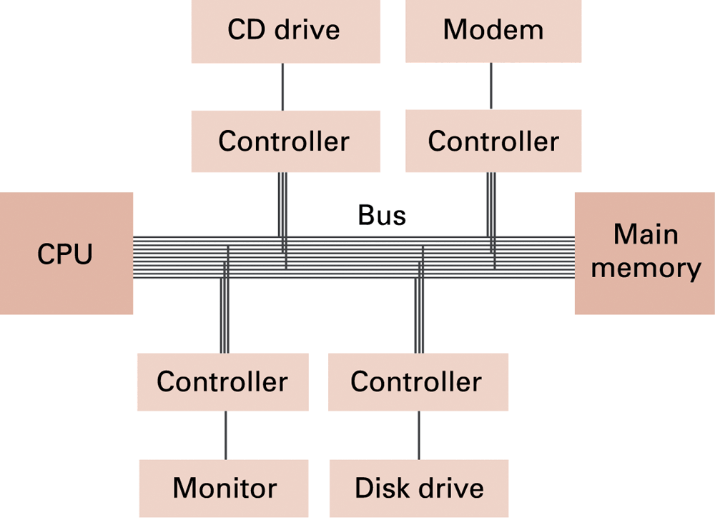
Controllers attached to a machine’s bus

Slide 26
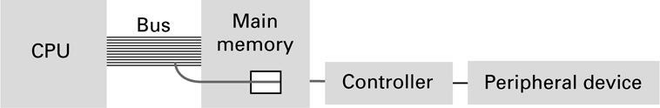
A conceptual representation of memory-mapped I/O

Slide 27
Communicating with Other Devices (continued)
Direct memory access (DMA): Main memory access by a controller over the bus
Von Neumann Bottleneck: Insufficient bus speed impedes performance
Handshaking: The process of coordinating the transfer of data between components

Slide 28
Communicating with Other Devices (continued)
Parallel Communication: Several communication paths transfer bits simultaneously.
Serial Communication: Bits are transferred one after the other over a single communication path.

Slide 29
Data Communication Rates
Measurement units
  Bps: Bits per second
  Kbps: Kilo-bps (1,000 bps)
  Mbps: Mega-bps (1,000,000 bps)
  Gbps: Giga-bps (1,000,000,000 bps)
Bandwidth: Maximum available rate

Slide 30
Increasing Performance
Technologies to increase throughput:
  Faster clock speed
  Bigger word size
  Larger cache memory
  Pipelining: Overlap steps of the machine cycle

Slide 31
Pipelining
Why not start fetching the next instruction while we’re decoding the current instruction?
Why not decode the next instruction while we’re executing the current instruction?
What if Instruction 1 is the JUMP to XY if R = reg. 0 instruction and we JUMP?

Slide 32
Increasing Performance
  Parallel Processing: Use multiple processors simultaneously
    SISD: No parallel processing
    MIMD: Different programs, different data
      Dual core, quad core
    SIMD: Same program, different data
      SSE, MMX

