Slide 1
Bits and Data Storage

Slide 2
Basic Hardware Units of a Computer

Slide 3
Bits and Bit Patterns
Bit: Binary Digit (0 or 1)
Bit Patterns are used to represent information.
Numbers
Text characters
Images
Sound
And others

Slide 4
Boolean Operations
Boolean Operation: An operation that manipulates one or more true/false values
Specific operations
AND
OR
XOR (exclusive or)
NOT

Slide 5
The Boolean operations AND, OR, and XOR (exclusive or)

Slide 6
Gates
Gate: A device that computes a Boolean operation
Often implemented as (small) electronic circuits
Provide the building blocks from which computers are constructed
VLSI (Very Large Scale Integration)

Slide 7
A pictorial representation of AND, OR, XOR, and NOT gates as well as their input and output values

Slide 8
Flip-flops
Flip-flop: A circuit built from gates that can store one bit.
One input line is used to set its stored value to 1
One input line is used to set its stored value to 0
While both input lines are 0, the most recently stored value is preserved

Slide 9
A simple flip-flop circuit

Slide 10
Setting the output of a flip-flop to 1

Slide 11
Setting the output of a flip-flop to 1 (continued)

Slide 12
Setting the output of a flip-flop to 1 (continued)

Slide 13
Another way of constructing a flip-flop
** Usually abstracted out as a box that stores a bit **

Slide 14
Main Memory Cells
Cell: A unit of main memory (typically 8 bits which is one byte)
Most significant bit: the bit at the left (high-order) end of the conceptual row of bits in a memory cell
Least significant bit: the bit at the right (low-order) end of the conceptual row of bits in a memory cell

Slide 15
The organization of a byte-size memory cell

Slide 16
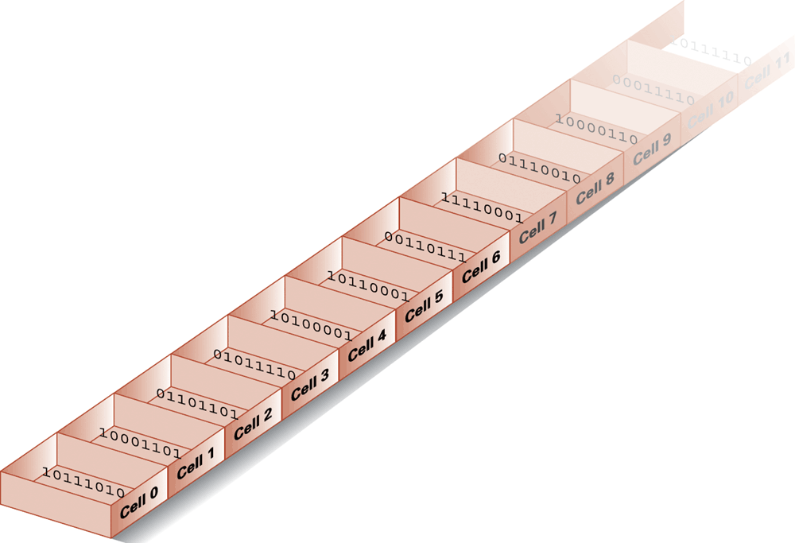
Main Memory Addresses
Address: A “name” that uniquely identifies one cell in the computer’s main memory
The names are actually numbers.
These numbers are assigned consecutively starting at zero.
Numbering the cells in this manner associates an order with the memory cells.

Slide 17
Memory Terminology
Random Access Memory (RAM): Memory in which individual cells can be easily accessed in any order
Dynamic Memory (DRAM): RAM composed of volatile memory (usually when referring to RAM we mean DRAM)
Read Only Memory (ROM) : RAM that cannot store new values; limited to pre-stored data

Slide 18
Measuring Memory Capacity
Kilobyte: 2¹⁰ bytes = 1024 bytes
Example: 3 KB = 3 times 1024 bytes
Megabyte: 2²⁰ bytes = 1,048,576 bytes
Example: 3 MB = 3 times 1,048,576 bytes
Gigabyte: 2³⁰ bytes = 1,073,741,824 bytes
Example: 3 GB = 3 times 1,073,741,824 bytes

Slide 19
Mass Storage
On-line versus off-line
Typically larger than main memory
Typically less volatile than main memory
Typically slower than main memory

Slide 20
Mass Storage Systems
Magnetic Systems
Disk
Tape
Optical Systems
CD
DVD
Flash Drives

Slide 21
A magnetic disk storage system

Slide 22
CD storage

Slide 23
Files
File: A unit of data stored in mass storage system
Fields and keyfields
Physical record versus Logical record
Buffer: A memory area used for the temporary storage of data (usually as a step in transferring the data)

