Slide 1
Introduction to Database Systems

Slide 2
Introduction to Database Systems
So, what is a database, anyway?
An integrated, self-describing collection of data about related sets of things and the relationships among them

Slide 3
If you burned down all our plants, and we just kept our people and our information files, we should soon be as strong as ever.
Thomas Watson, Jr. Former chairman of IBM

Slide 4
Database Management Systems
Simple text files or office documents are one way to store data:
  Fine for small amounts of data
  But impractical for large amounts of data
Businesses must maintain huge amounts of data
  A database management system (DBMS) is the typical solution to the data needs of business
  Designed to store, retrieve, & manipulate data
Most programming languages can communicate with several DBMS
  Tells DBMS what data to retrieve or manipulate

Slide 5
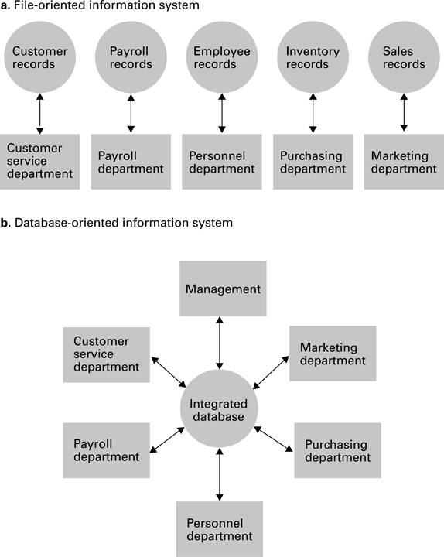
File vs. Database organization

Slide 6
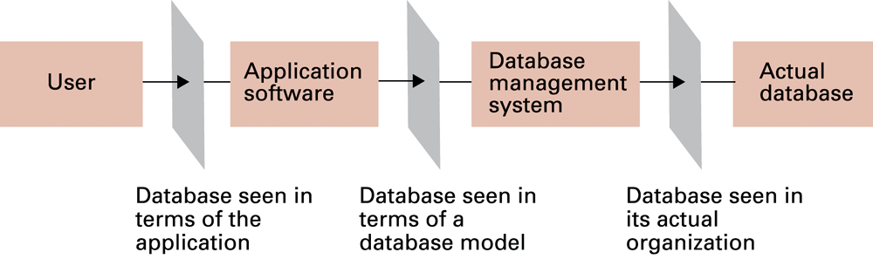
Layered Approach to Using a DBMS
Applications that work with a DBMS use a layered approach
  Application is topmost layer
  Application sends instructions to next layer, the DBMS
  DBMS works directly with data
Programmer need not understand the physical structure of the data
  Just need to know how to interact with the database

Slide 7
Why not just use the file system?
Day8-21.txt
8,drive to work
9,teach class
10, …
Day8-22.txt
8,drive to work
9,eat donut
10, …
…
Could write programs to operate on this text file data.

Slide 8
File Storage Problems
Sharing data
Same data may be duplicated many times
Need to write custom programs to manipulate the data (e.g search, print)
As file systems become more complex, managing files gets more difficult
Making changes in existing file structures is important and difficult.
Security, data integrity (redundancy, inconsistency, anomalies) features are difficult to implement and are lacking.

Slide 9
File Storage Problems - Dependence
Structural Dependence: A change in the file’s structure requires the modification of all programs using that file.
Data Dependence: A change in any file’s data characteristics requires changes of all data access programs.

Slide 10
Solution: DBMS
Logically related data are stored in a single data repository.
The database represents a change in the way end user data are stored, accessed, and managed efficiently.
Easier to eliminate most of the file system’s data inconsistency, data anomalies, and data structural dependency problems.
Store data structures and relationships (schema)
DBMS takes care of defining all the required access paths.

Slide 11
Disadvantages of DBMS
Cost of software and implementation
Higher cost of processing routine batches
Increase magnitude of potential disaster
Lack of database technical capability

Slide 12
Relational Database Model
Introduced in the 60’s and 70’s and is the most common type of DBMS today
Data elements stored in simple tables (related)
General structure good for many problems
Easy to understand, modify, maintain
Examples: MySQL, Access, Oracle, SQL Server
We will focus on relational databases using Microsoft Access in our course

Slide 13
The Relational Model
Views entities as two-dimensional tables
  Records are rows
  Attributes (fields) are columns
Tables can be linked
Supports one-to-many, many-to-many, and one-to-one relationships

Slide 14
Terminology
Database: a collection of interrelated tables
Table: a logical grouping of related data
  A category of people, places, or things
  For example, employees or departments
  Organized into rows and columns
Field: an individual piece of data pertaining to an item, an employee name for instance
Record: the complete data about a single item such as all information about an employee
  A record is a row of a table

Slide 15
Database Table
Each table has a primary key
  Uniquely identifies that row of the table
  Emp_Id is the primary key in this example
  Serves as an index to quickly retrieve the record
Columns are also called fields or attributes
Each column has a particular data type
Emp_Id | First_Name | Last_Name | Department
001234 | Ignacio | Fleta | Accounting
002000 | Christian | Martin | Computer Support
002122 | Orville | Gibson | Human Resources
003400 | Ben | Smith | Accounting
003780 | Allison | Chong | Computer Support
Row
(Record)
Column
Field

Slide 16
Choosing Column Names
Define a column for each piece of data
Allow plenty of space for text fields
Avoid using spaces in column names
For the members of an organization:
  Column Name Type Remarks
  Member_ID int Primary key
  First_Name varchar(40)
  Last_Name varchar(40)
  Phone varchar(30)
  Email varchar(50)
  Date_Joined smalldatetime Date only, no time values
  Meeings_Attended smallint
  Officer Yes/No True/False values

Slide 17
Issues with Redundant Data
Database design minimizes redundant data
In the following employee table:
ID First_Name Last_Name Department
001234 Ignacio Fleta Accounting
002000 Christian Martin Computer Support
002122 Orville Gibson Human Resources
00300 Jose Ramirez Research & Devel
003400 Ben Smith Accounting
003780 Allison Chong Computer Support
Same dept name appears multiple times
  Requires additional storage space
  Causes problems if misspelled
  What if a department needs to be renamed?

Slide 18
Eliminating Redundant Data
Create a department table
Dept_ID Dept_Name Num_Employees
1 Human Resources 10
2 Accounting 5
3 Computer Support 30
4 Research & Development 15
Reference department table in employee table
ID First_Name Last_Name Dept_ID
001234 Ignacio Fleta 2
002000 Christian Martin 3
002122 Orville Gibson 1
003000 Jose Ramirez 4
003400 Ben Smith 2
003780 Allison Chong 3

Slide 19
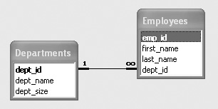
One-to-Many Relationships
The previous changes created a one-to-many relationship
  Every employee has one and only one dept
  Every department has many employees
  DeptID in department table is a primary key
  DeptID in employee table is a foreign key
One-to-many relationship
exists when primary key
of one table is specified
as a field of another table

Slide 20
Normalization
The previous example illustrated a technique used to make complex databases more efficient called Normalization
Break one large table into several smaller tables
  Eliminates all repeating groups in records
  Eliminates redundant data
Another example…

Slide 21
Redundant Data
Student
Student
Campus
Major
Phone
Course
Course
Instructor
Instructor
Instructor
Term
Grade
ID#
Name
Address
ID
Title
Name
Location
Phone
A121
Joy Egbert
100 N. State Street
MIS
555-7771
MIS 350
Intro. MIS
Van Deventer
T240C
555-2222
F'98
A
A121
Joy Egbert
100 N. State Street
MIS
555-7771
MIS 372
Database
Hann
T240F
555-2224
F'98
B
A121
Joy Egbert
100 N. State Street
MIS
555-7771
MIS 375
Elec. Comm.
Chatterjee
T240D
555-2228
F'98
B
+
A121
Joy Egbert
100 N. State Street
MIS
555-7771
MIS 448
Strategic MIS
Chatterjee
T240D
555-2228
F'98
A
−
A121
Joy Egbert
100 N. State Street
MIS
555-7771
MIS 474
Telecomm
Gilson
T240E
555-2226
F'98
C
+
A123
Larry Mueller
123 S. State Street
MIS
555-1235
MIS 350
Intro. MIS
Van Deventer
T240C
555-2222
F'98
A
A123
Larry Mueller
123 S. State Street
MIS
555-1235
MIS 372
Database
Hann
T240F
555-2224
F'98
B
−
A123
Larry Mueller
123 S. State Street
MIS
555-1235
MIS 375
Elec. Comm.
Chatterjee
T240D
555-2228
F'98
A
−
A123
Larry Mueller
123 S. State Street
MIS
555-1235
MIS 448
Strategic MIS
Chatterjee
T240D
555-2228
F'98
C
+
A124
Mike Guon
125 S. Elm
MGT
555-2214
MIS 350
Intro. MIS
Van Deventer
T240C
555-2222
F'98
A
−
A124
Mike Guon
125 S. Elm
MGT
555-2214
MIS 372
Database
Hann
T240F
555-2224
F'98
A
−
A124
Mike Guon
125 S. Elm
MGT
555-2214
MIS 375
Elec. Comm.
Chatterjee
T240D
555-2228
F'98
B
+
A124
Mike Guon
125 S. Elm
MGT
555-2214
MIS 474
Telecomm
Gilson
T240E
555-2226
F'98
B
A126
Jackie Judson
224 S. Sixth Street
MKT
555-1245
MIS 350
Intro. MIS
Van Deventer
T240C
555-2222
F'98
A
A126
Jackie Judson
224 S. Sixth Street
MKT
555-1245
MIS 372
Database
Hann
T240F
555-2224
F'98
B
+
A126
Jackie Judson
224 S. Sixth Street
MKT
555-1245
MIS 375
Elec. Comm.
Chatterjee
T240D
555-2228
F'98
B
+
A126
Jackie Judson
224 S. Sixth Street
MKT
555-1245
MIS 474
Telecomm
Gilson
T240E
555-2226
F'98
A
−
...
...
...
...
...
...
...
...
...
...
...
...

Slide 22
Normalized Data
Student Table
Student
Student
Campus
Major
Phone
Enrolled Table
ID#
Name
Address
A121
Joy Egbert
100 N. State Street
MIS
555-7771
Student
Course
Term
Grade
A123
Larry Mueller
123 S. State Street
MIS
555-1235
ID#
ID
A124
Mike Guon
125 S. Elm
MGT
555-2214
A121
MIS 350
F'98
A
A126
Jackie Judson
224 S. Sixth Street
MKT
555-1245
A121
MIS 372
F'98
B
...
...
...
...
...
A121
MIS 375
F'98
B
+
Teaching Assignment
A121
MIS 448
F'98
A
−
Course
Term
Instructor
A121
MIS 474
F'98
C
+
Class Table
ID
Name
A123
MIS 350
F'98
A
Course
Course
MIS 350
F'98
Van Deventer
A123
MIS 372
F'98
B
−
ID
Title
MIS 372
F'98
Hann
MIS 350
Intro. MIS
MIS 375
F'98
Chatterjee
A123
MIS 375
F'98
A
−
MIS 372
Database
MIS 448
F'98
Chatterjee
A123
MIS 448
F'98
C
+
MIS 375
Elec. Comm.
MIS 474
F'98
Gilson
A124
MIS 350
F'98
A
−
MIS 448
Strategic MIS
...
...
...
A124
MIS 372
F'98
A
−
MIS 474
Telecomm
Instructor Table
A124
MIS 375
F'98
B
+
...
...
Instructor
Instructor
Instructor
A124
MIS 474
F'98
B
Name
Location
Phone
A126
MIS 350
F'98
A
Chatterjee
T240D
555-2228
A126
MIS 372
F'98
B
+
Gilson
T240E
555-2226
A126
MIS 375
F'98
B
+
Hann
T240F
555-2224
Valacich
T240D
555-2223
A126
MIS 474
F'98
A
−
Van Deventer
T240C
555-2222
...
...
...
...

Slide 23
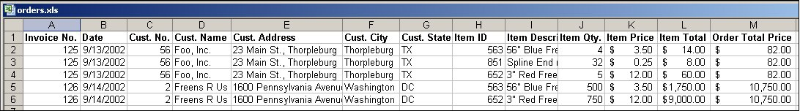
Exercise
Your company uses the following spreadsheet. How might it be normalized into database tables?

Slide 24
Associations
Relationships among the entities in the data structures
Three types
  One-to-one
  One-to-many
  Many-to-many
Relationships set by placing primary key from one table as foreign key in another
  Creates “acceptable” redundancy

Slide 25
Association Examples

Slide 26
Associations
Order (Order #, Order_Date, Customer)
1
Product(Prod #, Prod_Description, Qty)
1
M
M
Product_Order(Order #, Prod #, Customer)
Foreign key

Slide 27
Microsoft Access is Unique
Provides DBMS functions
  Not “industrial-strength”, designed for:
    Individuals
    Small workgroups
  External application programs work with Access
Provides built-in tools for reporting and for application development
  Forms
  Reports
  Code modules using Visual Basic for Applications (VBA)
Provides flexibility
  Small, simple all-in-one environment
  Data can be easily transferred to full-fledged DBMS
Notes:
NEEDS WORK!!!!

Slide 28
Introduction to Access
Sample databases
  Northwind
    Included with every version of Access since 2.0
Demonstration of Access
  Startup
  Create tables
  Link table relationships
  Create queries/reports

Slide 29
Access 2007 Example
Student ID Last Name First Name DOB Address
1 Mock Kenrick 4-18-1968 123 Somewhere
Ave
2 Cue Barbie 3-21-1970 567 A Street
3 Obama Barack 8-04-1961 123 Somewhere
Ave

Slide 30
Access 2007 Example
CS 101 Table
CS 201 Table
Student ID Grade
1 A
2 B
3 B
Student ID Grade
1 B
2 A
3 C

Slide 31
SQL
Structured Query Language, abbreviated SQL
  Usually pronounced “sequel” but also “ess-cue-ell”)
  The common language of client/server database management systems.
  Standardized – you can use a common set of SQL statements with all SQL-compliant systems.
  Defined by E.F. Codd at IBM research in 1970.
  Based on relational algebra and predicate logic

Slide 32
SQL Data Retrieval
Given an existing database, the SELECT statement is the basic statement for data retrieval.
  Both simple and complex, and it may be combined with other functions for greater flexibility.
SELECT data_element1 [, {data_element2 | function(..)} ] Or *
FROM table_1, [, table_2, …]
[ WHERE condition_1 [, {not, or, and} condition_2] ]
[ GROUP BY data_1, … ]
[ HAVING aggregate function(…)… ]
[ORDER BY data1, … ]

Slide 33
SELECT statement
Some sample aggregate functions:
  COUNT(*) SUM(item)
  AVG(item) MAX(item)
  MIN(item)
Conditional Operators
  = Equal
  < Less than
  > Greater than
  <>,!= Not equal to
  <= Less than or equal to
  >= Greater than or equal to

Slide 34
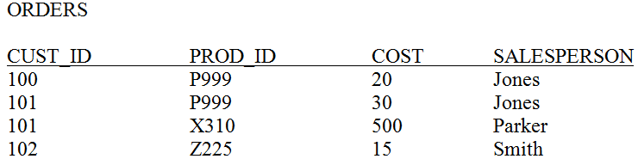
SELECT Examples
Select every row, column from the table:
  SELECT * FROM Orders;
  SELECT Orders.cust_id, Orders.prod_id, Orders.cost,
  Orders.salesperson
  FROM Orders;
Returns a set of all rows that match the query

Slide 35
SELECT
If a table has spaces or certain punctuation in it, then Access needs to have the items enclosed in square brackets []. The previous query is identical to the following:
  SELECT [orders].[cust_id], orders.prod_id, orders.cost, orders.[salesperson]
  FROM Orders;

Slide 36

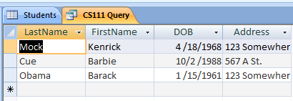
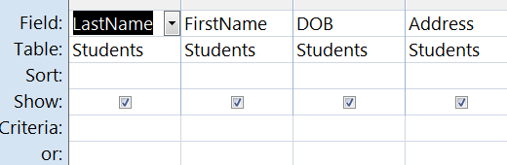
SELECT Query in Access
Can flip back and forth between SQL View, Run, and Design Mode
SQL
Run
Design

Slide 37
More SELECT Statements
Note that we can have duplicates as a result of the selection. If we want to remove duplicates, we can use the DISTINCT clause:
SELECT DISTINCT Orders.cust_id
FROM Orders;
We can combine a selection and a projection by using the WHERE clause:
SELECT Orders.cust_id
FROM Orders
WHERE Salesperson = “Jones”;
This could be used if we wanted to get all the customers that Jones has sold to, in this case, CUST_ID=101 and CUST_ID=100. By default, Access is not case-sensitive, so “jones” would also result in the same table.

Slide 38
More SELECT
We can further refine the query by adding AND , OR, or NOT conditions. If we want orders from Jones or from Smith then the query becomes:
SELECT Orders.cust_id
FROM Orders
WHERE Salesperson = “Jones” or Salesperson = “Smith”;
Another refinement is to use the BETWEEN operator. If we want only those orders between 10 and 100 then we could define this as:
SELECT Orders.cust_id, Orders.cost
FROM Orders
WHERE Orders.cost >10 and Orders.cost <100;
Or use the between operator:
SELECT Orders.cust_id, Orders.cost
FROM Orders
WHERE Orders.cost BETWEEN 10 and 100;

Slide 39
More SELECT
Finally, we might want to sort the data on some field. We can use the ORDER BY clause:
SELECT Orders.cust_id, Orders.cost
FROM Orders
WHERE Orders.cost >10 and Orders.cost <100
ORDER BY Orders.cost;
This sorts the data in ascending order of cost. An example is shown in the table:
CUST_ID COST
102 15
100 20
101 30
If we wanted to sort them in descending order, use the DESC keyword:
SELECT Orders.cust_id, Orders.cost
FROM Orders
WHERE Orders.cost >10 and Orders.cost <100
ORDER BY Orders.cost DESC;

Slide 40
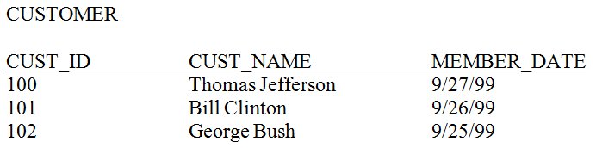
Joining Data from Multiple Tables
If our data is in multiple tables we can join them together in one query.
  Use a JOIN operator (Access default w/Design view)
  Add tables to the FROM, WHERE section (what we will use here)
Say we have the following table in addition to Orders:

Slide 41
Multiple Tables
SELECT Orders.cust_id, Customer.Cust_Name
FROM Orders, Customer
WHERE Orders.cost >10 and Orders.cost <100;
What do you expect from this query?
Result:
100 Thomas Jefferson
101 Thomas Jefferson
102 Thomas Jefferson
100 Bill Clinton
101 Bill Clinton
102 Bill Clinton
100 George Bush
101 George Bush
102 George Bush
PRODUCT of two tables!

Slide 42
Multiple Tables
Need to link the tables by their common field, the customer ID:
SELECT Orders.cust_id, Customer.Cust_Name
FROM Orders, Customer
WHERE Orders.cust_id = Customer.Cust_Id and
Orders.cost >10 and Orders.cost <100;
Result:
100 Thomas Jefferson
101 Bill Clinton
102 George Bush

Slide 43
INSERT command
Allows you to insert single or multiple rows of data into a table
INSERT INTO table [(column-list)] [VALUES (value-list) | sql-query]

Slide 44
INSERT examples
Given mytable(field1 as currency, field2 as text, field3 as integer):
INSERT INTO mytable (field1, field2, field3)
VALUES (12.10, “bah”,20);
Adds a new row to the table mytable
If you don’t specify every field then fields left out get the default:
INSERT INTO mytable (field1, field2) VALUES(24.2, “zot”);
Adds only for field1 and field2.

Slide 45
INSERT Examples
INSERT INTO ORDERS (CUST_ID, PROD_ID, COST, SALESPESON)
VALUES (103, ‘Y338’, 55, ‘Smith’);
INSERT INTO ORDERS (PROD_ID, COST, SALESPESON)
VALUES (‘Y638’, 155, ‘Smith’);
Second might be useful if the CUST_ID is an autonumber field

Slide 46
DELETE
Delete will remove a row from the table.
DELETE FROM table_name [WHERE search-condition]
Examples:
DELETE FROM mytable1;
Removes all rows!
DELETE FROM mytable1 WHERE field1 > 100;
Removes only rows with field1>100

Slide 47
UPDATE
Update lets you modify the contents of the data.
UPDATE table_name
SET field_name = expression [, field-name=expression …] [WHERE search-condition]
UPDATE mytable SET field1 = 0.0;
Changes all field1’s to zero for every row!
UPDATE mytable SET field1 = 0.0, field2 = “woof”;
Sets field1 to 0 and field2 to woof for all rows!
If this is a violation, access will prevent it from happening
UPDATE mytable SET field1 = 25.0 WHERE field2=“foo”;
Only updates the field where field2 is “foo”

Slide 48
SQL Queries
There are a lot more queries, but that should give you an idea of what is possible and how it is done

Slide 49
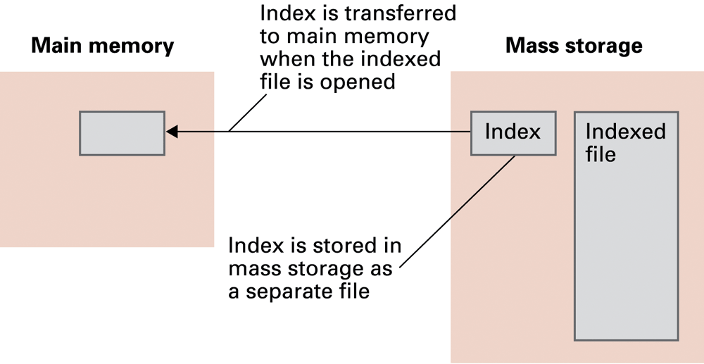
Indexed files
Mostly skipping implementation of database systems; a little on indices - key to quickly accessing a record

Slide 50
Hashing
Each record has a key field
The storage space is divided into buckets
A hash function computes a bucket number for each key value
Each record is stored in the bucket corresponding to the hash of its key

Slide 51
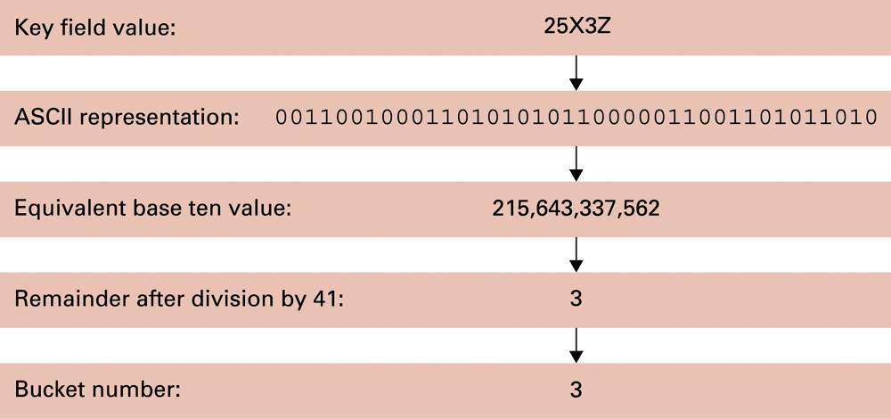
Hashing the key field value 25X3Z to one of 41 buckets

Slide 52
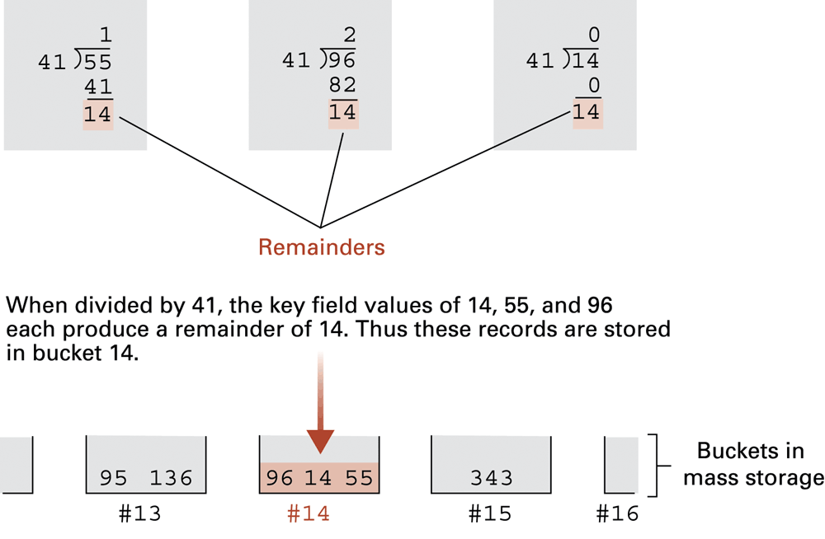
The rudiments of a hashing system

Slide 53
Collisions in Hashing
Collision: The case of two keys hashing to the same bucket
  Major problem when table is over 75% full
  Solution: increase number of buckets and rehash all data

Slide 54
Data Mining
Data Mining: The area of computer science that deals with discovering patterns in collections of data
Data warehouse: A static data collection to be mined
  Data cube: Data presented from many perspectives to enable mining

Slide 55
Social Impact of Database Technology
Problems
  Massive amounts of personal data are being collected
    Often without knowledge or meaningful consent of affected people
  Data merging produces new, more invasive information
  Errors are widely disseminated and hard to correct
Remedies
  Existing legal remedies often difficult to apply
  Negative publicity may be more effective

