Slide 1
Operating Systems
Chapter 4

Slide 2
Functions of Operating Systems
Oversee operation of computer
Store and retrieve files
Schedule programs for execution
Coordinate the execution of programs
Provide an interface to the user to access machine functions

Slide 3
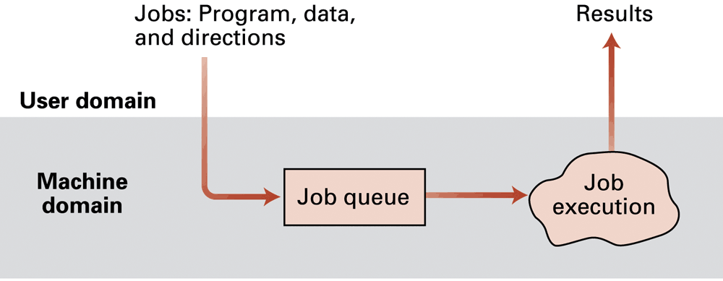
Evolution of Shared Computing
Manual jobs
Batch processing
Interactive processing
  Requires real-time processing
Time-sharing/Multitasking
  Implemented by Multiprogramming
Multiprocessor machines

Slide 4
Types of Software
Application software
  Performs specific tasks for users
System software
  Provides infrastructure for application software
  Consists of operating system and utility software

Slide 5
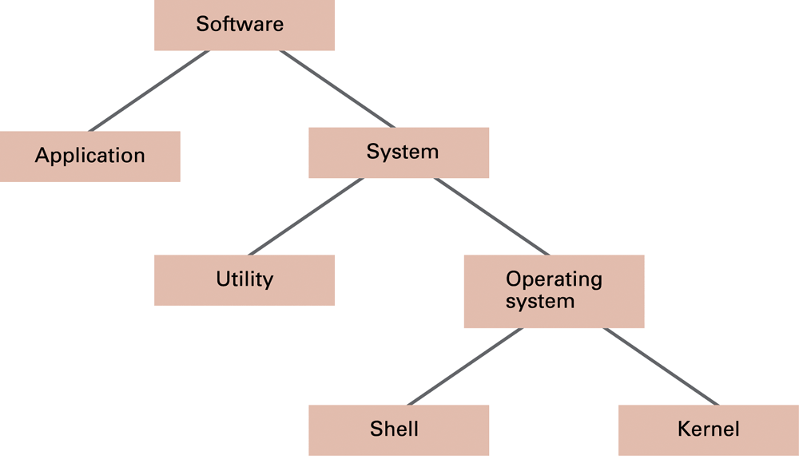
Software classification

Slide 6
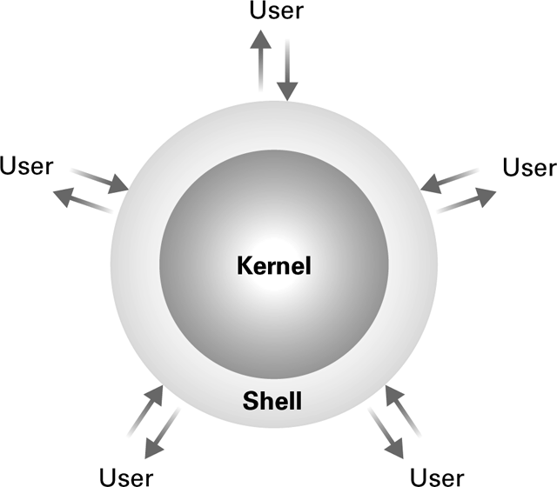
Operating System Components
Shell: Communicates with users
  Text based
  Graphical user interface (GUI)
Kernel: Performs basic required functions
  File manager
    Where files are on the disk, clusters
  Device drivers
    Interface with physical devices
  Memory manager
  Scheduler and dispatcher

Slide 7
Memory Manager
Allocates space in main memory
May create the illusion that the machine has more memory than it actually does (virtual memory) by playing a “shell game” in which blocks of data (pages) are shifted back and forth between main memory and mass storage

Slide 8
Getting it Started (Bootstrapping)
Bootstrap: Program in ROM (example of firmware)
  Run by the CPU when power is turned on
  Transfers operating system from mass storage to main memory
  Executes jump to operating system

Slide 9
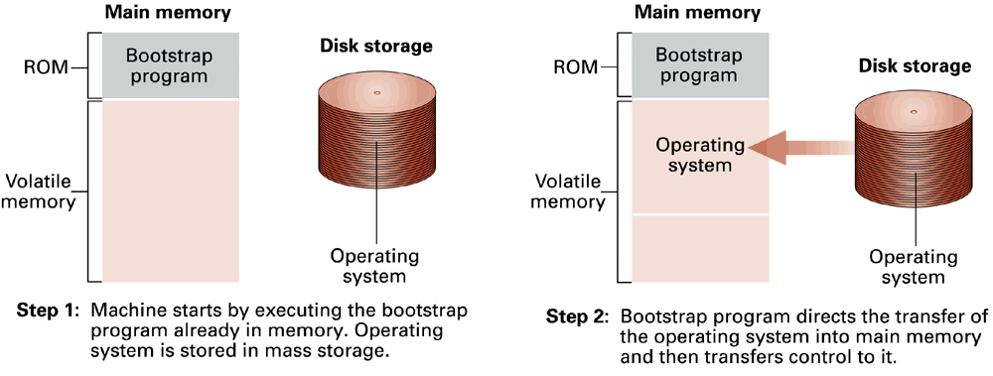
The booting process
BIOS – Basic I/O System – software utilities for fundamental I/O activities
stored on the ROM along with the bootstrap program

Slide 10
Processes
Process: The activity of executing a program
Process State: Current status of the activity
  Program counter
  General purpose registers
  Related portion of main memory

Slide 11
Process Administration
Scheduler: Adds new processes to the process table and removes completed processes from the process table
Dispatcher: Controls the allocation of time slices to the processes in the process table
  The end of a time slice is signaled by an interrupt.

Slide 12
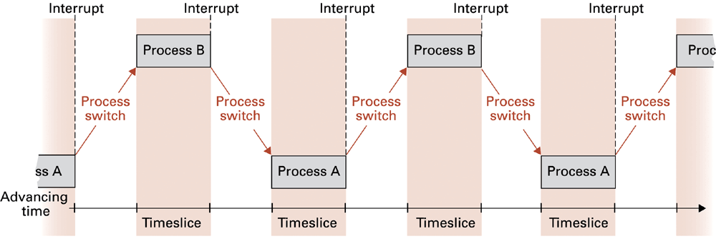
Time-sharing between process A and process B
See Windows Task Manager for an example

Slide 13
Race Condition
When two processes want to use a common shared resource a “race condition” may result and cause undesirable results
Example: Two processes writing to the same location in memory (one to subtract 10, one to add 20)
Process 1
Load value from memory to register
Add 20
Store register back to memory
Process 2
Load value from memory to register
Subtract 10
Store register back to memory

Slide 14
Attempt to fix: use register 0 as “in use” flag
Process 1
If register 0 is 0
Set register 0 to 1
Load value from memory to register
Add 20
Store register back to memory
Set register 0 to 0
Else
wait until register 0 is 0
Process 2
If register 0 is 0
Set register 0 to 1
Load value from memory to register
Subtract 10
Store register back to memory
Set register 0 to 0
Else
wait until register 0 is 0
Will this fix the problem?

Slide 15
Handling Competition for Resources
Semaphore: A “control flag”
Critical Region: A group of instructions that should be executed by only one process at a time
Mutual exclusion: Requirement for proper implementation of a critical region

Slide 16
Solution: Semaphore
In this example we use an uninterruptible Test and Set Instruction
Process 1
If register 0 is 0 set register 0 to 1
Load value from memory to register
Add 20
Store register back to memory
Set register 0 to 0
Else
wait until register 0 is 0
Process 2
If register 0 is 0 set register 0 to 1
Load value from memory to register
Subtract 10
Store register back to memory
Set register 0 to 0
Else
wait until register 0 is 0

Slide 17
Deadlock
Processes block each other from continuing
Conditions required for deadlock
  1. Competition for non-sharable resources
  2. Resources requested on a partial basis
  3. An allocated resource can not be forcibly retrieved

Slide 18
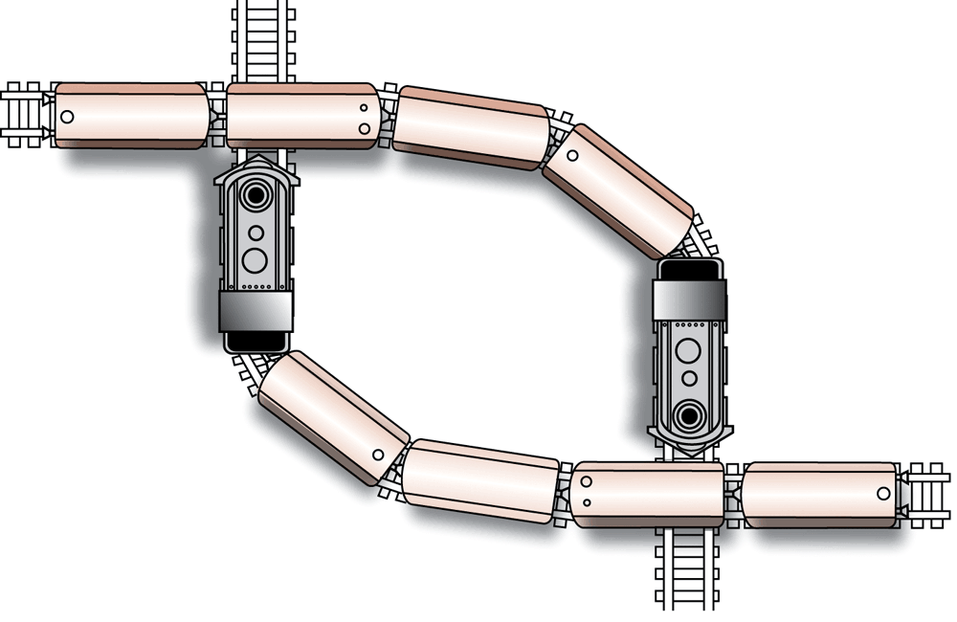
A deadlock resulting from competition for nonshareable railroad intersections

Slide 19
Security
Attacks from outside
  Problems
    System errors
    Insecure passwords
    Sniffing software
  Counter measures
    Auditing software
    Firewalls, scanners

Slide 20
Security (continued)
Attacks from within
  Problem: System errors
  Counter measures: patches, virtual machine
  Problem: Unruly processes
  Counter measures: Control process activities via privileged modes and privileged instructions

