Slide 1
Algorithms

Slide 2
Definition of Algorithm
An algorithm is an ordered set of unambiguous, executable steps that defines a (ideally) terminating process.

Slide 3
Algorithm Representation
Requires well-defined primitives
A collection of primitives that the computer can follow constitutes a programming language.

Slide 4
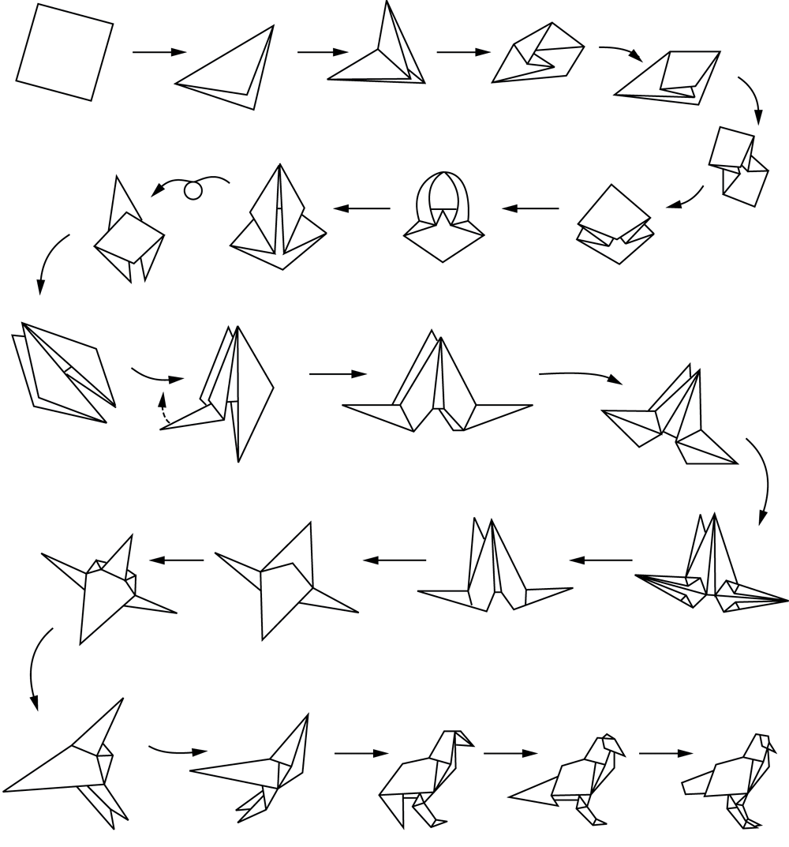
Folding a bird from a square piece of paper

Slide 5
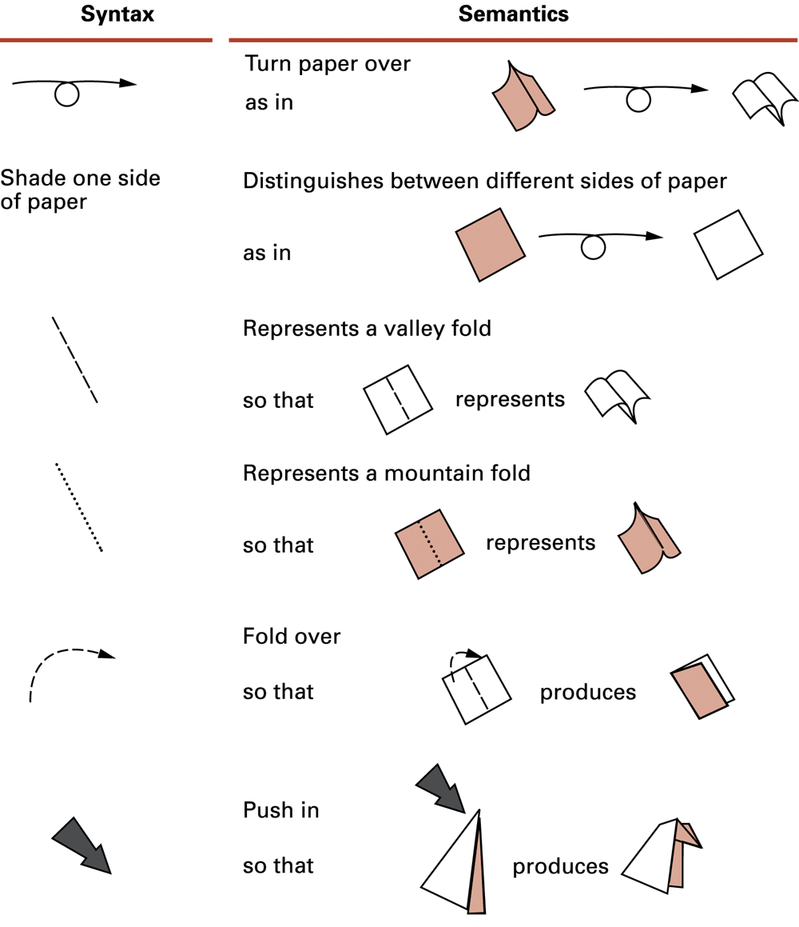
Origami primitives

Slide 6
Pseudocode Primitives
Pseudocode is “sort of” code that a computer can understand, but a higher level to be more easily human understandable
  But becomes pretty straightforward to convert to an actual programming language
Assignment
name ← expression
Conditional selection
if condition then action

Slide 7
Pseudocode Primitives (continued)
Repeated execution
while condition do activity
Procedure (aka Method, Subroutine, Function)
procedure name
list of primitives associated with name

Slide 8
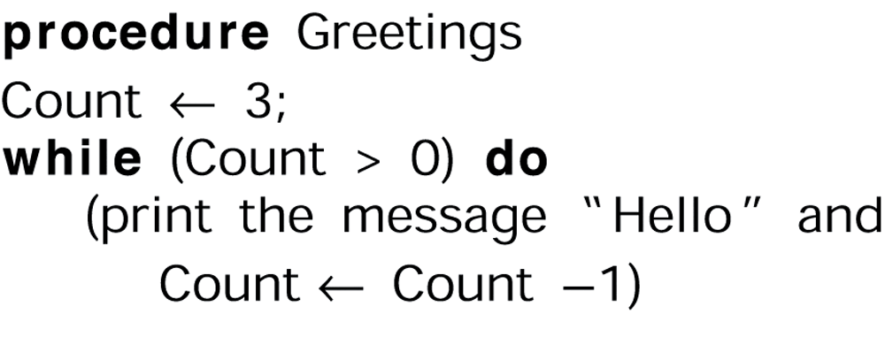
The procedure Greetings in pseudocode

Slide 9
Running Example
You are running a marathon (26.2 miles) and would like to know what your finishing time will be if you run a particular pace. Most runners calculate pace in terms of minutes per mile. So for example, let’s say you can run at 7 minutes and 30 seconds per mile. Write a program that calculates the finishing time and outputs the answer in hours, minutes, and seconds.
Input:
Distance : 26.2
PaceMinutes: 7
PaceSeconds: 30
Output:
3 hours, 16 minutes, 30 seconds

Slide 10
One possible solution
Express pace in terms of seconds per mile by multiplying the minutes by 60 and then add the seconds; call this SecsPerMile
Multiply SecsPerMile * 26.2 to get the total number of seconds to finish. Call this result TotalSeconds.
There are 60 seconds per minute and 60 minutes per hour, for a total of 60*60 = 3600 seconds per hour. If we divide TotalSeconds by 3600 and throw away the remainder, this is how many hours it takes to finish.
The remainder of TotalSeconds / 3600 gives us the number of seconds leftover after the hours have been accounted for. If we divide this value by 60, it gives us the number of minutes.
The remainder of ( the remainder of(TotalSeconds / 3600) / 60) gives us the number of seconds leftover after the hours and minutes are accounted for
Output the values we calculated!

Slide 11
Pseudocode
SecsPerMile ← (PaceMinutes * 60) + PaceSeconds
TotalSeconds ← Distance * SecsPerMile
Hours ← Floor(TotalSeconds / 3600)
LeftoverSeconds ← Remainder of (TotalSeconds / 3600)
Minutes ← Floor(LeftoverSeconds / 60)
Seconds ← Remainder of (LeftoverSeconds /60)
Output Hours, Minutes, Seconds as finishing time

Slide 12
Polya’s Problem Solving Steps
1. Understand the problem.
2. Devise a plan for solving the problem.
3. Carry out the plan.
4. Evaluate the solution for accuracy and its potential as a tool for solving other problems.

Slide 13
Getting a Foot in the Door
Try working the problem backwards
Solve an easier related problem
  Relax some of the problem constraints
  Solve pieces of the problem first (bottom up methodology)
Stepwise refinement: Divide the problem into smaller problems (top-down methodology)

Slide 14
Ages of Children Problem
Person A is charged with the task of determining the ages of B’s three children.
  B tells A that the product of the children’s ages is 36.
  A replies that another clue is required.
  B tells A the sum of the children’s ages.
  A replies that another clue is needed.
  B tells A that the oldest child plays the piano.
  A tells B the ages of the three children.
How old are the three children?

Slide 15
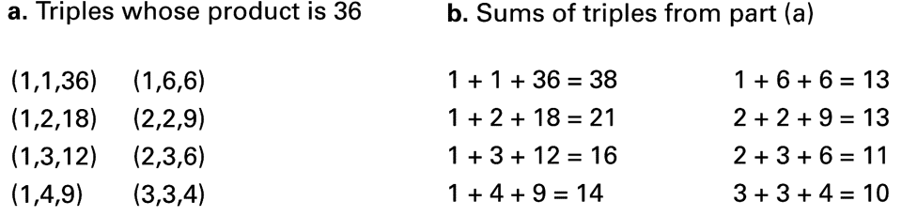
Solution

Slide 16
Iterative Structures
Pretest loop:
while (condition) do
(loop body)
Posttest loop:
repeat (loop body)
until(condition)

Slide 17
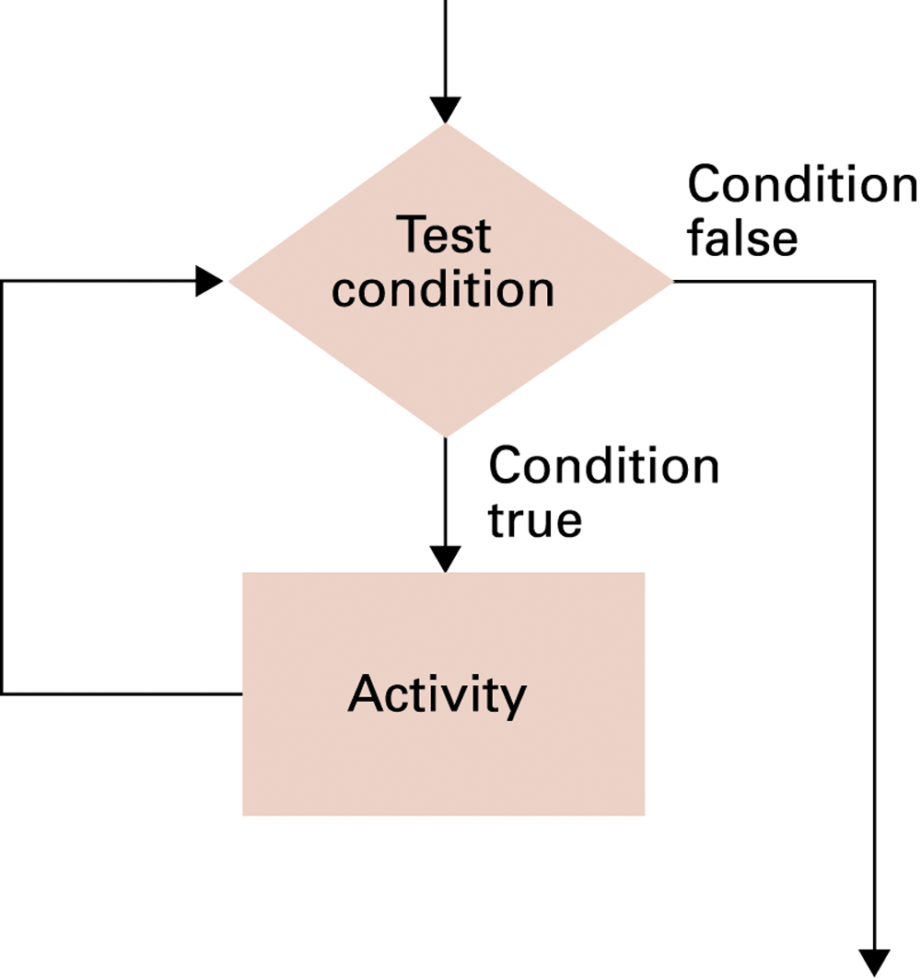
The while loop structure

Slide 18
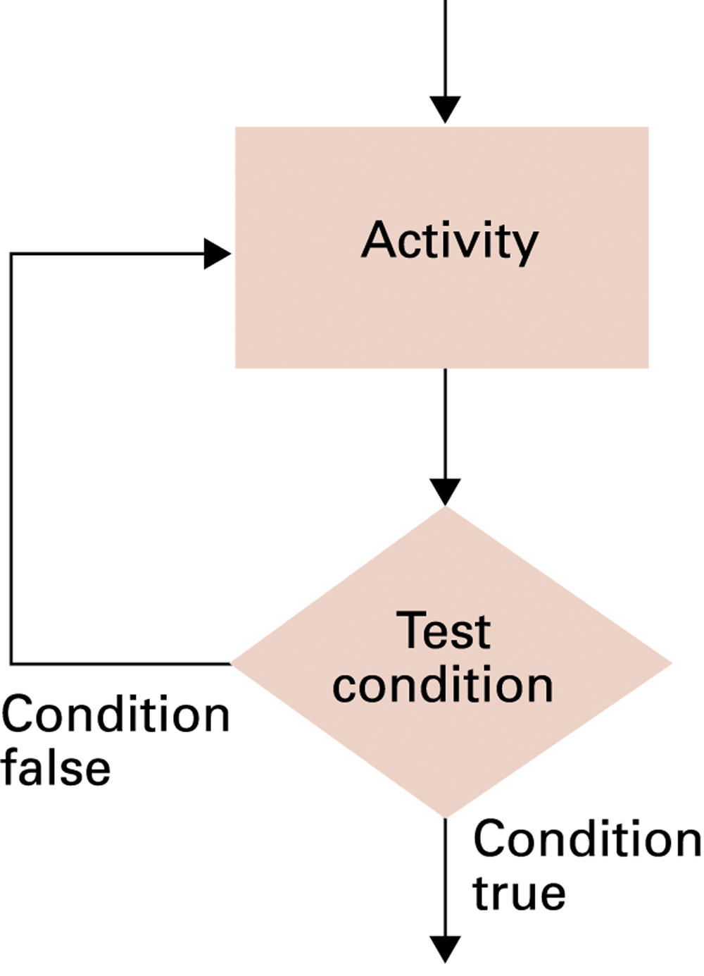
The repeat loop structure

Slide 19
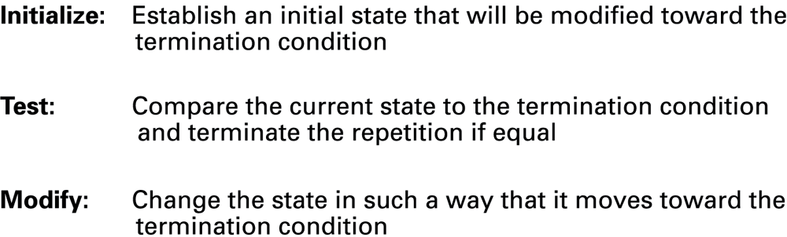
Components of repetitive control

Slide 20
Example: Sequential Search of a List
Fred
Alex
Diana
Byron
Carol
Want to see if Byron is in the list

Slide 21
The sequential search algorithm in pseudocode
procedure Search(List, TargetValue)
If (List is empty)
Then
(Target is not found)
Else
(
name ← first entry in List
while (no more names on the List)
(
if (name = TargetValue)
(Stop, Target Found)
else
name ← next name in List
)
(Target is not found)
)

Slide 22
Sorting the list Fred, Alex, Diana, Byron, and Carol alphabetically
Insertion Sort: Moving to the right, insert each name in the proper
sorted location to its left
Fred Alex Diana Byron Carol

Slide 23
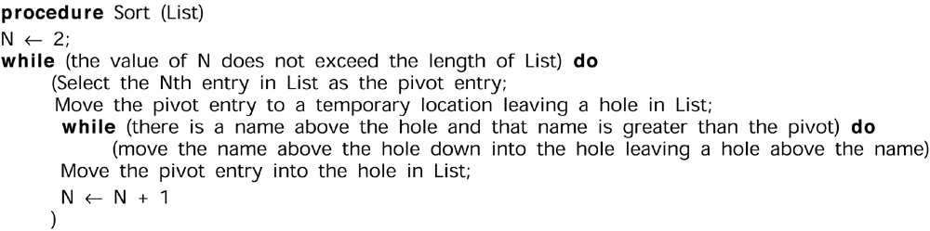
The insertion sort algorithm expressed in pseudocode
1 2 3 4 5
Fred Alex Diana Byron Carol

Slide 24
Recursion
The execution of a procedure leads to another execution of the procedure.
Multiple activations of the procedure are formed, all but one of which are waiting for other activations to complete.
Example: Binary Search

Slide 25
Applying our strategy to search a list for the entry John
Alice
Bob
Carol
David
Elaine
Fred
George
Harry
Irene
John
Kelly
Larry
Mary
Nancy
Oliver

Slide 26
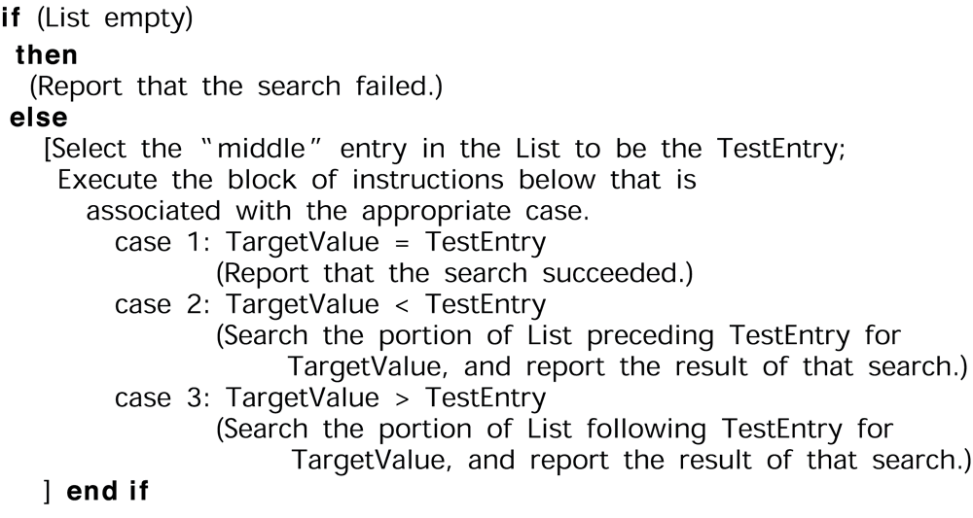
A first draft of the binary search technique

Slide 27
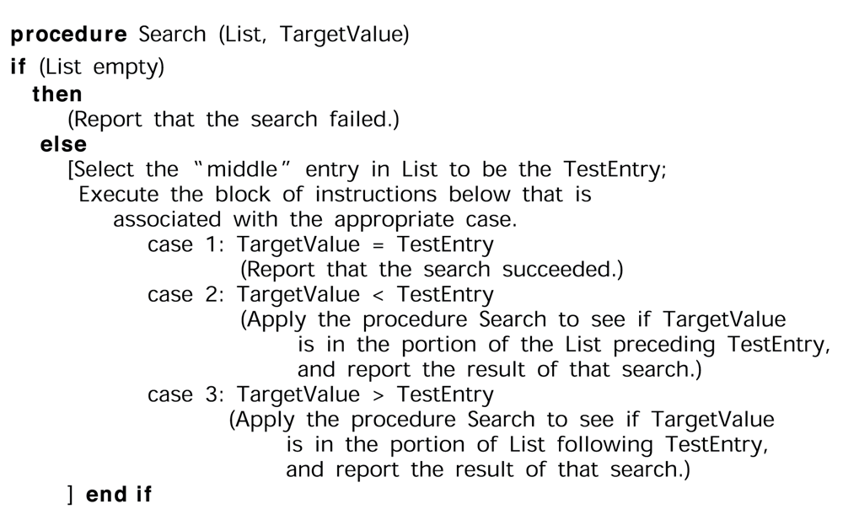
The binary search algorithm in pseudocode

Slide 28
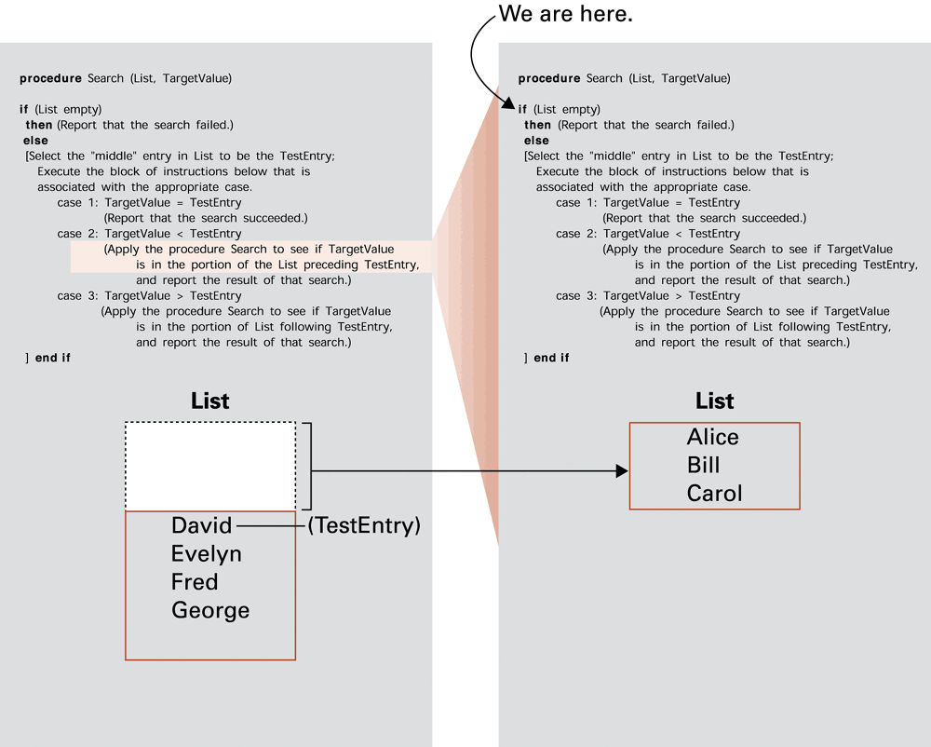
Searching for Bill

Slide 29
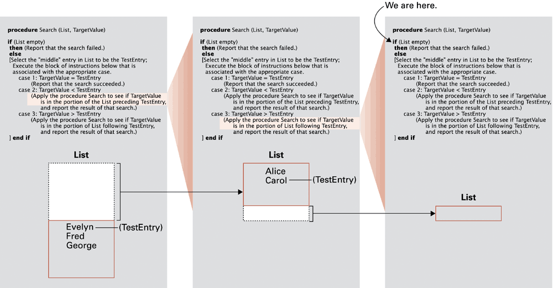
Searching for David

Slide 30
Algorithm Efficiency
Measured as number of instructions executed
Big theta notation: Used to represent efficiency classes
  Example: Insertion sort is in Θ(n²)
Best, worst, and average case analysis

Slide 31
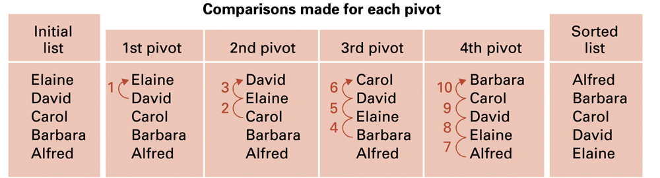
Applying the insertion sort in a worst-case situation

Slide 32
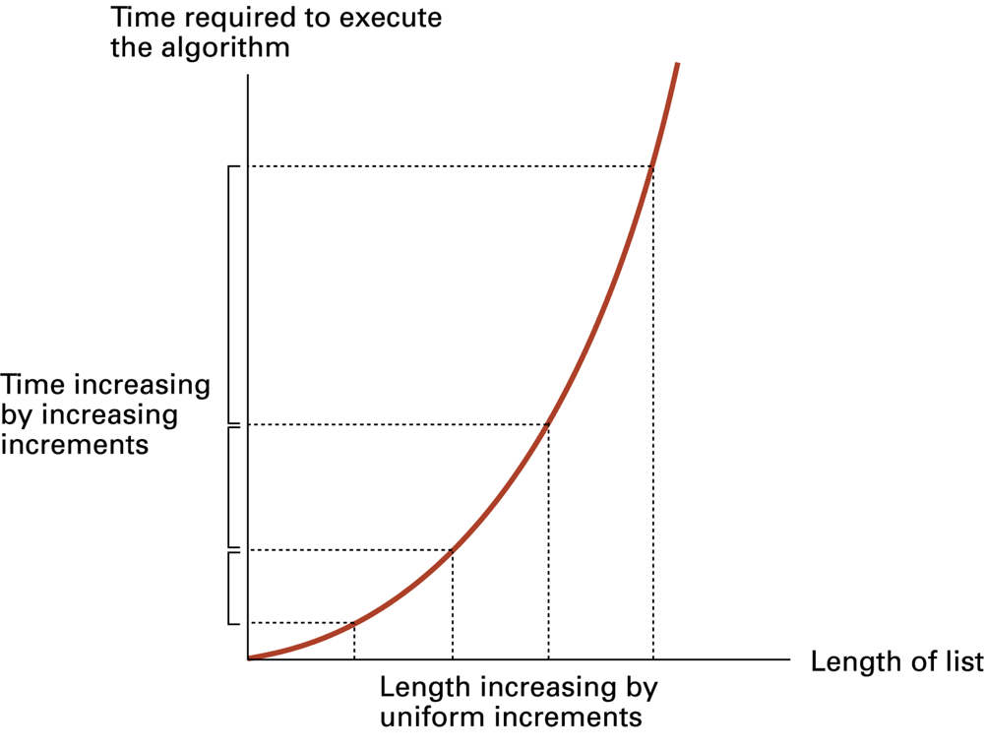
Graph of the worst-case analysis of the insertion sort algorithm

Slide 33
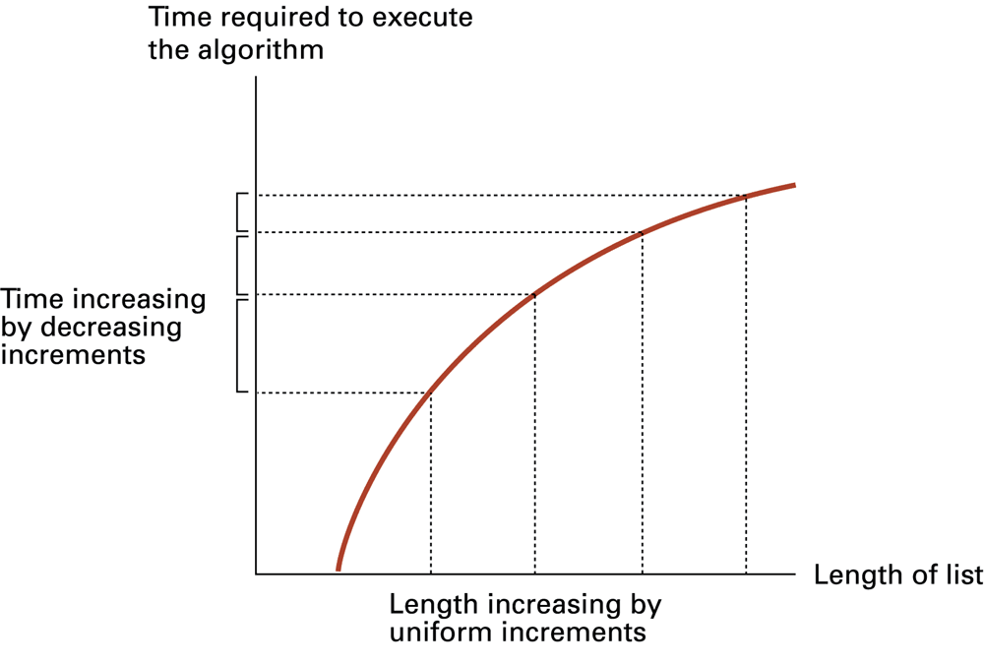
Graph of the worst-case analysis of the binary search algorithm

Slide 34
Software Verification
Proof of correctness
  Assertions
    Preconditions
    Loop invariants
Testing

Slide 35
Chain Separating Problem
A traveler has a gold chain of seven links.
He must stay at an isolated hotel for seven nights.
The rent each night consists of one link from the chain.
What is the fewest number of links that must be cut so that the traveler can pay the hotel one link of the chain each morning without paying for lodging in advance?

Slide 36
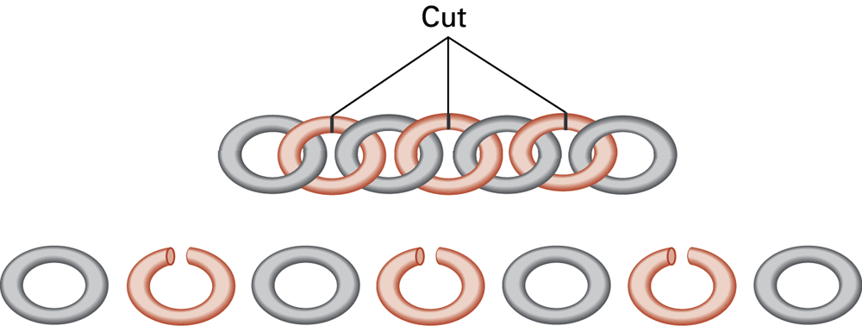
Separating the chain using only three cuts

Slide 37
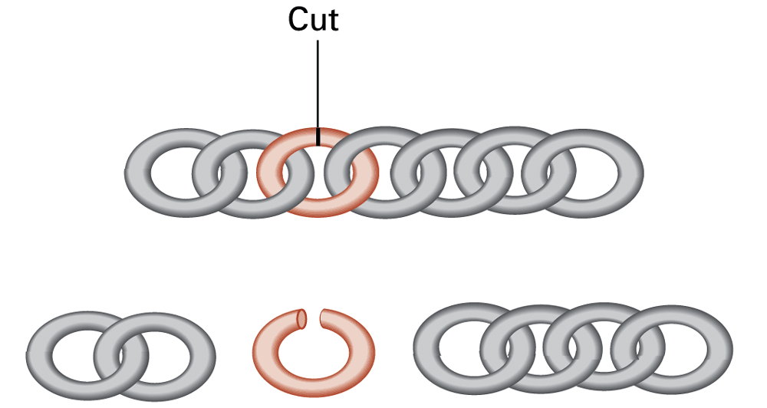
Solving the problem with only one cut

