Slide 1
Introduction to Computer Science
CS A101

Slide 2
What is Computer Science?
First, some misconceptions.
Misconception 1: I can put together my own PC, am good with Windows, and can surf the net with ease, so I know CS.
Misconception 2: Computer science is the study of how to write computer programs.
Misconception 3: Computer science is the study of the uses and applications of computers and software.

Slide 3
Computer Science
Computer science is the study of algorithms, including
Their formal and mathematical properties
Their hardware realizations
Their linguistic realizations
Their applications

Slide 4
What Will We Cover?
Broad survey of computer science topics, some depth in programming, more on breadth
Topics
History
Data representation
Computer architecture (software perspective)
Operating Systems
Networking
Algorithms
Theory
Database Systems
Programming (more depth than other topics)

Slide 5
Terminology
Algorithm: A set of steps that defines how a task is performed
Program: A representation of an algorithm
Programming: The process of developing a program
Software: Programs and algorithms
Hardware: Physical equipment

Slide 6
History of Algorithms
The study of algorithms was originally a subject in mathematics.
Early examples of algorithms
Long division algorithm
Euclidean Algorithm
Gödel's Incompleteness Theorem: Some problems cannot be solved by algorithms.

Slide 7
Example: Euclid’s algorithm

Slide 8
Central Questions of Computer Science
Which problems can be solved by algorithmic processes?
How can algorithm discovery be made easier?
How can techniques of representing and communicating algorithms be improved?
How can characteristics of different algorithms be analyzed and compared?

Slide 9
Central Questions of Computer Science (continued)
How can algorithms be used to manipulate information?
How can algorithms be applied to produce intelligent behavior?
How does the application of algorithms affect society?

Slide 10
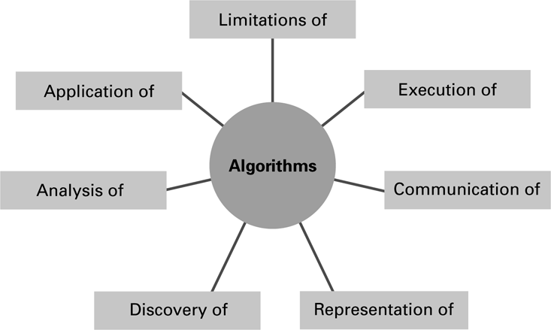
The central role of algorithms in computer science

Slide 11
Abstraction
Abstraction: The distinction between the external properties of an entity and the details of the entity’s internal composition
Abstract tool: A “component” that can be used without concern for the component’s internal properties
Abstraction simplifies many aspects of computing and makes it possible to build complex systems

Slide 12
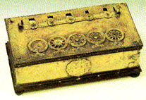
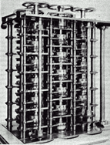
A Brief History of Computing
Roots in Mathematical Sciences and computational devices
Abacus, counting device, state
Blaise Pascal, the Pascaline 1642
Manual gear system to add numbers
Charles Babbage
Difference Engine designed in 1812
Could not be built using the tools of the era
Eventually built later using modern tools
Analytic Engine 1823, steam-powered more general computational device with conditional controls
Also too complex to build in the 19th century

Slide 13
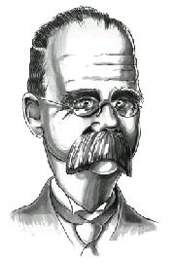
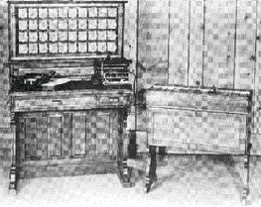
Roots of Computing…
Herman Hollerith’s Tabulating Machine
Former MIT lecturer, developed a machine to read punch cards
Inspired by a train conductor to punch tickets
Used in the 1890 US Census
Company became IBM in 1924

Slide 14
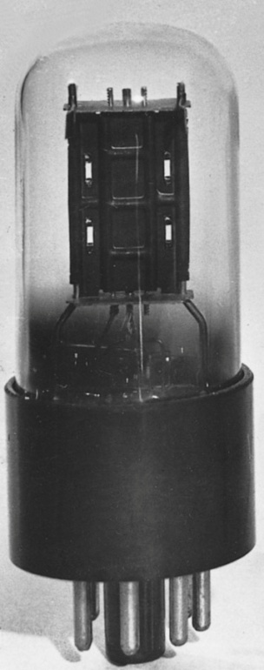
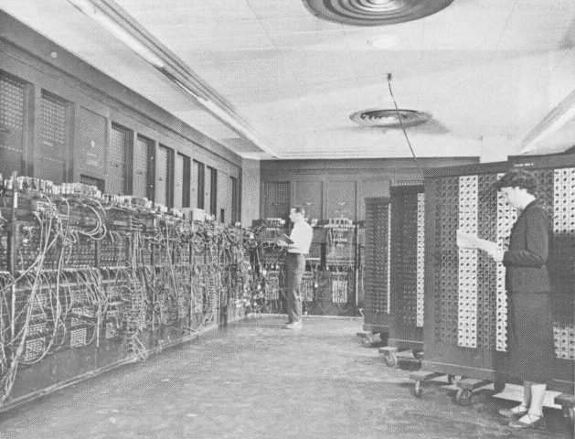
Roots of Computing…
1940, Conrad Zuse’s Z3
First computing machine to use binary code, precursor to modern digital computers
1944, Harvard Mark I, Howard Aiken
1946, ENIAC, first all digital computer
Ushered in the “Mainframe” era of computing
“First Generation”
18,000 vacuum tubes
Similar to a lightbulb but plate in middle controls flow of electrical current

Slide 15
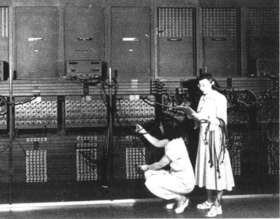
1.7 The von Neumann Model
On the ENIAC, all programming was done at the digital logic level.
Programming the computer involved moving plugs and wires.

Slide 16
Roots of Computing…
1945: John von Neumann defines his architecture for an “automatic computing system”
Basis for architecture of modern computing
Computer accepts input
Processes data using a CPU
Stores data in memory
Stored program technique, storing instructions with data in memory
Produces output
Led to the EDVAC and UNIVAC computers

Slide 17
Roots of Computing…
1951, UNIVAC, Universal Automatic Computer
When we say there is a “bug” in the program, we mean it doesn’t work right… the term originated from an actual moth found in the UNIVAC by Grace Hopper

Slide 18
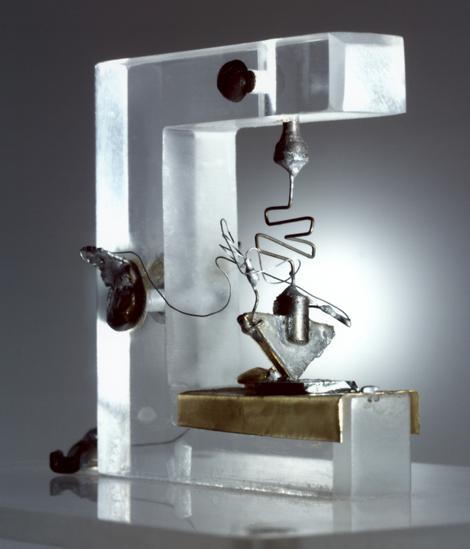
The Second Generation: Transistors
Invented 1947, Bell Labs: Bardeen, Shockley, Brattain
1958 -1964
Transistors generate less heat
Transistors are smaller, faster, and more reliable
First transistors smaller than a dime
UNIVAC II built using transistors
Notes:
Transforming invention! Like the invention of the steam engine. First transistor about the size of a thumb, with a paperclip, gold foil, germanium, and coiled wire. Germanium is, like silicon, a semiconductor – it only conducts a trickle of electricity. This can be used to control the amplification of signals by changing the material from a conductor to an insulator. Actually an accident, some evidence Shockley was annoyed and was looking for something else. It took until 1948 to see the real value and in 1951 you could license transistor technology for $25K. Then Shockley went on to start the seeds of Silicon Valley.
The 2nd generation UNIVAC was produced with transistors instead of vacuum tubes with a greater performance. It could perform thousands of operations a second.

Slide 19
The Third Generation: Integrated Circuits (IC)
1964 -1990
Multiple transistors on a single chip
IBM 360 - First mainframe to use IC
DEC PDP-11 - First minicomputer
End of mainframe era, on to the minicomputer era
Notes:
The 360 also used the first general-purpose operating system which allowed computers to be more easily programmed.
In 1971 Intel invented the 4004, the world’s first microprocessor which led to the world of desktop computing of today.
William Gates and Paul Allen founded Microsoft with a version of BASIC written for the Altair.
Jobs and Wozniak built the first Apple computer in their garage in 1976.
By the time Intel announced the Pentium processor in 1993 the Wintel (Windows/Intel) dynasty was off and running.
Microprocessors have become 5,000 times faster in 24 years.

Slide 20
Integrated Circuit
Invented at TI by Jack Kilby, Bob Noyce
"What we didn't realize then was that the integrated circuit would reduce the cost of electronic functions by a factor of a million to one, nothing had ever done that for anything before" - Jack Kilby

Slide 21
Minicomputer Era
Made possible by DEC and Data General Corporation, IBM
Medium-sized computer, e.g. DEC-PDP
Much less expensive than mainframes, computing more accessible to smaller organizations
Used transistors with integrated circuits

Slide 22
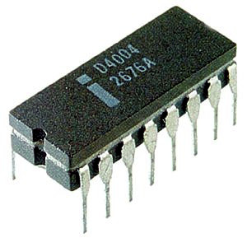
Personal Computer Era
First microprocessor, Intel 4004 in 1971
MITS Altair “kit” in 1975
Apple in 1976
IBM PC in 1981 using 8086
Macintosh in 1984, introduced the GUI (Graphical User Interface) we still use today
Some critics: Don Norman on complexity
Next interface delegation instead of direct manipulation?

Slide 23
Today: Internetworking Era?
Computer as communication device across networks
World Wide Web, Internet
Publishing, data sharing, real-time communications

Slide 24
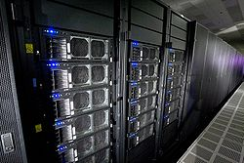
Supercomputers
The most powerful and expensive computers
Contain numerous very fast processors that work in parallel
IBM Roadrunner
1,105 TeraFlops (Floating Point Operations/Second)
12,960 IBM PowerXCell 8i and 6,480 AMD Opteron dual-core processors
At 2 TeraFlops, could do in 1 second what would take every man, woman, and child 125 years work nonstop on hand calculators
Used by researchers and scientists to solve very complex problems
Cost millions of dollars
Notes:
Sandia National Laboratories used a supercomputer to model fallout from nuclear explosions.
More parallelism does not equal more speed! Need specific applications that require this type of parallel processing. Studies have indicated the inherent amount of parallelism is 2-3.
ASCI White by IBM, 12 TeraFlops, size of two basketball courts, 8192 copper processors
Intel’s ASCI RED at Sandia with 9400 200Mhz pentium pro processors. It has 300GB of RAM and costs $55 million to build. 1.8 TeraFlops on benchmarks, more than all the mainframes of the world combined. It would take every man, woman, and child 125 years to work nonstop on hand calculators to do what this computer can do in 1 second.
Eli Lilly and Dow Chemical used one to design and evaluate new combinations of chemical elements to identify promising drugs.
Los Alamos used them for nuclear simulations. Weather, particle simulators.
They require an extensive staff to operate and maintain.
SETI @Home? Over 2,000,000 users. 375,000 years of computing time. 15 TeraFLOPs, more than ASCI RED!

Slide 25
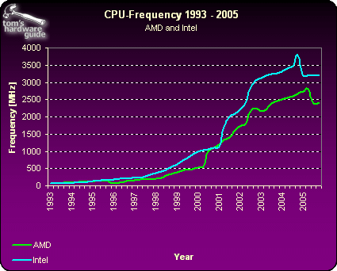
CPU Clock Speeds
Notes:
More Mhz is better, but this is not a good benchmark *across* different computer architectures. Mhz refers to the clock speed, so 1 Mhz is 1/1000000. A 1Mhz machine could theoretically execute a million instructions per second. But what an instruction is varies across architectures. On a pentium it may take 100 instructions to do a task, while only 10 instructions on some other type of machine.

Slide 26
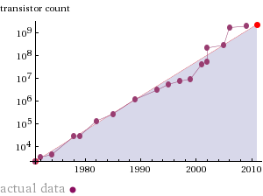
Moore’s Law
1965: Computing power doubles ~ every 18 months

Slide 27
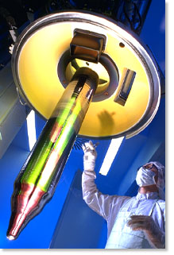
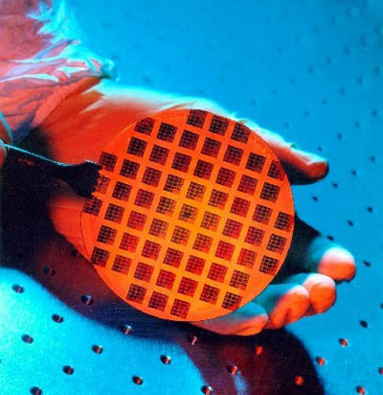
Chip Production
Ingot of purified silicon – 1 meter long, sliced into thin wafers
Chips are etched – much like photography
UV light through multiple masks
Circuits laid down through mask
Process takes about 3 months
View of
Cross-Section
Notes:
Sliced using diamond saws
Yield is the % of usable chips per wafer

Slide 28
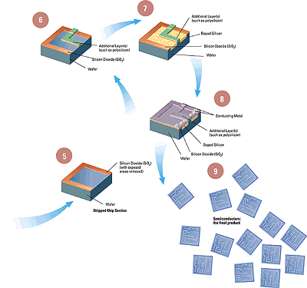
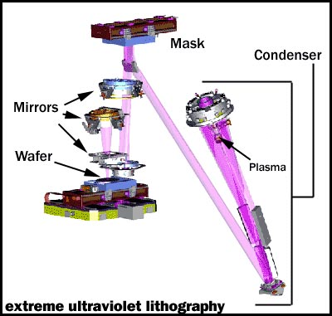
Fabrication
“wires” – chemical
or vapor deposition
SiO2 gate
Doping
Annealing

Slide 29
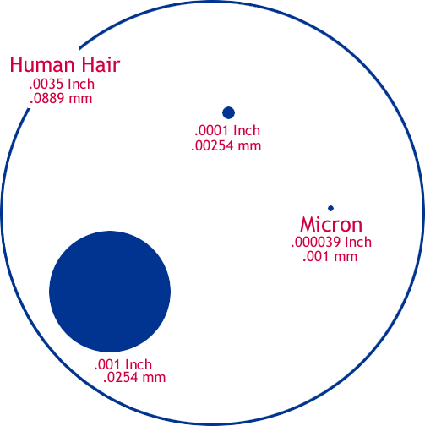
The Shrinking Chip
Human Hair: 100 microns wide
1 micron is 1 millionth of a meter
Bacterium: 5 microns
Virus: 0.8 microns
Early microprocessors: 10-15 micron technology
1997: 0.35 Micron
1998: 0.25 Micron
1999: 0.18 Micron
2001: 0.13 Micron
2003: 0.09 Micron
2007: 0.065 Micron
2009: 0.045 Micron
Physical limits believed to be around 0.016 Microns, should reach it around 2018
Notes:
Smaller process technology means we can generate less heat, pack more transistors into the same area as before

Slide 30
Size

