Slide 1
Networking and the Internet

Slide 2
Introduction: “Everything is Connected to Everything”
Seeds of Networking
  1966: ARPA (Advanced Research Projects Agency) State Defense Department’s research organization.
    Focused major development effort on computer networking.
    ARPA’s Goal: To promote research in advanced future technologies by funding university and industry research proposals.
      Distributed communication system
      Enable research communication
      Enable dissimilar computers to share information
      Reroute information automatically
      Act as a network of networks; internetworking
  Result: Thousands of databases became available to researchers

Slide 3
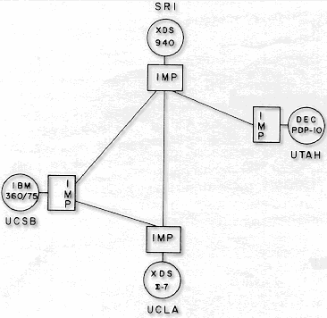
Original ARPANet Sites

Slide 4
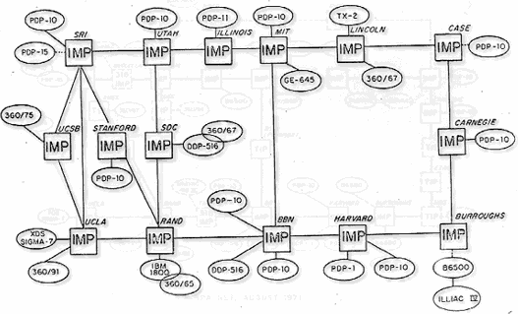
ARPANet 1972

Slide 5
The Internet:
Struggling to Maturity
ARPA intended to sell off the ARPAnet to an academic or corporate consortium.
  Before the sale, federal rules required the Defense Department to determine if ARPAnet was needed for national defense.
  ARPAnet was transferred to the Defense Communications Agency in 1975.
  Only about 15 universities were given access to the network.
1980: National Science Foundation started CSnet
  Purpose: To provide a resource-sharing network opportunity to computer science research at all universities.
  Used TCP/IP protocol.

Slide 6
The Internet:
Struggling to Maturity
CSnet fueled interest in creating a more comprehensive network to link all scientific communities (not just CS)
  NSF couldn’t fund such an expensive project.
    Backbone: NSF built a very fast connection between 5 supercomputing centers linking them all together.
    Each region surrounding each center would develop its own community network.
    NSF allowed the regional community networks exclusive use of the backbone.

Slide 7
The Internet:
Struggling to Maturity
1983: ARPAnet split.
  Converted to TCP/IP protocol.
  Part remained ARPAnet: universities, research institutes.
  Part became Milnet: non-classified military information.
1989: majority of ARPAnet switched to NSF’s backbone.
  ARPAnet sites were connected to the NSF backbone through the regional community networks.
NSFnet became what is known today as the Internet.

Slide 8
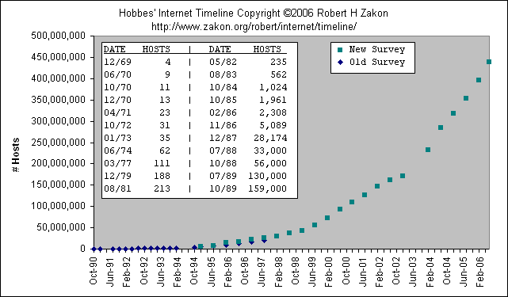
Growth of the Internet

Slide 9
The Physical Organization of Networks
LAN (Local Area Network)
  A collection of nodes (i.e. computing devices) within a small area.
  The nodes are linked in a bus, ring, star, tree, or fully connected topology network configuration.
  Benefits of LANs:
    Sharing of hardware resources.
    Sharing of software and data.
    More efficient person-to-person communication.

Slide 10
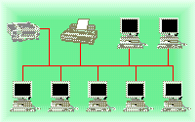
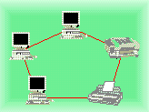
The Physical Organization of Networks
The bus network -
  A continuous coaxial cable to which all the devices are attached.
  All nodes can detect all messages sent along the bus.
The ring network -
  Nodes linked together to form a circle.
  A message sent out from one node is passed along to each node in between until the target node receives the message.
Linking nodes:
Both of these topologies are uncommon today

Slide 11
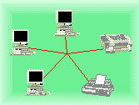
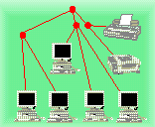
The Physical Organization of Networks
The star network -
  Each node is linked to a central node.
  All messages are routed through the central node, who delivers it to the proper node.
  Most common today
The tree network - (hierarchical network)
  Looks like an upside-down tree where end nodes are linked to interior nodes that allow linking through to another end node.
Linking nodes:

Slide 12
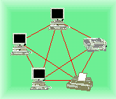
The Physical Organization of Networks
The fully connected network -
  All nodes are connected to all other nodes.
  Typically too expensive to implement, need n(n-1)/2 connections for n nodes
Internetworking -
  Connecting together any number of direct-connected networks.
  The largest: Internet.
  Some collection of networks: internet
  Terms intranet and extranet also used
Linking nodes:

Slide 13
Hardware Architecture of Networks
Types of hardware used to create networks:
Hub A device that repeats or broadcasts the network stream of information to individual nodes ( usually personal computers)
Switch A device that receives packets from its input link, and then sorts them and transmits them over the proper link that connects to the node addressed.
Bridge Transparently links two local networks that have identical rules of communication.
Gateway A link between two different networks that have different rules of communication.
Router A node that sends network packets in one of many possible directions to get them to their destination.

Slide 14
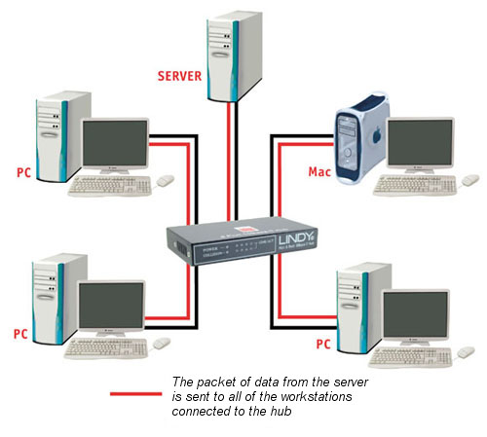
Hub
A hub looks like a star configuration but really implements a bus

Slide 15
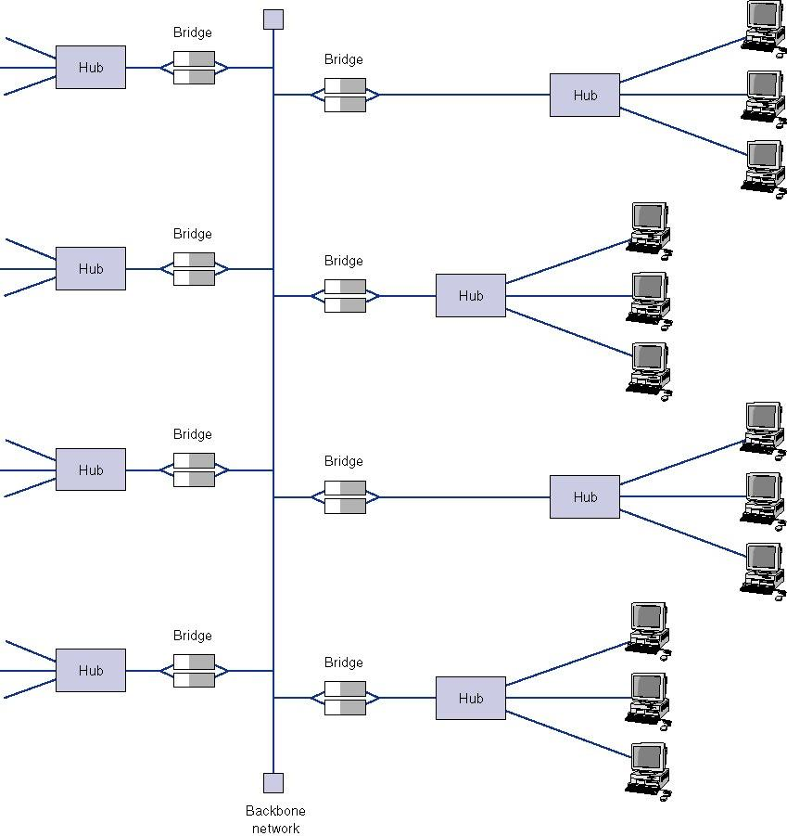
Bridge LAN / Backbone Design

Slide 16
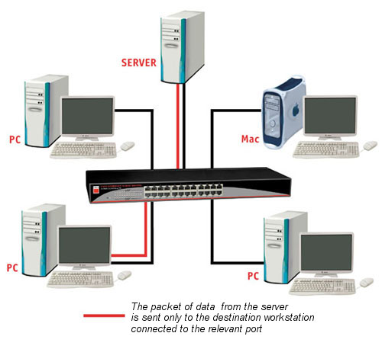
Switch
A switch is a true star configuration
Consumer devices today are switches, not hubs

Slide 17
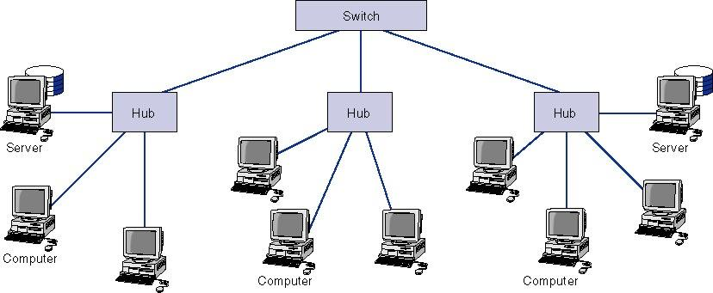

Switches

Slide 18
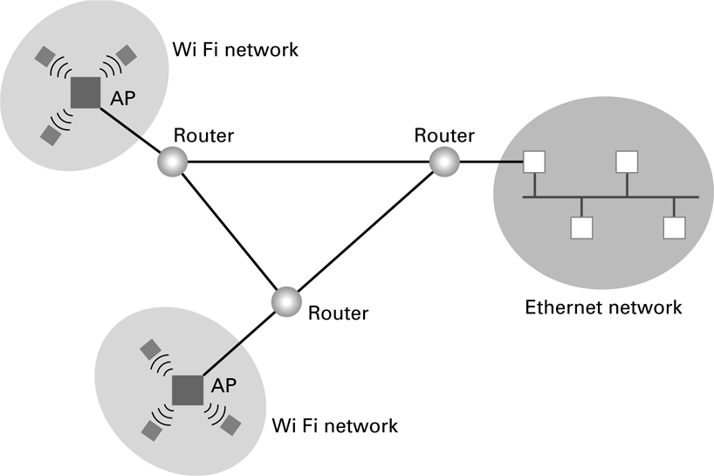
Routers connecting two WiFi networks and an Ethernet network to form an internet

Slide 19
The Physical Organization of Networks
MAN (Metropolitan Area Network)
  Consists of many local area networks linked together.
  Span the distance of several few miles.
WAN (Wide Area Network)
  Consists of a number of computer networks including LANs.
  Connected by many types of links.

Slide 20
Connecting Independent Networks
Router: fundamental building block of the Internet
  Has a processor, memory, and network interface, its own specialized software
  Connects LANs to backbone WANs
  Forwards data from one network to another
  Determines best routes for data to travel
Notes:
Routers are special-purpose computers with no software.
Routers are the means through which thousands of LANs and WANs are interconnected. A backbone network manages the bulk of network traffic and typically uses a higher-speed protocol than the individual LAN segments.
To gain access to the Internet, organizations generally connect a router between one of its own networks and the closest Internet site. Individuals use telephone dial-up services to connect to a computer or network that is connected to the Internet.

Slide 21
Routers Enable Different Paths between Networks
Path 2
Network A
Path 3
Network B
Path 1
Path 4
Router
Path 6
Path 5
Network C

Slide 22
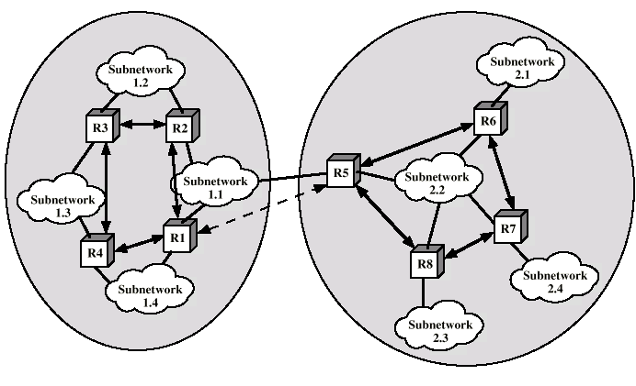
Routers – Connect Networks

Slide 23
Software Architecture of Networks
Problem:
  Connect several different machines running different operating systems (Windows, OS/2, MacOS, UNIX, VMS...)
  Now, try to: send email, data or files between them.
Solution:
  Create a standardized set of rules, or protocols, that, when followed, will allow an orderly exchange of information.
  A collection of these programs is called a protocol suite.
    Must be on all computers or nodes in the network.
    In order to send data over the network, the necessary programs must be executed.
  Network’s architecture: The protocol suite and the general scheme that guides the network’s rules.

Slide 24
Software Architecture of Networks
Problem: Collisions of information are caused by two computers simultaneously attempting to send information to the network.
Solution: Different networks have different protocol suites:
  Apple Computer’s LocalTalk Protocol - Permission must be granted before information can be sent along the network.
  Token-Ring Protocol (IBM and others) - A token is “picked up” by a node signifying that a message is about to be sent, the computer sends the message, then, replaces the token so that others can use the network.
  Ethernet Protocol (Xerox and others) – CSMA/CD
    Carrier Sense Multiple Access / Collision Detection
    “Listen” for quiet line; then send message
    Collision occurs with simultaneous messages
    If detected, send jam signal, wait random time, and resend
    Distributed Fairness

Slide 25
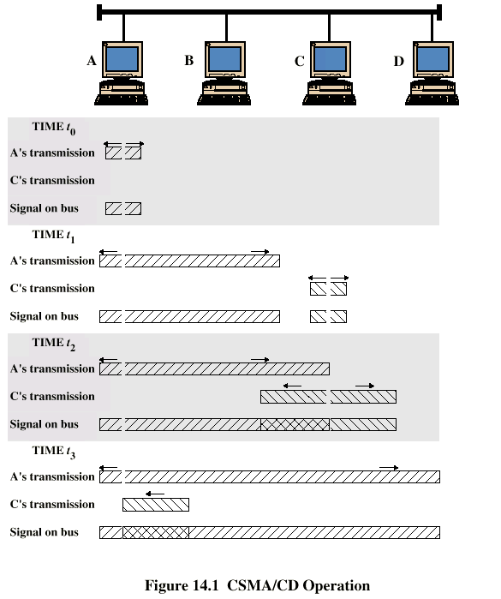
CSMA/CD
Operation
Frames must be long enough to detect collision during transmission!

Slide 26
Wireless LANs
IEEE 802.11
Basic service set (cell)
  One or more stations using same protocol, together with an access point or base station
  Typically some radius (~200 ft) from the access point
  Competing to access shared medium
  May connect to backbone via access point (bridge)
Extended service set
  Two or more BSS connected by distributed system
  Appears as single logic LAN to Data Link layer

Slide 27
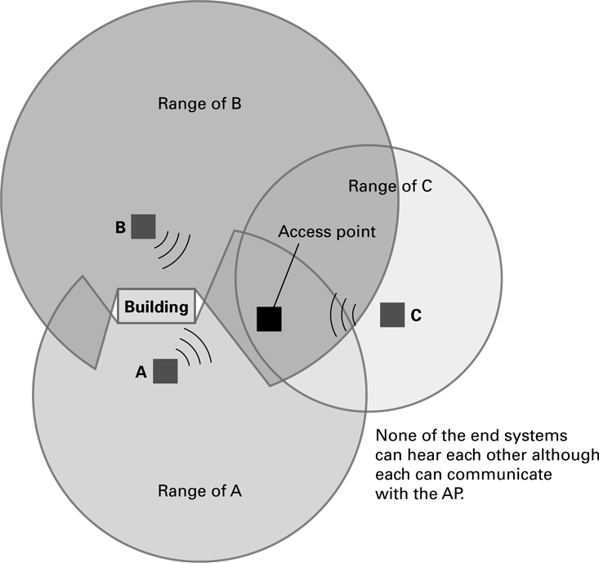
Wireless – 802.11
CSMA/CD approach doesn’t work because of the Hidden Terminal Problem

Slide 28
802.11 Media Access
If media is idle for some time then it is allowed to transmit
If media is busy
  Wait until media is free
  Then wait an additional random time (less greedy than 802.3)
Data is sent with a checksum
  A checksum is a simple check to see if the data was received properly
  E.g. if sending the numbers 10, 20, and 30 then the checksum might be the sum of all numbers (60), so 10,20,30 and 60 are sent. The receiver verifies that all numbers received add up to 60.
If the checksum matches, the receiver sends an ACK to the sender
Receiver might get a collision, but no detection for one – instead the checksum will (hopefully) fail
  If sender doesn’t receive ACK in some time period, resends

Slide 29
802.11 Media Access
Also supports a way to reserve channel access, avoids hidden station problem
Sender sends short Request To Send (RTS)
Receiver sends short Clear To Send (CTS) with permission to the Sender
  All other stations also hear the CTS, and have to withhold sending until transmission is complete
Sender sends data
Recipient sends ACK if successful
  Other stations also hear the ACK, can now issue their own RTS
Might have collisions with RTS or CTS but not with Data or ACK. If collisions, stations requesting to send will not get a CTS and will have to wait random time to re-submit the RTS

Slide 30
Inter-Program Communication
Client-server
  One server, many clients
  Server must execute continuously
  Client initiates communication
  E.g. web browser asks a web server for a web page
Peer-to-peer (P2P)
  Two processes communicating as equals
  Peer processes can be short-lived
  E.g. copying music or video directly from another computer
    Legal issues

Slide 31
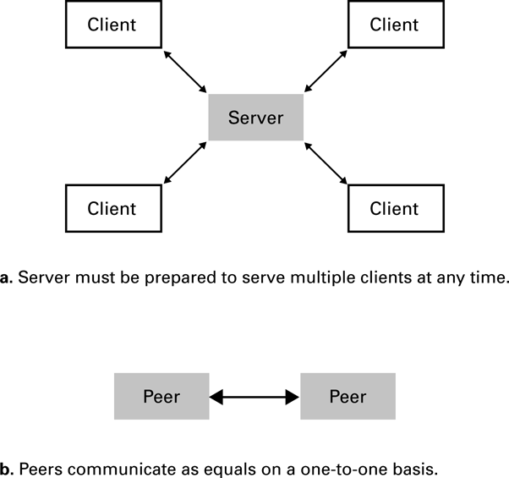
The client/server model compared to the peer-to-peer model

Slide 32
Internet Architecture
Internet Service Provider (ISP)
  Tier-1
    Major communication companies
  Tier-2
Access ISP: Provides connectivity to the Internet
  Traditional telephone (dial up connection)
  Cable connections
  DSL
  Wireless

Slide 33
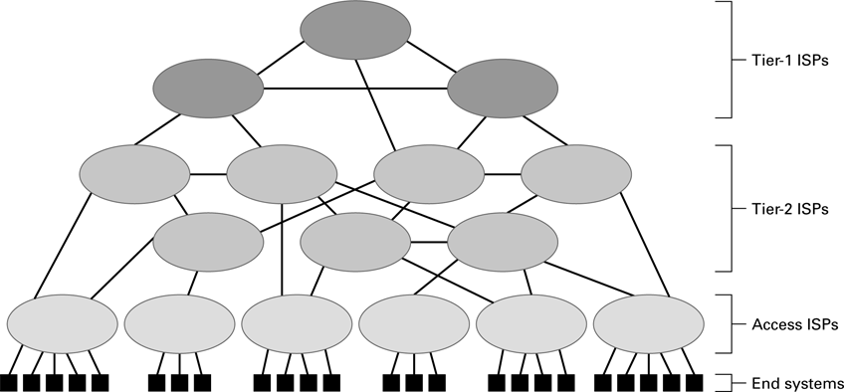
Internet Composition

Slide 34
Internet Addressing
IP address: pattern of 32 or 128 bits often represented in dotted decimal notation
  IP 4: 32 bits
    Four groups of 8 bits; each 8 bit group can be represented by a value from 0 to 255
    0.0.0.0 to 255.255.255.255
    2³² or about 4.3 billion addresses theoretically possible, but not divided equally; exhaustion predicted 2010-2012
  IP 6: 128 bits
  Addresses often assigned to clients via DHCP – Dynamic Host Configuration Protocol
Domain name system (DNS)
  Provides a way to assign a more meaningful name to the IP address
  Name servers
  DNS lookup

Slide 35
Internet Corporation for Assigned Names & Numbers (ICANN)
Allocates IP addresses to ISPs who then assign those addresses within their regions.
Oversees the registration of domains and domain names.
Names of computers use the following convention for domains
  hostname.subdomain.domain.type
    type : Organization status
    domain : Registered ICANN name
    Subdomain : optional hostname
    Hostname : Name of the machine
  Organizations determine own structure at the hostname and subdomain levels

Slide 36
Common Types
.edu - Educational
.gov - Government
.org - Nonprofit organizations
.net - Internet service providers, backbone
.country - Two letter country code, e.g. .jp for Japan, .us for United States, .to for Togo
Latest top level domains approved:
  .aero, .biz, .museum, .info, .jobs, .travel
  .xxx rejected in 2006

Slide 37
Hierarchy of Names - DNS
Routers are based on IP address (e.g. 134.114.140.34), not the English-like domain name!
DNS = Domain Name Server system
  Way to translate from domain name to IP address
Tree-based hierarchy, with .org, .com, .edu, and .gov at the top of the tree

Slide 38
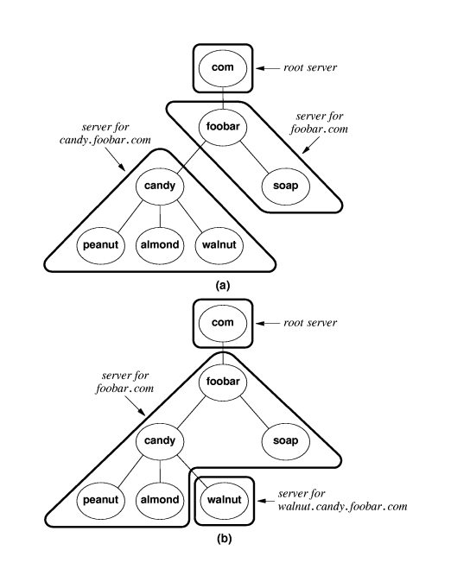
DNS Client-Server
DNS names are managed by a hierarchy of DNS servers
Hierarchy is related to DNS domain hierarchy
Root server at top of tree knows about next level servers
  Next level servers, in turn, know about lower level servers

Slide 39
DNS Servers
Each DNS server is the authoritative server for the names it manages
If request contains name managed by receiving server, that server replies directly
Otherwise, request must be forwarded to the appropriate authoritative server
Process:
  Client contacts local DNS server, L
  If L knows the requested IP or is the authority, return the IP
  Otherwise, contact the root server
    Root server returns to L the authoritative server for the domain
    L contacts this server
    Process may repeat until we find the authoritative server

Slide 40
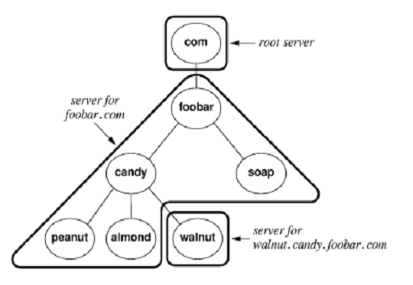
DNS Lookup Example
2,3
Computer requests IP for comp.walnut.candy.foobar.com from local DNS
Not found in local DNS, local DNS becomes a client and contacts root server
Root server returns server below, for foobar.com
Local DNS contacts server at foobar.com
Foobar.com server returns server below, for walnut.foobar.com
Local DNS contacts server at walnut.foobar.com
This is the authority, returns IP
Local DNS returns IP to Computer
4,5
6,7
Iterative Resolution

Slide 41
DNS Efficiencies
DNS resolution can be very inefficient
  Every host referenced by name triggers a DNS request
  Every DNS request for the address of a host in a different organization goes through the root server
Servers and hosts use caching to reduce the number of DNS requests
  Cache is a list of recently resolved names and IP addresses
Servers use replication to decrease the load on root servers

Slide 42
Protocol of the Internet: TCP/IP
Data is sent on the Internet using TCP/IP
Transmission Control Protocol
  Breaks information into data packets
  Reassembles packets when received
  Checks for lost packets
Internet Protocol
  Addressing using IP addresses
First, an analogy with shipping packages
Notes:
Organizations use diverse network technologies that may not be compatible with the technologies of other organizations. Because so many different networks are connected, they must have a common protocol to communicate. The protocol of the Internet is TCP/IP.
TCP control s the packets. IP controls the addressing of individual machines. Packets travel independently to their destination, sometimes following different paths and arriving out of order. The destination computer uses TCP to reassemble the packets based on their identification and sequencing information.
Every computer that uses the Internet must run IP software. The IP defines how a packet must be formed and how a router must forward each packet. TCP helps guarantee delivery of the packets.

Slide 43
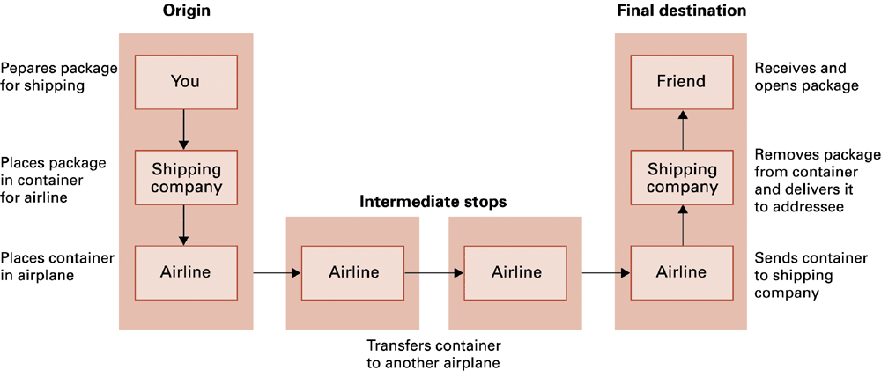
Package-shipping example

Slide 44
High Level Internet Architecture
Different Layers in the “Stack”
  Application
    Programs like web browsers, servers,
    Protocols such as ftp, ssh, httpd, html
  Transport
    Keeps track of a session, breaks data into packets, error checking
    Protocols such as TCP or UDP
  Internet
    Routes messages to their destination
    Protocols such as IP
  Data Access or Data Link
    Controls physical hardware
    Protocols such as Ethernet, PPP
  Physical
    Physical medium, twisted pair, fiber, radio, etc.

Slide 45
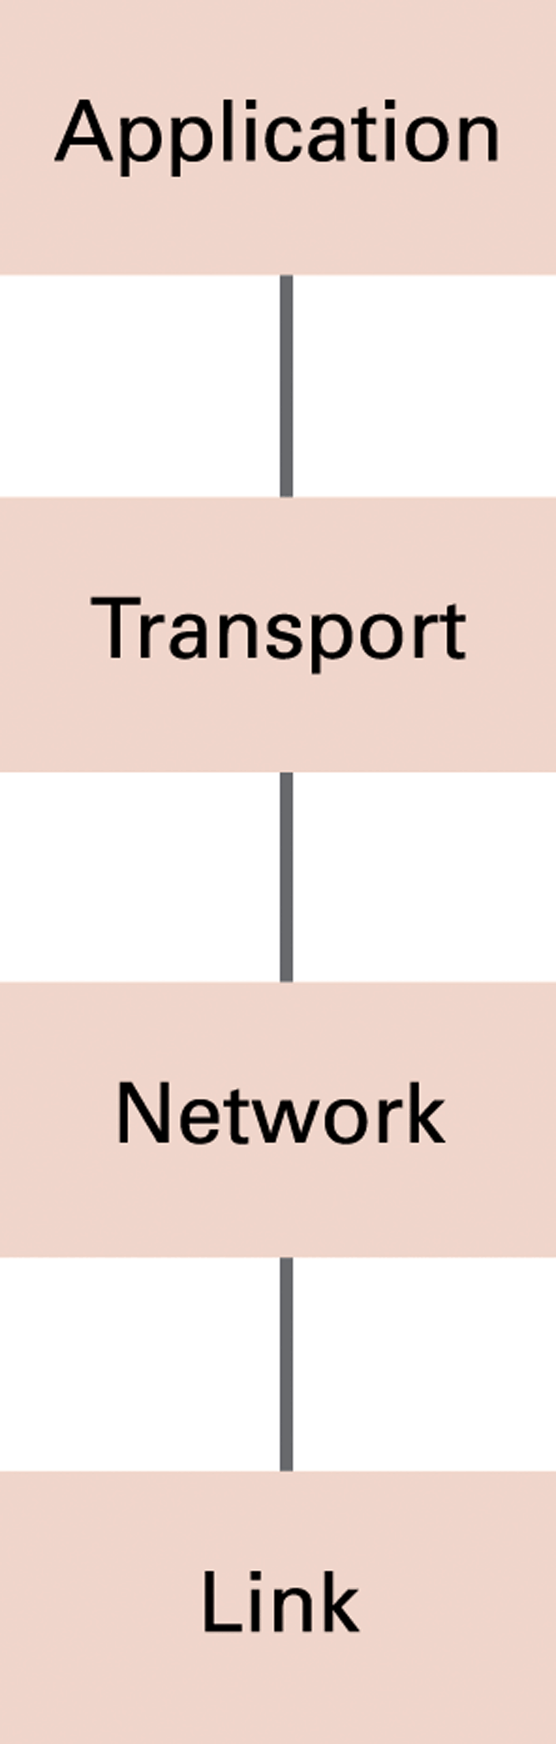
Abstract Internet software layers

Slide 46
Basics of Internet Communication
At the Transport Layer, messages broken into datagrams, also known as packets, and addressed at the IP layer:
Sequence Number
Source Address
Destination Address
Data Size
(Other fields)
Data
34
128.120.56.214
199.237.80.7
7
…
hi mom

Slide 47
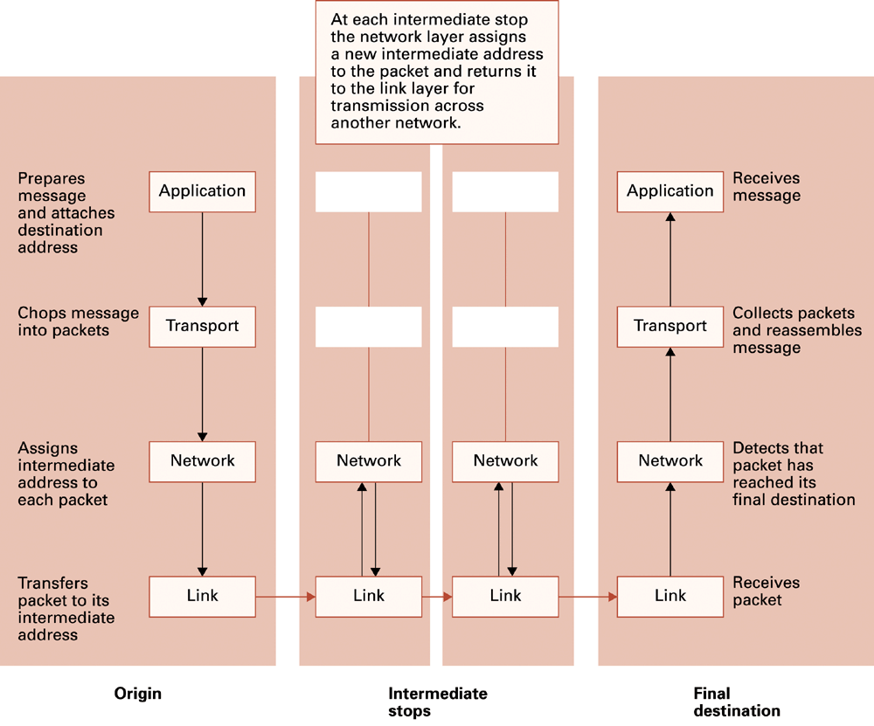
Following a message through the Internet

Slide 48
Packet Routing
Packets may travel different routes to reach their destination
Sequence number used to put data back in the original order

Slide 49
TCP/IP Protocol Suite
Transport Layer
  TCP
    Transmission Control Protocol
    Reliable but overhead to get the reliability
    Used with email, retrieving web pages, etc.
  UDP
    User Datagram Protocol
    Unreliable but less overhead / more efficient
    Used for streaming video/audio, DNS requests
Network Layer
  IP (IPv4 and IPv6)

Slide 50
Network Example: Traceroute
Traceroute: A program that allows the the tracing of packets over the Internet or any network using TCP/IP protocol.
  Uses a special number - TTL (Time to Live) - contained in a place at the beginning of each packet sent over the network.
    The number is originally set to 255.
    Each time it is received by a router, it decrements by 1.
    If the TTL number becomes 0 before reaching its destination, the router where this happened sends back an error message (time exceeded) with the address of the router.
      Stops messages from circulating forever.

Slide 51
Tracing the router hops…
On Windows: tracert <dest> This is an OLD traceroute:
Tracing route to www.alaska.net [209.112.131.196] over a maximum of 30 hops:
1 431 ms 440 ms 421 ms uaa-du-02.alaska.edu [137.229.98.66]
2 350 ms 341 ms 300 ms r98-99-e1.alaska.edu [137.229.98.99]
3 361 ms 340 ms 381 ms swf-7507-1 [137.229.254.21]
4 300 ms 341 ms 300 ms m40 [137.229.2.1]
5 290 ms 321 ms 320 ms uacore1-ge-0-0-0-0.pnw-gigapop.net [198.32.40.129]
6 411 ms 401 ms 390 ms westincore1-so-0-1-0-0.pnw-gigapop.net [198.48.91.33]
7 431 ms 380 ms 441 ms westinnsp2-GE1-0.pnw-gigapop.net [198.32.170.17]
8 631 ms 440 ms 461 ms p1-1-2-2.a07.sttlwa01.us.ra.verio.net [204.203.3.1]
9 591 ms 640 ms 461 ms ge-6-2-0.r03.sttlwa01.us.bb.verio.net [129.250.28.1]
10 521 ms 500 ms 421 ms p4-5-0-0.r06.plalca01.us.bb.verio.net [129.250.3.89]
11 461 ms 450 ms 511 ms p4-6-0-0.r01.snjsca03.us.bb.verio.net [129.250.2.198]
12 621 ms 681 ms 620 ms p4-1-0-0.r00.lsanca01.us.bb.verio.net [129.250.2.114]
13 611 ms 661 ms 621 ms p1.att.r00.lsanca01.us.bb.verio.net [129.250.9.34]
14 601 ms 541 ms 531 ms gbr3-p50.la2ca.ip.att.net [12.123.28.130]
15 481 ms 421 ms 560 ms gbr4-p20.sffca.ip.att.net [12.122.2.69]
16 371 ms 420 ms 401 ms gbr3-p30.st6wa.ip.att.net [12.122.2.198]
17 400 ms 481 ms 481 ms gbr2-p10.st6wa.ip.att.net [12.122.5.166]
18 421 ms 421 ms 410 ms gar1-p370.st6wa.ip.att.net [12.123.44.62]
19 521 ms 561 ms 540 ms 12.123.203.1
20 440 ms 441 ms 501 ms 12.124.174.6
21 561 ms 440 ms 461 ms www.alaska.net [209.112.131.196]
21 hops from Anchorage to Anchorage!

Slide 52
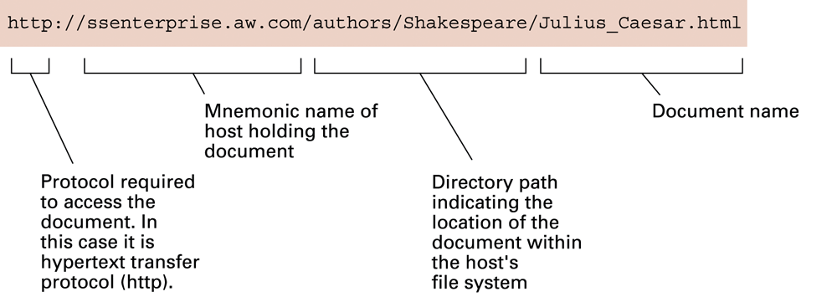
World Wide Web
Example Internet Program: Web Browser
Hypertext and HTTP
Browser gets documents from Web server
Documents identified by URLs

Slide 53
Web Browser Request
Client navigates to http://www.foo.com/index.html
www.foo.com
Client Program – Web Browser
Internet
Client sends HTTP request to www.foo.com
GET /index.html HTTP/1.0
2. Server receives request and loads index.html from disk
4. Browser renders or displays the web page (more requests may be required)
3. Server sends contents of index.html back to the client

Slide 54
Hypertext Document Format
Encoded as text file
Contains tags to communicate with browser
  Appearance
    <h1> to start a level one heading
    <p> to start a new paragraph
  Links to other documents and content
    <a href = "http://www...">Click Me</a>
  Insert images
    <img src = "mypic.jpg">

Slide 55
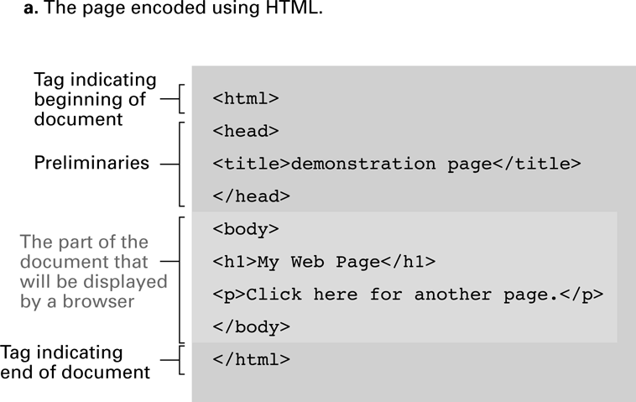
A simple Web page

Slide 56
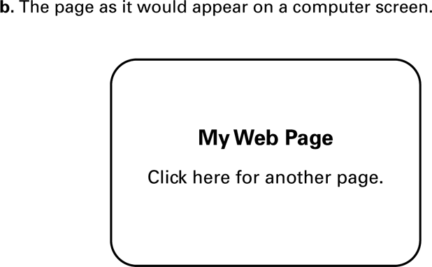
A simple Web page (continued)

Slide 57
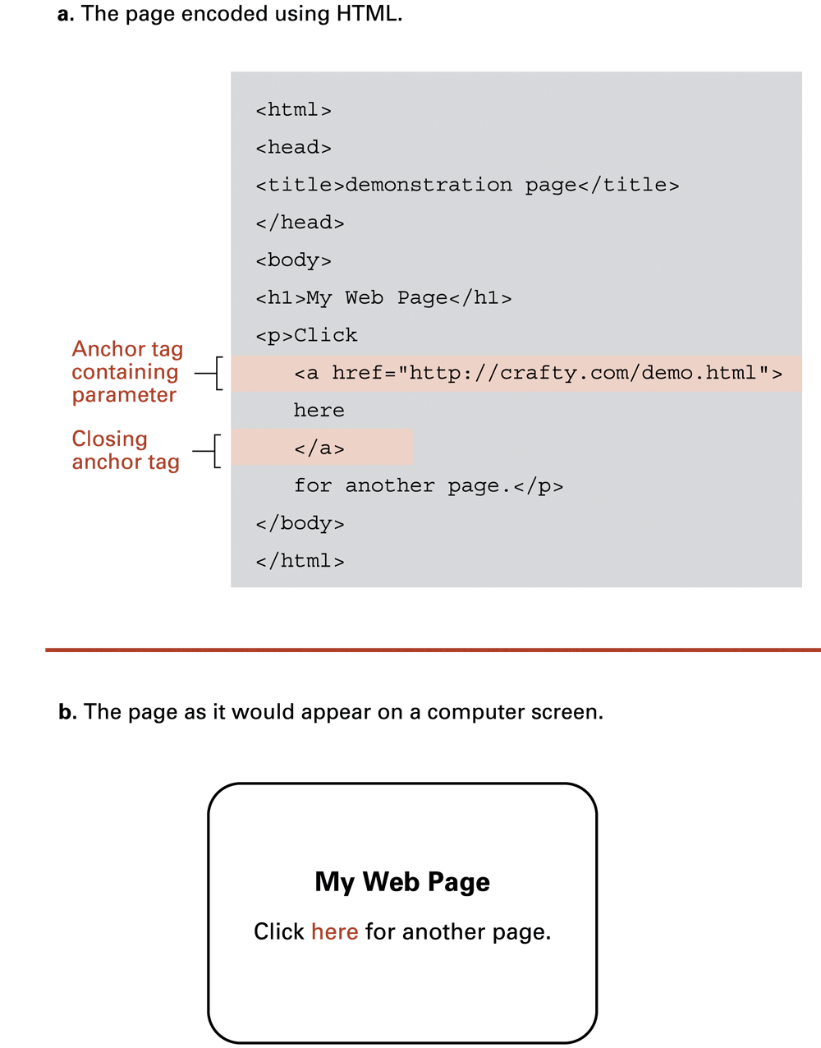
An enhanced simple Web page

Slide 58
An enhanced simple Web page (continued)

Slide 59
Programs can run on the Client Side or the Server Side
Client-side activities
  Examples: java applets, javascript, Macromedia Flash
Server-side activities
  Common Gateway Interface (CGI)
  Servlets
  PHP

Slide 60
Security
Attacks
  Malware (viruses, worms, Trojan horses, spyware, phishing software)
    Example: Erin Andrews peephole video http://www.youtube.com/watch?v=H4qbLKy32rI
  Denial of service
  Spam
Protection
  Firewalls
    Can operate at the IP or Application Layers
  Spam filters
  Antivirus software

Slide 61
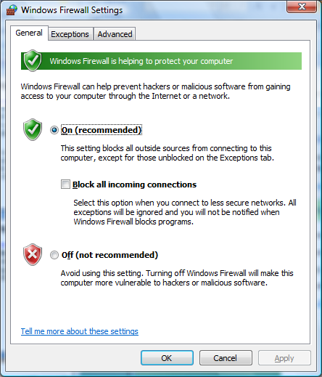
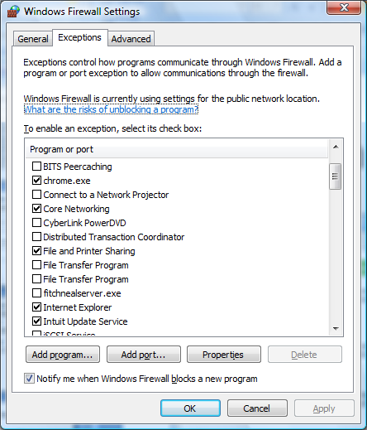
Example: Windows Firewall

Slide 62
Encryption
Data sent over a network may be vulnerable to eavesdropping
  All clients on a bus or wireless coverage receive broadcast data
  Routers along the path could piece together individual packets
  Routers along the path could change or mess with data
FTPS, HTTPS, SSL
Public-key Encryption
  Public key: Used to encrypt messages
  Private key: Used to decrypt messages
Certificates and Digital Signatures

Slide 63
Issues
Privacy
  Message is secret
Authentication
  Recipient knows the message is not a forgery
Integrity
  Message was not tampered with in transit
Nonrepudiation
  Author can’t later deny sending the message

Slide 64
Simple Encryption
Substitution cipher, assign different letter to each letter; Y=“A”, E=“Z”, S=“B” so to encrypt “YES” this becomes “AZB”
  Both sender and receiver share a secret key – the proper substitutions
Can use statistical properties to help deduce guesses
Fairly easy to break using brute force of the computer to try all possible assignments

Slide 65
Block Cipher
Takes a fixed-length block of plaintext, perhaps 64 bits, and encrypts it
Plaintext: ATTACK AT DAWN
Using blocks of 4 chars: ATTA, CK A, TDA,WN
encrypt
3Arj% AJrjA ZfjwR
Each block is usually treated as a number.
Most schemes use block ciphers.
There are some modifications to prevent repeating blocks
so someone couldn’t insert them and confuse the data.

Slide 66
Public Key Crypto
Each participant gets two keys
  Public key is made available to anyone
  Private key is kept secret
Like a safe with a slot in the top – anyone can put information in, but only the person with the combo can get it out
A’s Private
Key
Plaintext
B Encrypts
Ciphertext
A’s Public Key
A Decrypts
Plaintext
read by A

Slide 67
Authentication
Problem with the previous – anyone could have sent the message!
Solution : double encryption. Design the public and private keys so that they can encrypt or decrypt each other:
  M = Plaintext Message
  P = Public Key
  S = Secret Key
  Then: M = P(S(M)) and M=S(P(M))
That is, if we encrypt with the public key, we can decrypt it with the private key. Similarly if we encrypt with the private key, we can decrypt it with the public key.

Slide 68
Crypto Example
Bob encrypts the message M using his private key to get C1
Bob encrypts C1 using Alice’s public key to get C2 and sends it to Alice
Alice decrypts C2 using her private key to get C1
Alice decrypts C1 using Bob’s public key
  Bob sends: AlicePublic(BobPrivate(M))
  Alice decrypts: BobPublic(AlicePrivate(M))
If this all works, only Alice can read M and only Bob could have sent it! (idea of digital signature)
How is this done? Lots of math and number theory; RSA uses the idea that it is computationally hard to factor large numbers.

Slide 69
Summary
Network Fundamentals
The Internet
The World Wide Web
Internet Protocols
Security

