Slide 1
Theory of Computation

Slide 2
Theory of Computation
What is possible to compute?
We can prove that there are some problems computers cannot solve
There are some problems computers can theoretically solve, but are intractable (would take too long to compute to be practical)

Slide 3
Automata Theory
The study of abstract computing devices, or “machines.”
Days before digital computers
  What is possible to compute with an abstract machine
  Seminal work by Alan Turing
Why is this useful?
  Direct application to creating compilers, programming languages, designing applications.
  Formal framework to analyze new types of computing devices, e.g. biocomputers or quantum computers.
Covers simple to powerful computing “devices”
  Finite state automaton
  Grammars
  Turing Machine

Slide 4
Finite State Automata
Automata – plural of “automaton”
  i.e. a robot
Finite state automata then a “robot composed of a finite number of states”
  Informally, a finite list of states with transitions between the states
Useful to model hardware, software, algorithms, processes
  Software to design and verify circuit behavior
  Lexical analyzer of a typical compiler
  Parser for natural language processing
  An efficient scanner for patterns in large bodies of text (e.g. text search on the web)
  Verification of protocols (e.g. communications, security).

Slide 5
On-Off Switch Automaton
Here is perhaps one of the simplest finite automaton, an on-off switch
States are represented by circles. Edges or arcs between states indicate transitions or inputs to the system. The “start” edge indicates which state we start in.
Sometimes it is necessary to indicate a “final” or “accepting” state. We’ll do this by drawing the state in double circles

Slide 6
Gas Furnace Example
The R terminal is the hot wire and completes a circuit. When R and G are connected, the blower turns on. When R and W are connected, the burner comes on. Any other state where R is not connected to either G or W results in no action.

Slide 7
Furnace Automaton
Could be implemented in a thermostat

Slide 8
Furnace Notes
We left out connections that have no effect
  E.g. connecting W and G
Once the logic in the automata has been formalized, the model can be used to construct an actual circuit to control the furnace (i.e., a thermostat).
The model can also help to identify states that may be dangerous or problematic.
  E.g. state with Burner On and Blower Off could overhead the furnace
  Want to avoid this state or add some additional states to prevent failure from occurring (e.g., a timeout or failsafe )

Slide 9
Often Used for Video Game AI
Computer AI player for a sentry guarding two locations
At Location Y?
Player dead?
Player in sight?
March to Location X
Attack Player
March to Location Y
Player in sight?
At Location X?

Slide 10
Example
Design a finite state automaton that determines if some input sequence of bits has an odd number of 1’s

Slide 11
Grammars
Grammars provide a different “view” of computing than automata
  Describes the “Language” of what is possible to generate
  Often grammars are identical to automata
Example: Odd finite state automaton
  Could try to describe a grammar that generates all possible sequences of 1’s and 0’s with an odd number of 1’s

Slide 12
Grammar Example
Just like English, languages can be described by grammars. For example, below is a very simple grammar:
S→ Noun Verb-Phrase
Verb-Phrase → Verb Noun
Noun → { Kenrick, cows }
Verb → { loves, eats }
Using this simple grammar our language allows the following sentences. They are “in” the Language defined by the grammar:
Kenrick loves Kenrick
Kenrick loves cows
Kenrick eats Kenrick
Kenrick eats cows
Cows loves Kenrick
Cows loves cows
Cows eats Kenrick
Cows eats cows
Some sentences not in the grammar:
Kenrick loves cows and kenrick.
Cows eats love cows.
Kenrick loves chocolate.

Slide 13
Grammars and Languages
The “sentences” that a grammar generates can describe a particular problem or solution to a problem
Grammar provides a “cut” through the space of possible sentences – can be crude to sophisticated cuts
Grammars can represent languages that deterministic finite automaton cannot

Slide 14
Grammar Example
What can the following grammar generate?
S → 0
S → 0S1
What can the following grammar generate?
S → 1
S → Z1ZSZ1Z
Z → empty
Z → 0
Z → 0Z

Slide 15
Taxonomy of Complexity

Slide 16
Turing Machine
Finite state automatons and grammars have limitations for even simple tasks, too restrictive as general purpose computers
Enter the Turing Machine
  More powerful than either of the above
  Essentially a finite state automaton but with unlimited memory
  Although theoretical, can do everything a general purpose computer of today can do
    If a TM can’t solve it, neither can a computer

Slide 17
Turing Machines
TM’s described in 1936
  Well before the days of modern computers but remains a popular model for what is possible to compute on today’s systems
  Advances in computing still fall under the TM model, so even if they may run faster, they are still subject to the same limitations
A TM consists of a finite control (i.e. a finite state automaton) that is connected to an infinite tape.

Slide 18
Turing Machine
The tape consists of cells where each cell holds a symbol from the tape alphabet. Initially the input consists of a finite-length string of symbols and is placed on the tape. To the left of the input and to the right of the input, extending to infinity, are placed blanks. The tape head is initially positioned at the leftmost cell holding the input.
Finite control
… B B X₁ X₂ … X_{i} X_{n} B B …

Slide 19
Turing Machine Details
In one move the TM will:
  Change state, which may be the same as the current state
  Write a tape symbol in the current cell, which may be the same as the current symbol
  Move the tape head left or right one cell
  The special states for rejecting and accepting take effect immediately

Slide 20
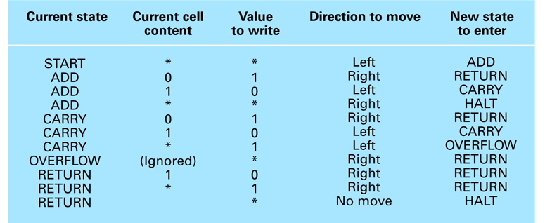
A Turing machine for incrementing a value
0
1
*

Slide 21
Equivalence of TM’s and Computers
In one sense, a real computer has a finite amount of memory, and thus is weaker than a TM.
But, we can postulate an infinite supply of tapes, disks, or some peripheral storage device to simulate an infinite TM tape. Additionally, we can assume there is a human operator to mount disks, keep them stacked neatly on the sides of the computer, etc.
Need to show both directions, a TM can simulate a computer and that a computer can simulate a TM

Slide 22
Computer Simulate a TM
This direction is fairly easy - Given a computer with a modern programming language, certainly, we can write a computer program that emulates the finite control of the TM.
The only issue remains the infinite tape. Our program must map cells in the tape to storage locations in a disk. When the disk becomes full, we must be able to map to a different disk in the stack of disks mounted by the human operator.

Slide 23
TM Simulate a Computer
In this exercise the simulation is performed at the level of stored instructions and accessing words of main memory.
  TM has one tape that holds all the used memory locations and their contents.
  Other TM tapes hold the program counter, memory address, computer input file, and scratch data.
  The computer’s instruction cycle is simulated by:
  Find the word indicated by the program counter on the memory tape.
  Examine the instruction code (a finite set of options), and get the contents of any memory words mentioned in the instruction, using the scratch tape.
  Perform the instruction, changing any words' values as needed, and adding new address-value pairs to the memory tape, if needed.

Slide 24
TM/Computer Equivalence
Anything a computer can do, a TM can do, and vice versa
TM is much slower than the computer, though
  But the difference in speed is polynomial
  Each step done on the computer can be completed in O(n²) steps on the TM
While slow, this is key information if we wish to make an analogy to modern computers. Anything that we can prove using Turing machines translates to modern computers with a polynomial time transformation.
Whenever we talk about defining algorithms to solve problems, we can equivalently talk about how to construct a TM to solve the problem. If a TM cannot be built to solve a particular problem, then it means our modern computer cannot solve the problem either.

Slide 25
Church-Turing Thesis
The functions that are computable by a Turing machine are exactly the functions that can be computed by any algorithmic means.

Slide 26
Universal Programming Language
A language with which a solution to any computable function can be expressed
  Examples: “Bare Bones” and most popular programming languages

Slide 27
The Bare Bones Language
Bare Bones is a simple, yet universal language.
Statements
  clear name;
  incr name;
  decr name;
  while name not 0 do; … end;

Slide 28
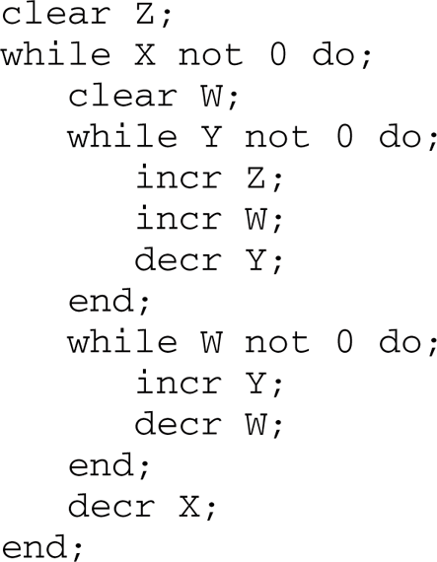
A Bare Bones program for computing X × Y

Slide 29
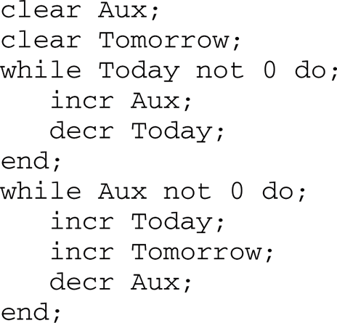
A Bare Bones implementation of the instruction “copy Today to Tomorrow”

Slide 30
The Halting Problem
Given the encoded version of any program, return 1 if the program is self-terminating, or 0 if the program is not.
First thought: Run the program to see if it halts or not. Problem?

Slide 31
Halting Tester
Yes, halts
H
Halting tester
P
No, doesn’t halt

Slide 32
Halting Tester (2)
Next we modify H to a new program H1 that acts like H, but when H prints “Yes, halts”, H1 enters an infinite loop
H1
H
Halting tester
Yes, halts
P
Infinite Loop
No, doesn’t halt

Slide 33
Halting Tester (3)
However, H1 cannot exist. If it did, what would H1(H1 ) do?
That is, we give H1 as input to itself:
H1
H
Halting tester
Yes, halts
H1
Infinite Loop
No, doesn’t halt
If H1 on the left halts, then H1 given H1 as input will enter an infinite loop and not halt, in which case it should output that it doesn’t halt. But we just supposed that H1 is supposed to halt.
The situation is paradoxical and we conclude that H1 cannot exist and this problem is undecidable.

Slide 34
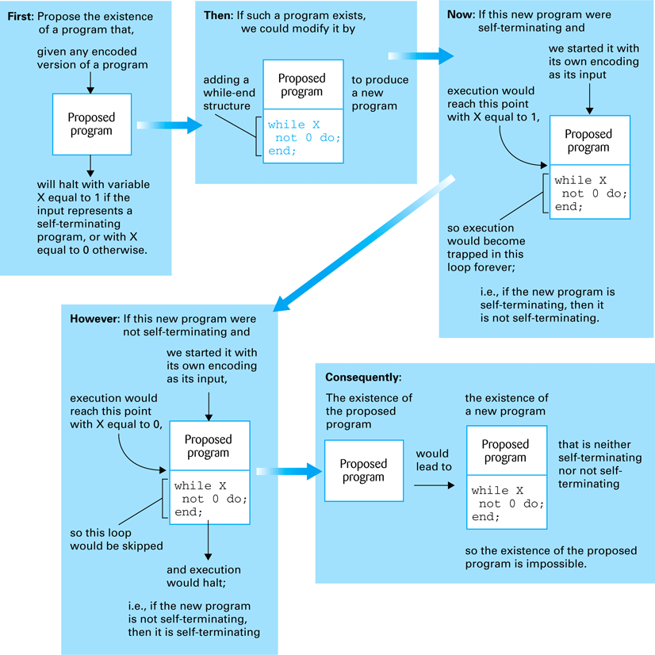
The Halting program is unsolvable

Slide 35
Complexity of Problems
Time Complexity: The number of instruction executions required
  Unless otherwise noted, “complexity” means “time complexity.”
Theta or Big-O notation
  A problem is in class Θ(f(n)) if it can be solved in some number of steps proportional to f(n)
    A problem is in class Ο(f(n)) if it can be solved in some number of steps proportional or less than f(n); i.e. f(n) is an upper bound
  Examples
    Sequential search is Θ(n)
    Binary search is Θ(lg n)
    Insertion Sort is Ο(n²)

Slide 36
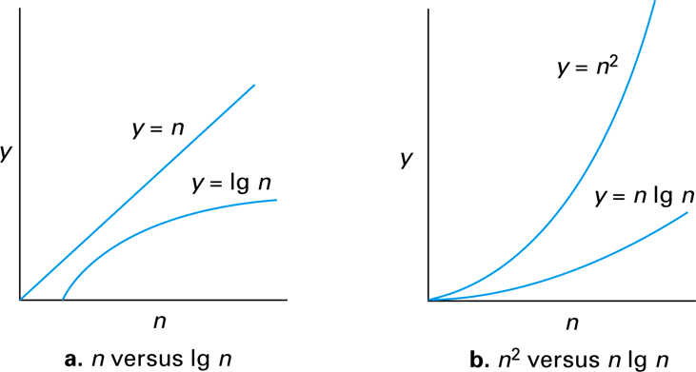
Graphs of the mathematical expressions n, lg n, n lg n, and n²

Slide 37
P versus NP
Class P: All problems in any class Θ(f(n)), where f(n) is a polynomial; problem can be solved in polynomial time
Class NP: All problems that can be solved by a nondeterministic algorithm in polynomial time
  Nondeterministic algorithm = an algorithm described by a Turing Machine that could be in multiple states at the same time
  Given a proposed solution to a problem, can verify if the proposed solution is an actual solution in polynomial time.
Whether the class NP is bigger than class P is currently unknown.

Slide 38
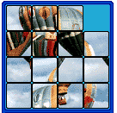

NP ⊇ P
NP is obviously a superset of P
But many problems appear to be in NP but not in P
  E.g., consider a “sliding tile” puzzle
Solve in polynomial time? (e.g. function of # of tiles)
But given a proposed solution, easy to verify if it is correct in
polynomial time

Slide 39
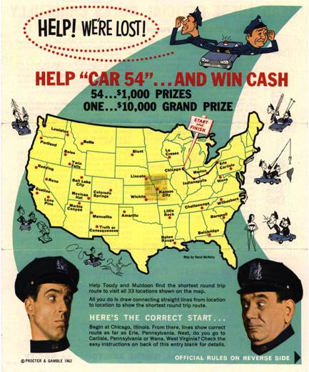
29 Node Traveling Salesperson Problem
29! = 8.8 trillion billion billion possible asymmetric routes.
ASCI White, an IBM supercomputer being used by Lawrence Livermore National Labs to model nuclear explosions, is capable of 12 trillion operations per second (TeraFLOPS) peak throughput
Assuming symmetric routes, ASCI White would take 11.7 billion years to exhaustively search the solution space

Slide 40
The Big Question
Is there anything in NP that is not in P?
We know that P ⊆ NP
But it is unknown if P = NP
Most people believe that P ≠ NP due to the existence of problems in NP that are in the class NPC, or NP Complete
The Clay Mathematics Institute has offered a million dollar prize to anyone that can prove that P=NP or that P≠NP

