Slide 1
Intro to C#

Slide 2
Programming Coverage
Methods, Classes, Arrays
Iteration, Control Structures
Variables, Expressions
Data Types

Slide 3
Course Design
Instead
Lecture not a rehash of the book but covers same concepts from a different perspective
Lots of hands-on activities
Attempt at relevance

Slide 4
Bend Your Brain Into Submission
Slow down. The more you understand the less you have to memorize.
Do the book’s exercises. Write your own notes.
Make this the last thing you read before bed, or the last challenging thing.
Drink lots of water.

Slide 5
Bend Your Brain Into Submission
Talk about it. Out loud.
Listen to your brain. Pay attention when it feels overloaded or you find yourself skimming.
Feel something. Your brain needs to feel that it matters.
Write a lot of software!

Slide 6
Intro to Computing
(From C# Software Solutions)

Slide 7
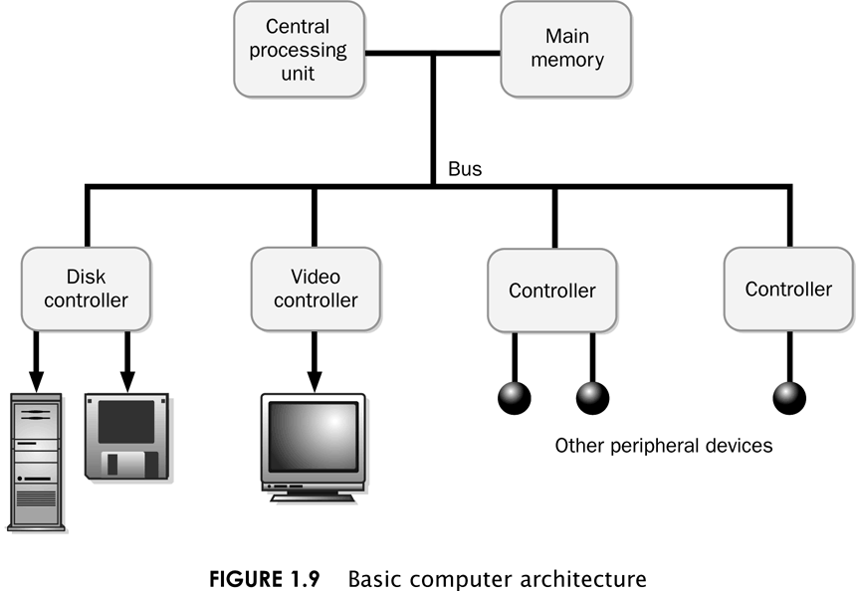

Slide 8
The CPU
Fetches instructions from main memory
Carries out the operations commanded by the instructions
Each instruction produces some outcome
A program is an entire sequence of instructions
Instructions are stored as binary numbers
Binary number - a sequence of 1’s and 0’s

Slide 9
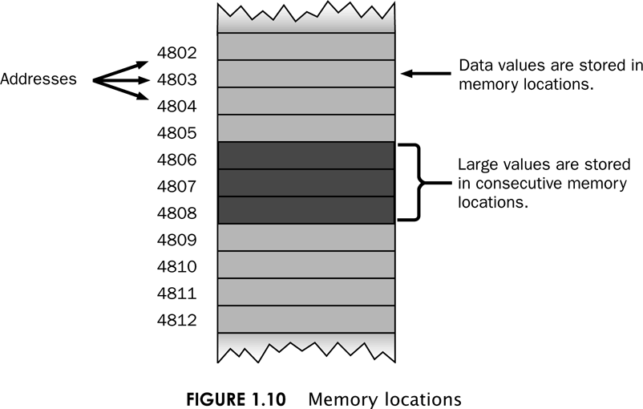
Main Memory – a big list of addresses

Slide 10
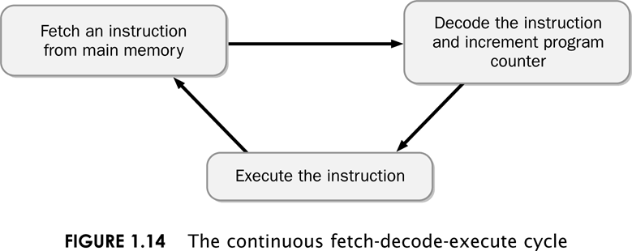
The Fetch-Decode Execute Cycle

Slide 11
Knowing About: Computer Hardware
Bit: smallest and most basic data item in a computer; represents a 0 or a 1
Byte: a grouping of eight bits
E.g., 00010001
What does this represent?
Word: a grouping of one or more bytes

Slide 12
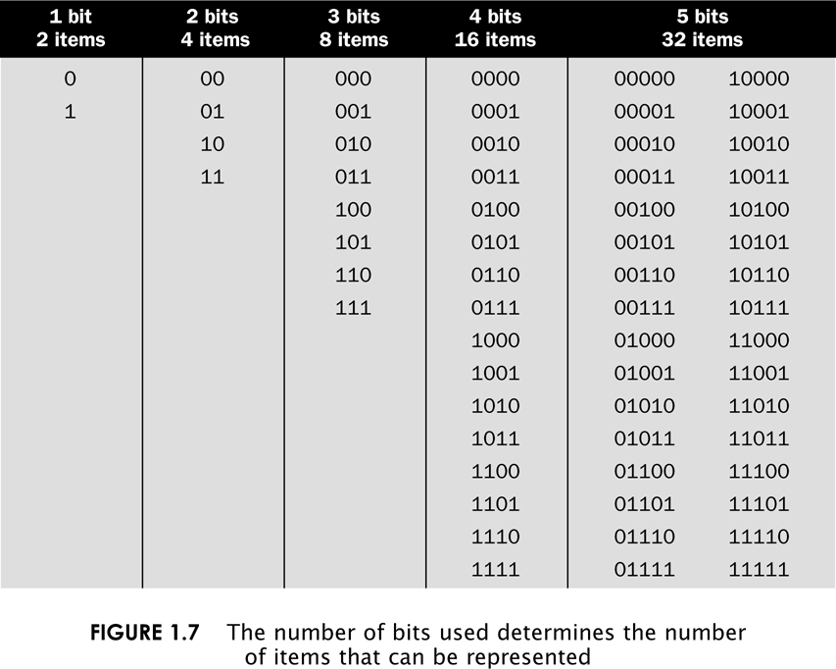

Slide 13
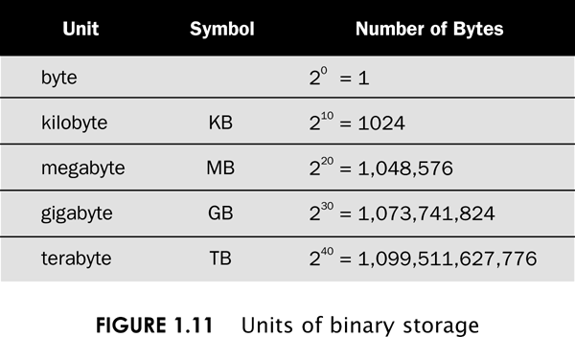

Slide 14
Bits could represent characters

Slide 15
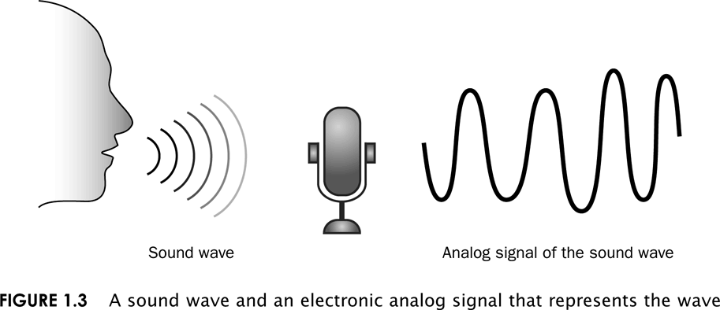
Bits could represent sound
We said that 00010001 could represent
anything, a number, sound, color, etc.

Slide 16
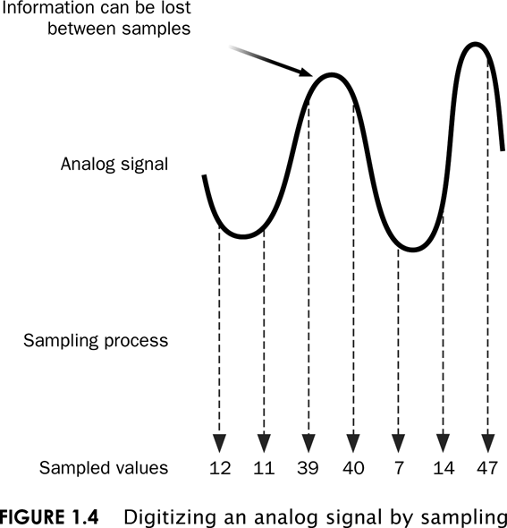

Slide 17
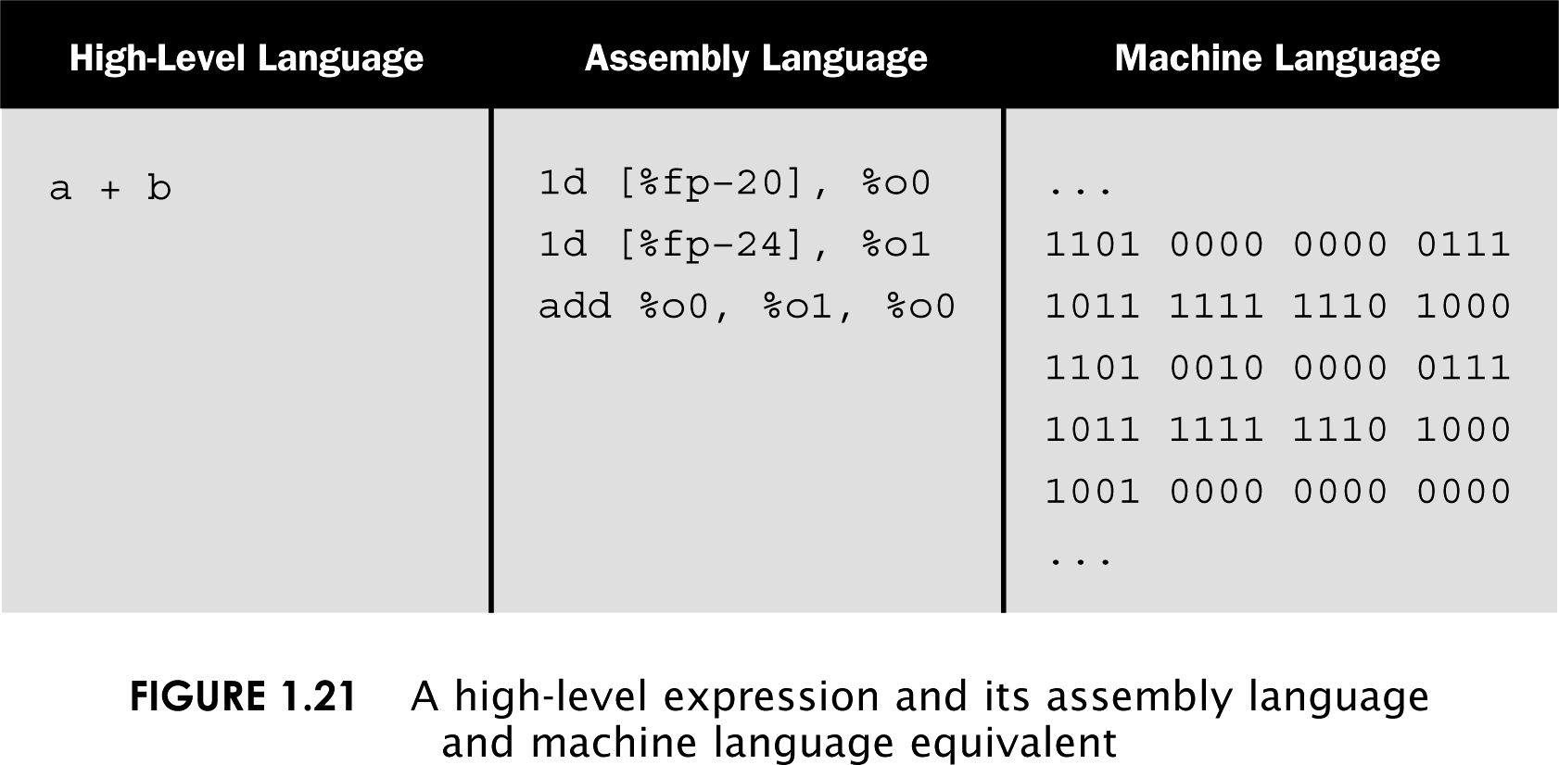
Layers of Programming Languages
A program called a compiler translates from high-level to machine language

Slide 18
Layers of Software Systems
Applications
Operating
System
BIOS
CPU

Slide 19
The .NET Platform
C# .NET is in a sense one step removed from a typical high-level language
C# runs using a “Virtual Machine” or “Common Language Runtime”
The physical computer simulates a virtual computer that runs your program
.NET Software
.NET Software
.NET Program

Slide 20
Why a virtual machine?
More robust to failure
Bad programs crash the virtual machine, not the real machine
Easier to deploy software written for the virtual machine
If a virtual machine exists for Macs or Linux or Windows, then the same program can run anywhere (not the case yet for C# but same idea with Java)

Slide 21
.NET Framework
C# VB.NET C++.NET Other
Visual
Studio
.NET
Common Language Specification
Framework Class Library
ASP.NET
Windows Forms
Web Services
Web Forms
Controls
Drawing
ASP.NET Application Services
Windows Application Services
ADO.NET
XML
Threading
IO
Network
Security
Diagnostics
Etc.
Common Language Runtime
Memory Management
Common Type System
Lifecycle Monitoring
Operating System

Slide 22
C# Demonstration
How to start Visual Studio
Create a new project
Add textboxes, labels, buttons
Adjust font properties, colors
How to run your project
Where to find your files and compress them into a zip file (for submitting homework)
How to open your saved project (double-click the .sln file)

