Slide 1
Instruction-Level Parallelism
CS448

Slide 2
Instruction Level Parallelism (ILP)
Pipelining
  Limited form of ILP
  Overlapping instructions, these instructions can be evaluated in parallel (to some degree)
  Pipeline CPI = Idea pipeline CPI + Structural Stalls + RAW stalls + WAR stalls + WAW stalls + Control Stalls
Focus now on the Control Stalls!
  Methods to reduce the control stalls
  Will use both hardware and software (i.e. compiler) methods

Slide 3
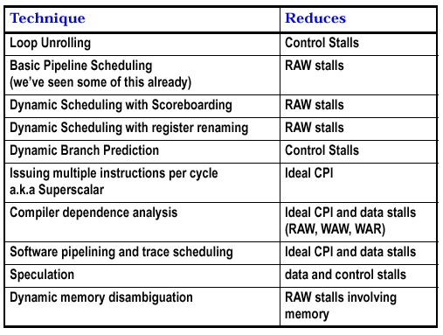
Techniques

Slide 4
ILP and Basic Blocks
Basic Block
  Straight line code without any branches except entry and exit
  I.e. real code consists of multiple basic blocks connected via branches
Branch frequency was 15%
  If evenly distributed, this means a branch every six or seven instructions
  Means basic blocks are pretty small, not too much to exploit for parallelism
  To get better performance we must exploit ILP across multiple basic blocks
Easiest target is the LOOP

Slide 5
Loop Level Parallelism
Trivial Example
  for (i=1; i<=1000; i++)
  x[i] = x[i] + y[i];
Note
  No dependence between data values in iteration i and iteration i+1, so each loop iteration is truly independent
  We could execute all 1000 of these in parallel if we could!
  Since independent, No data hazards → No stalls
  BUT
    There is a branch to implement the loop, ruining all this nice parallelism
    The prediction is pretty easy here, but in general it may be more difficult
Vector Processor Model
  If we could execute four adds in parallel, we could have a loop up to 250 and simultaneously add x[i], x[i+1], x[i+2], x[i+3]

Slide 6
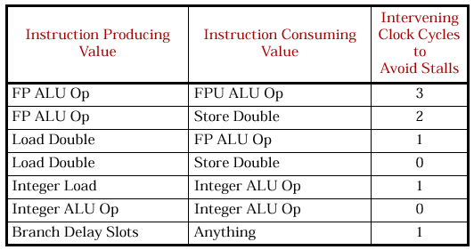
Assumptions - Latency
Assume we need the following intervening cycles to avoid stalls

Slide 7
Loop with a Scalar
Adding a scalar value within a loop:
  for (i=1000; i>0; i--)
  x[i] = x[i] + s;
Convert to MIPS
  R2 precomputed to store last address of x to operate on
  Loop: L.D F0, 0(R1) ; F0 gets x[i]
  ADD.D F4, F0, F2
  S.D 0(R1), F4
  DADDUI R1, R1, #-8 ; doubleword
  BNE R1,R2, Loop ; Repeat if R1!=R2
Let’s see how this loop executes without any special scheduling

Slide 8
No Scheduling – Loop w/ Scalar
Loop: L.D F0,0(R1) Cycle 1
stall Cycle 2
ADD.D F4, F0, F2 Cycle 3
stall Cycle 4
stall Cycle 5
S.D 0(R1), F4 Cycle 6
DADDUI R1, R1, #-8 Cycle 7
stall Cycle 8
BNE R1, R2,Loop Cycle 9
stall Cycle 10
Total of 10 clocks per iteration!
For 1000 iterations, 10000 cycles

Slide 9
Optimized, Scheduled Version
  Original: L.D F0, 0(R1) ; F0 gets x[i]
  ADD.D F4, F0, F2
  S.D 0(R1), F4
  DADDUI R1, R1, #-8 ;doubleword
  BNE R1, R2, Loop ;Repeat
Move S.D after BNE into the delay slot, move DADDUI up!
  New: L.D F0, 0(R1) ; F0 gets x[i]
  stall
  ADD.D F4, F0, F2
  DADDUI R1, R1, #-8
  stall
  BNE R1, R2, Loop ; Repeat
  SD 8(R1), F4
Have to add 8 as SD’s offset because we already subtracted 8 off!
From 10 to 7 cycles per iteration (7000 cycles total)
Not a trivial computation, many compilers won’t do this

Slide 10
Loop Unrolling
In the previous example, there were 3 cycles that did work in the loop (LD, SW, ADD) and 3 cycles that were just overhead to control the loop (SUB, BNE, stall)
To get more instructions doing work relative to control instructions
  We need to make our loop body larger
  Can do this be replicating the loop body multiple times, and adjusting the loop termination code
    Obviously can’t do it for the entire loop, if the loop iteration is high
  Called loop unrolling
    Tradeoff: Longer code, but higher ILP

Slide 11
Loop Unrolling Example
Four copies of the loop body per iteration
Loop: L.D F0, 0(R1)
ADD.D F4, F0, F2
S.D 0(R1), F4 ; Drop DADDUI and BNEZ
L.D F6, -8(R1)
ADD.D F8, F6, F2
S.D -8(R1), F8 ; Drop DADDUI and BNEZ
L.D F10, -16(R1)
ADD.D F12, F10, F2
S.D -16(R1), F12 ; Drop DADDUI and BNEZ
LD F14, -24(R1)
ADDD F16, F14, F2
SD -24(R1), F16
DADDUI R1, R1, #-32
BNE R1, R2, Loop
Without scheduling, a stall after every instruction, 28 cycles per iteration,
28*250 = 7000 cycles total

Slide 12
Scheduling the Unrolled Loop
Loop: L.D F0, 0(R1)
L.D F6, -8(R1)
L.D F10,-16(R1)
L.D F14,-24(R1)
ADD.D F4, F0, F2
ADD.D F8, F6, F2
ADD.D F12, F10, F2
ADD.D F16, F14, F2
S.D 0(R1), F4
S.D -8(R1), F8
DADDUI R1, R1, #-32
S.D 16(R1), F12
BNE R1, R2, Loop
S.D 8(R1), F16 ; -24=8-32
Shuffle unrolled loop instead of concatenating
No stalls! Must incorporate previous tricks of filling the delay slot
14 instructions, 14*250 = 3500 cycles total

Slide 13
Stuff to Notice
Eight unused registers
  Could have unrolled 8 instead of 4 loop iterations without any register conflicts
  What if we have a remainder? E.g. our loop was 1002, not evenly divisible by 4
  Just compute the extra N mod L blocks independently before or after the unrolled loop
Tricky to unroll the loop, even this simple one
  3 types of dependence: data, name, and control

Slide 14
Data Dependence
Occurs when either
  Instruction I produces a result used by instruction J
  Instruction J is data dependent on instruction K, and instruction K is data dependent on instruction I
    L.D F0, 0 (R1)
    ADD.D F4, F0, F2
    S.D 0(R1), F4
  or
    DADDUI R1, R1, #-8
    BNE R1, R2, Loop
Introduces possible RAW hazards
  Whether there is an actual hazard depends on the pipeline, forwarding mechanisms, split cycle, etc.
Compiler identifies these with static dataflow analysis

Slide 15
Name Dependence
Occurs when
  2 instructions use the same register name without a data dependence
If I precedes J
  I is antidependent on J when J writes a register that I reads
    a WAR hazard
    ordering must be preserved to avoid the hazard
  I is output dependent on J if both I and J write to the same register
    WAW hazard
E.g. occurs if we unroll a loop but don’t changing the register names
  This can be solved by renaming registers via the compiler, or we can also do this dynamically

Slide 16
Name Dependence Example
Part of unrolled loop, always going to F0:
Loop: L.D F0, 0(R1)
ADD.D F4, F0, F2
S.D 0(R1), F4
L.D F0, -8(R1)
ADD.D F4, F0, F2
S.D -8(R1), F4
Name dependencies force execution stalls to avoid potential WAW or WAR problems
Eliminated by renaming the registers as in earlier example

Slide 17
Control Dependences
Occurs when
  Conditional branch exists and we have instructions after the branch that may or may not be executed
Constraints to maintain dependencies
  instructions controlled by the branch cannot be moved before the branch (e.g. put part of a “then” before the “if”)
  an instruction not controlled by the branch cannot be moved after the branch (e.g. put a statement before the “if” and put it into the “then”)
Once in a while we can violate these constraints and get away with it…

Slide 18
Preserving Control Dependence
Should preserve the exception behavior
  Assume no delay branches
  No data dependence in the following:
    BEQZ R2, SomeLabel
    LW R1,0(R2)
  Safe to move this to the following?
    LW R1,0(R2)
    BEQZ R2, SomeLabel
  If we ignore the control dependence, if the load instruction generates an exception (e.g. memory protection fault) we get a different behavior

Slide 19
Preserving Control Dependence
Should preserve the data flow
  Assume no delay branches
    ADD R1, R2, R3
    BEQZ R4, L
    SUB R1, R5, R6
    L: OR R7, R1, R8
  R1 in the OR depends on if we took the branch or not
  OR is also data dependent on the ADD, SUB
  Must preserve the control dependence of the SUB on the branch to prevent an illegal change to the data flow

Slide 20
Some Examples
for (i=1; i<=100; i++) {
A[i+1]=A[i]+C[i]; // S1
B[i+1]=B[i]+A[i+1]; // S2
}
Can usually find dependences via source code
Observations of dependencies:
S1 uses S1 value produced in an earlier iteration
S2 uses S2 value produced in an earlier iteration
S2 uses an S1 value produced in the same iteration
Implications:
Values dependent on the earlier iteration are called
loop carried dependent; order must be preserved
non- loop carried dependences we can try and execute in
parallel (but not in this case, due to other dependency)

Slide 21
One More Example
for (i=1; i<=100; i++) {
A[i]=A[i]+B[i]; // S1
B[i+1]=C[i]+D[i]; // S2
}
S1 uses previous value of S2, but despite the loop-carried dependence this is not circular, since neither statement depends on itself
S2 doesn’t depend on S1
Implies S2 can be moved!
No more loop carried dependence so we can unroll the loop and expect good performance gains!
A variety of these transformations possible, but tricky
A[1]=A[1]+B[1]
for (i=1; i<=99; i++) {
B[i+1]=C[i]+D[i];
A[i+1]=A[i+1]+B[i+1];
}
B[101]=C[100]+D[100]

Slide 22
Instruction-Level Parallelism
Dynamic Branch Prediction

Slide 23
Reducing Branch Penalties
Previously discussed – static schemes
  Move branch calculation earlier in pipeline
  Static branch prediction
    Always taken, not taken
  Delayed branch
  Loop unrolling
    Good, but limited to loops
This section – dynamic schemes
A more general dynamic scheme that can be used with all branches
  Dynamic branch prediction

Slide 24
Dynamic Branch Prediction
Becomes crucial to any processor that tries to issue more than one instruction per cycle
  Scoreboard, Tomasulo’s algorithm we will see later operate on a basic block (no branches)
    Possible to extend Tomasulo’s algorithm to include branches
  Just not enough instructions in a basic block to get the superscalar performance
Result
  Control dependencies can become the limiting factor
    Hard for compilers to deal with, so may be ignored, resulting in a higher frequency of branches
  Amdahl’s Law too
    As CPI decreases the impact of control stalls increases

Slide 25
Branch Prediction Buffer
Simplest Scheme – one bit Branch Prediction Buffer (BPB) aka Branch History Table (BHT)
Idea
  Take low order bits of the address of branch instruction, and store a branch prediction in the BHT
  Can be implemented in a fashion very similar to cache
Instruction Stream
10F00: LD R1, 1000(R0)
10F04: BEQZ L1
BHT
Set bit to
actual result
of the branch
00 Taken
…
04 Not Taken
..
FF Taken
Get from PC

Slide 26
Simple and Effective, But…
Aliasing Problem
  branches with same lower order bits will reference the same entry if we get unlucky, causing mutual prediction
  Counter-argument: there’s no guarantee that a prediction is right so it might not matter
  Avoidance
    Same ideas as in caching
    Make the table bigger
      Not much of a problem since it’s only a single bit we are storing
    Can try other cache strategies as well, like set-associative mapping
Shortcomings with loops
  always mispredict twice for every loop
    Mispredict upon exiting a loop, since this is a surprise
    If we repeat the loop, we’ll miss again since we’ll predict to not take the branch
    Book example: branch taken 90% of time predicted 80% accuracy

Slide 27

Solution to Loops – N bit Prediction
Use a finite state automata with 2^{n} states
Called an n-bit prediction
Most common is to use 2 bits, giving 4 states
  Example below will only miss on exit
NT
Predict taken
11
Predict taken
10
T
T
T
NT
NT
Predict not taken
01
Predict not taken
00
NT
T

Slide 28
Implementation
Separate Branch History Cache Buffer
  associated with the IF stage (using the PC) but we don’t know if this is a branch until the ID stage
    but IF stage knows the target address and hence the index
    at ID if it’s a branch then the prediction goes into effect
    This is still useful for most pipelines
  Not useful for pipeline in our improved MIPS example
    branch resolution happens in ID stage for improved MIPS (in EX for original MIPS)
    so this model doesn’t improve anything for the improved MIPS, we would need the predicted branch by the ID stage so we could be fetching it while decoding! Possible to always fetch or decode branches in IF but then this makes the IF stage longer
Instruction cache extension
  hold the bits with the instruction in the Instruction Cache as an early branch indicator
  Increased cost since the bits will take up space for non- branch instructions as well

Slide 29
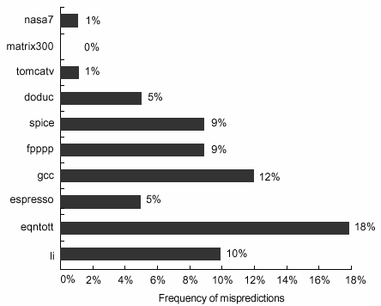
Does It Work?
SPEC89
Prediction accuracy for 4K two-bit prediction buffer
Somewhat misleading for the scientific programs (top three)

Slide 30
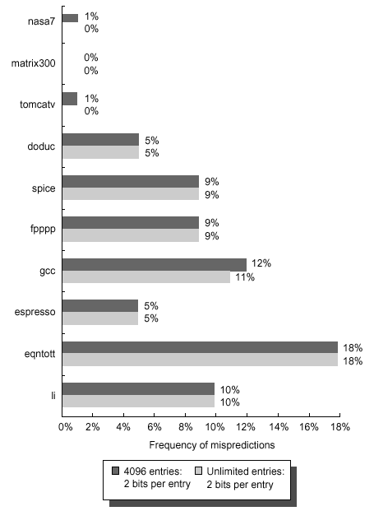
Increased Table Size
Increasing the table size helps with caching, does it help here?
We can simulate branch prediction quite easily. The answer is NO compared to an unlimited size table!
Performance bottleneck is the actual goodness of our prediction algorithm

Slide 31
Improving Branch Prediction
Let’s look at an example of the types of branches that our scheme performed poorly on
  if (aa==2) aa=0;
  if (bb==2) bb=0;
  if (aa!=bb) { …. }
If the first two branches are not taken, then we will always take the third
  But our branch prediction scheme for the third branch is based on the prior history of the third branch only, not on the behavior of other branches!
  Will never capture this behavior with the existing model
Solution
  Use a correlating predictor, or what happened on the previous (in a dynamic sense, not static sense) branch
  Not necessarily a good predictor (consider spaghetti code)

Slide 32
Example – Correlating Predictor
Consider the following code fragment
  if (d==0) d=1;
  if (d==1) { … }
Typical code generated by this fragment
  BNEZ R1, L1 ; check if d==0 B1
  ADDI R1, R0, #1 ; d←1
  L1: SEQI R3, R1, #1 ; Set R3 if R1==1
  BNEZ R3, L2 ; Skip if d!=1 B2
  L2: …
Let’s look at all the possible outcomes based on the value of d going into this code

Slide 33
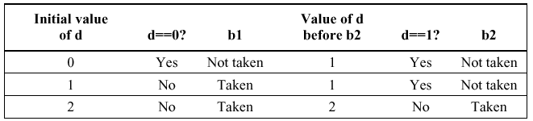
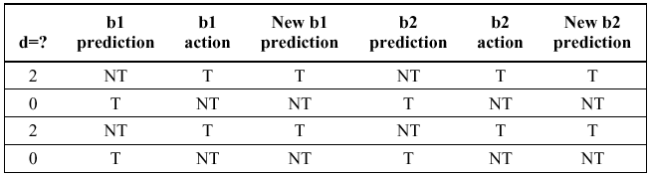
Example – Correlating Predictor
Any value not 0 or 1
If b1 not taken, then b2 not taken, all the time!
Worst-case sequence: all predictions fail!

Slide 34
Solution – Use correlator
Use a predictor with one bit of correlation
  i.e. we remember what happened with the last branch to predict the current branch
  Think of this as the last branch has two separate prediction bits
    One bit assuming the last branch was taken
    One bit assuming the last branch was not taken
Pair the prediction bits: first bit is the prediction if the last branch is not taken, second bit is the prediction if the last branch is taken
Leads to 4 possibilities: which way the last one went chooses the prediction
  (Last-taken, last-not-taken) X (predict-taken, predict-not-taken)

Slide 35
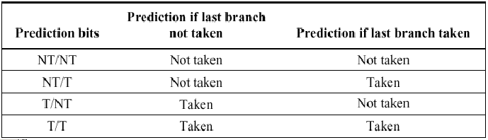
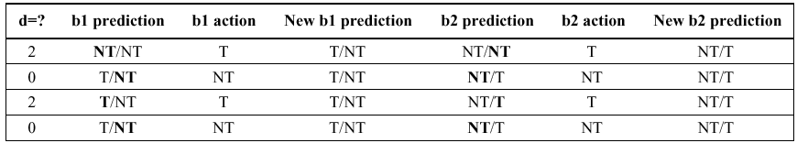
Single Correlator
Notation a bit confusing since we have two interpretations
taken/not-taken : for what really happened last branch, and prediction
Behavior using one-bit of correlation : every branch correct except first
Start in NT/NT state for both branches; prediction in bold

Slide 36
Predictors in General
Previous example a (1,1) predictor
  Used last 1 branches, with a 1 bit predictor
Can generalize to a (m, n) predictor
  M = number of previous last branches to consider
    Results in 2^{m} branch predictors, each using n bits
  Total number of bits needed
    2^{m} * n * Number_of_entries_selected_in_table
    E.g. (2, 2) with 16 entries = 128 bits
      Shown on next slide
  Can implement in hardware without too much difficulty
    Some shifters needed to select entries
  (1,1) and (2,2) and (0,2) the most interesting/common selections

Slide 37
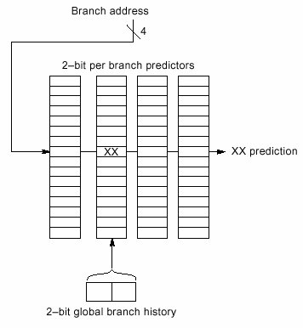
(2,2) buffer with 2 bit history

Slide 38
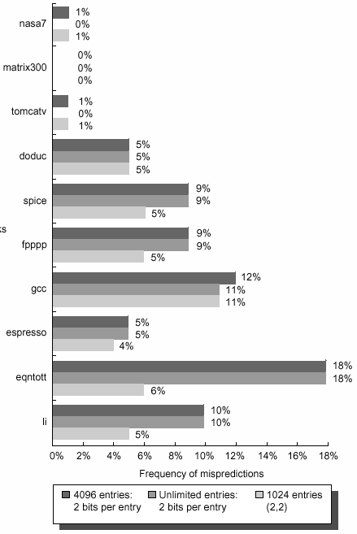
Performance of Predictors?
SPEC 89 Benchmark
Improves performance, but of course with the extra cost
Note no improvement in first few cases, but no decrease in performance either
Big win here!

Slide 39
Branch Target Buffers
How can we use branch prediction on improved MIPS?
  As indicated earlier, we need the branch target during the IF stage
  But we don’t know it’s a branch until ID … stuck?
  Solution
    Use the address of the current instruction to determine if it is a branch! Recall we have the Branch History Buffer
BHT
Instruction Stream
10F04: BEQZ L1
00 Taken
…
04 Not Taken
..
FF Taken
Will change and rename to Branch Target Buffer/Cache
Get from PC

Slide 40
Branch Target Buffer
Need to change a bit from Branch History Table
  Store the actual Predicted PC with the branch prediction for each entry
  If an entry exists in the BTB, this lets us look up the Predicted PC during the IF stage, and then use this Predicted PC for the IF of the next instruction during the ID of the branch instruction

Slide 41
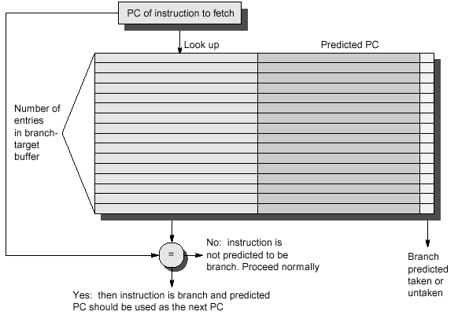
BTB Diagram

Slide 42
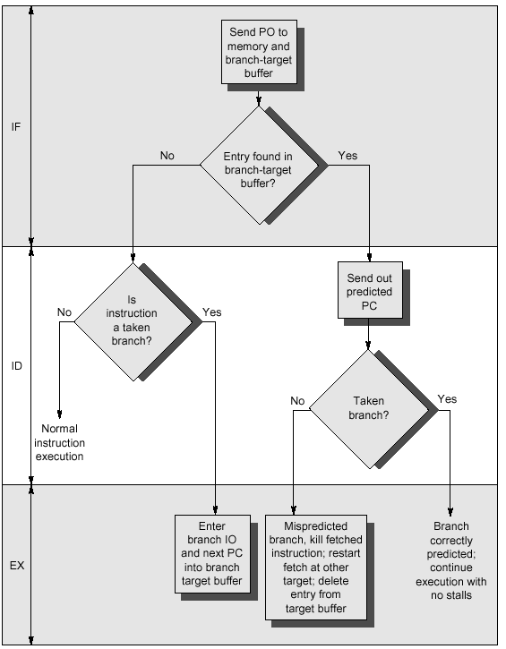
Steps in our MIPS Arch
This really means
correct prediction

Slide 43
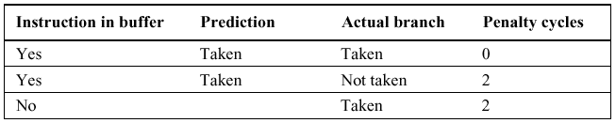
Penalties
Branch penalties for incorrect predictions are shown below
  No delay if prediction correct
  Two cycle penalty if incorrect
    One to discover the wrong branch was taken
    One to update the buffer (might be able to overlap this with other stages)
Penalty not too bad here, but much worse for many other machines (e.g. with longer pipelines)

Slide 44
Other Improvements
Branch Folding
  Store the target instruction in the cache, not the address
  We can then start executing this instruction directly instead of having to fetch it!
    Branch “disappears” for unconditional branches
    Will then update the PC during the EX stage
    Used with some VLIW architectures (e.g. CRISP)
    Increases buffer size, but removes an IF stage
    Complicates hardware
Predict Indirect Jumps
  Dynamic Jumps, target changes
  Used most frequently for Returns
  Implies a stack, so we could try a stack-based prediction scheme, caching the recent return addresses
  Can combine with folding to get Indirect Jump Folding
Predication
  Do the If and Else at the same time, select correct one later

Slide 45
Branch Prediction Summary
Active Research Topic
  Tons of papers and ideas coming out on branch prediction
    Easy to simulate
    Easy to forget about costs
  Motivation is real though
    Mispredicted branches are a large bottleneck and a small percent improvement in prediction can lead to larger overall speedup
    Intel has claimed that up to 30% of processor performance gets tossed out the window because of those 5-10% wrong branches
Basic concepts presented here used in one form or another in most systems today

Slide 46
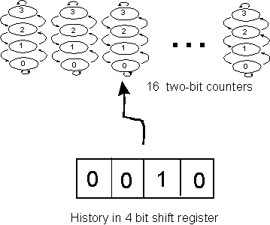
Example – Intel Pentium Branch Prediction
Two level branch prediction scheme
  1. Four bit shift register, indicates last 4 branches
  2. Sixteen 2-bit counters (the FSA we saw earlier)
  The shift register selects which of the 16 counters to use
Advantage: remembers history and can learn patterns of branches
Consider 1010 (T/NT)
History shifts:
1010 → 0101 → 1010 → 0101
Update 5th and 10th counters

Slide 47
ILP Summary
 | Software Solution | Hardware Solution
Data Hazards | Pipeline Scheduling Register Renaming | Scoreboarding Tomasulo’s Algo
Structural Hazards | Pipeline Scheduling | More Functional Units
Control Hazards | Static Branch Prediction Pipeline Scheduling – Delayed Branch Loop Unrolling | Dynamic Branch Prediction / Correlation Branch Folding Predication

