Slide 1
CUDA Misc
Mergesort, Pinned Memory, Device Query, Multi GPU

Slide 2
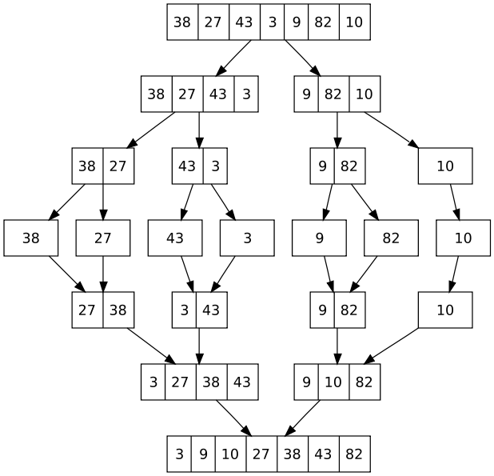
Parallel Mergesort
O(N) runtime with memory copy overhead
Not really worth it compared to O(NlgN) sequential version but an interesting exercise
Regular mergesort

Slide 3
CUDA Mergesort
Split portion
Assign each thread to a number in the unsorted array
Example: 2 blocks, 4 threads per block
index = threadIdx.x + (blockIdx.x * blockDim.x)
e.g. index = 3 + (1 * 4) = 7 for Block1 Thread 3
B0T0
B0T1
B0T2
B0T3
B1T0
B1T1
B1T2
B1T3
38
27
43
3
9
82
15
37
Merge split into two phases
First phase: Sort each block by merging into shared memory
B0T0
B0T2
B1T0
B1T2
27
38
3
43
9
82
15
37
B0T0
B1T0
3
38
27
43
9
15
37
82
Why can’t we keep doing
this for the whole array?
Notes:
Can’t synchronize across blocks, don’t know when the previous step has finished to begin the next step

Slide 4
Code to sort blocks
// This version only works for N = THREADS*BLOCKS
__global__ void sortBlocks(int *a)
{
int i=2;
__shared__ int temp[THREADS];
while (i <= THREADS)
{
if ((threadIdx.x % i)==0)
{
int index1 = threadIdx.x + (blockIdx.x * blockDim.x);
int endIndex1 = index1 + i/2;
int index2 = endIndex1;
int endIndex2 = index2 + i/2;
int targetIndex = threadIdx.x;
int done = 0;
while (!done)
{
if ((index1 == endIndex1) && (index2 < endIndex2))
temp[targetIndex++] = a[index2++];
else if ((index2 == endIndex2) && (index1 < endIndex1))
temp[targetIndex++] = a[index1++];
else if (a[index1] < a[index2])
temp[targetIndex++] = a[index1++];
else
temp[targetIndex++] = a[index2++];
if ((index1==endIndex1) && (index2==endIndex2))
done = 1;
}
}
__syncthreads();
a[threadIdx.x + (blockIdx.x*blockDim.x)] = temp[threadIdx.x];
__syncthreads();
i *= 2;
}
}

Slide 5
Code for main
int main()
{
int a[N];
int *dev_a, *dev_temp;
cudaMalloc((void **) &dev_a, N*sizeof(int));
cudaMalloc((void **) &dev_temp, N*sizeof(int));
// Fill array
srand(time(NULL));
for (int i = 0; i < N; i++)
{
int num = rand() % 100;
a[i] = num;
printf("%d ",a[i]);
}
printf("\n");
// Copy data from host to device
cudaMemcpy(dev_a, a, N*sizeof(int), cudaMemcpyHostToDevice);
sortBlocks<<<BLOCKS,THREADS>>>(dev_a);
cudaMemcpy(a, dev_a, N*sizeof(int), cudaMemcpyDeviceToHost);
…

Slide 6
Merging Blocks
We now need to merge the sorted blocks
For simplicity, 1 thread per block
B0T0
B1T0
3
38
27
43
9
15
37
82
3
38
27
43
9
15
37
82
3
9
15
27
37
38
43
82
3
9
15
27
37
38
43
82
B0T0
3
3
9
9
15
15
27
27
37
37
38
38
43
43
82
82

Slide 7
Single Step of Parallel Merge
__global__ void mergeBlocks(int *a, int *temp, int sortedsize)
{
int id = blockIdx.x;
int index1 = id * 2 * sortedsize;
int endIndex1 = index1 + sortedsize;
int index2 = endIndex1;
int endIndex2 = index2 + sortedsize;
int targetIndex = id * 2 * sortedsize;
int done = 0;
while (!done)
{
if ((index1 == endIndex1) && (index2 < endIndex2))
temp[targetIndex++] = a[index2++];
else if ((index2 == endIndex2) && (index1 < endIndex1))
temp[targetIndex++] = a[index1++];
else if (a[index1] < a[index2])
temp[targetIndex++] = a[index1++];
else
temp[targetIndex++] = a[index2++];
if ((index1==endIndex1) && (index2==endIndex2))
done = 1;
}
}
temp = device memory
same size as a
sortedsize = length of
a sorted “block” (doubles
in size from original block)

Slide 8
Main code
int blocks = BLOCKS/2;
int sortedsize = THREADS;
while (blocks > 0)
{
mergeBlocks<<<blocks,1>>>(dev_a, dev_temp, sortedsize);
cudaMemcpy(dev_a, dev_temp, N*sizeof(int), cudaMemcpyDeviceToDevice);
blocks /= 2;
sortedsize *= 2;
}
cudaMemcpy(a, dev_a, N*sizeof(int), cudaMemcpyDeviceToHost);
Copy from device to device

Slide 9
MergeSort
With bigger array:
#define N 1048576
#define THREADS 512
#define BLOCKS 2048
Our implementation is limited to a power of 2 for the number of blocks and for the number of threads per block
The slowest part seems to be copying the data back to the host, is there anything we can do about that?

Slide 10
Page-Locked or Pinned Memory
The CUDA runtime offers cudaHostAlloc() which is similar to malloc
malloc memory is standard, pageable host memory
cudaHostAlloc() memory is page-locked host memory or pinned memory
The OS guarantees it will never page the memory to disk and will reside in physical memory
Faster copying to the GPU because paged memory is first copied to pinned memory then DMA copies it to the GPU
Does take away from total available system memory, may affect system performance

Slide 11
cudaHostAlloc
Instead of malloc use:
int *a;
cudaHostAlloc((void **) &a, size, cudaHostAllocDefault);
…
cudaFreeHost(a);
Won’t make much difference on our small mergesort but benchmark test with hundreds of copies:
Time using cudaMalloc: 9298.7 ms
MB/s during copy up: 2753.1
Time using cudaMalloc: 17415.4 ms
MB/s during copy down: 1470.0
Time using cudaHostAlloc: 6794.8 ms
MB/s during copy up: 3767.6
Time using cudaHostAlloc: 17167.1 ms
MB/s during copy down: 1491.2

Slide 12
Zero-Copy Host Memory
Skipping, but pinned memory allows the possibility for the GPU to directly access host memory
Requires some different flags for cudaHostAlloc
Performance win if the GPU is integrated with the host (memory shared with the host anyway)
Performance loss for data read multiple times since zero-copy memory is not cached on the GPU

Slide 13
Device Query
How do you know if you have integrated graphics?
Can use deviceQuery to see what devices you have
cudaGetDeviceCount( &count )
Stores number of CUDA-enabled devices in count
cudaGetDeviceProperties( &prop, i )
Stores device info into the prop struct for device i

Slide 14
Code
#include "stdio.h"
int main()
{
cudaDeviceProp prop;
int count;
cudaGetDeviceCount(&count);
for (int i=0; i< count; i++)
{
cudaGetDeviceProperties(&prop, i);
printf( " --- General Information for device %d ---\n", i );
printf( "Name: %s\n", prop.name );
printf( "Compute capability: %d.%d\n", prop.major, prop.minor );
printf( "Clock rate: %d\n", prop.clockRate );
printf( "Device copy overlap: " );
printf( "Integrated graphics: " );
if (prop.integrated)
printf( "True\n" );
else
printf( "False\n" );
if (prop.deviceOverlap)
printf( "Enabled\n" );
else
printf( "Disabled\n");
…

Slide 15
Using Multiple GPU’s
Can use cudaSetDevice(deviceNum) but has to run on separate threads
Fortunately this is not too bad
Thread implementation varies by OS
Simple example using pthreads
Better than fork/exec since threads share the same memory instead of a copy of the memory space

Slide 16
Thread Sample
/* Need to compile with -pthread */
#include <pthread.h>
#include <stdio.h>
#include <stdlib.h>
#include <assert.h>
typedef struct argdata
{
int i;
int return_val;
} arg_data;
void *TaskCode(void *argument)
{
int tid;
arg_data *p;
p = (arg_data *) argument;
tid = (*p).i;
printf("Hello World! It's me, thread %d!\n", tid);
p->return_val = tid;
return NULL;
}
int main ()
{
pthread_t thread1,thread2;
arg_data arg1, arg2;
/* create two threads */
arg1.i = 1;
arg2.i = 2;
pthread_create(&thread1, NULL, TaskCode, (void *) &arg1);
pthread_create(&thread2, NULL, TaskCode, (void *) &arg2);
/* wait for all threads to complete */
pthread_join(thread1, NULL);
pthread_join(thread2, NULL);
printf("Done, values in return: %d %d\n", arg1.return_val,
arg2.return_val);
return 0;
}

Slide 17
Threads with GPU Code
// Using two GPU's to increment by 1 an array of 4 integers,
// one GPU to increment the first two, the second GPU to increment the next two
// Don't need to use -pthread with nvcc
#include <pthread.h>
#include <stdio.h>
#include <stdlib.h>
#include <assert.h>
typedef struct argdata
{
int deviceID;
int *data;
} arg_data;
__global__ void kernel(int *data)
{
data[threadIdx.x]++;
}
// Use 2 threads to increment 2 integers in an array
void *TaskCode(void *argument)
{
arg_data *p;
int *dev_data;
p = (arg_data *) argument;
cudaSetDevice(p->deviceID);
cudaMalloc((void **) &dev_data, 2*sizeof(int));
cudaMemcpy(dev_data, p->data, 2*sizeof(int), cudaMemcpyHostToDevice);
kernel<<<1,2>>>(dev_data);
cudaMemcpy(p->data, dev_data, 2*sizeof(int), cudaMemcpyDeviceToHost);
cudaFree(dev_data);
return NULL;
}

Slide 18
Main
int main ()
{
pthread_t thread1,thread2;
arg_data arg1, arg2;
int a[4];
a[0] = 0; a[1] = 1; a[2] = 2; a[3] = 3;
arg1.deviceID = 0;
arg2.deviceID = 1;
arg1.data = &a[0]; // Address of first 2 ints
arg2.data = &a[2]; // Address of second 2 ints
/* create two threads */
pthread_create(&thread1, NULL, TaskCode, (void *) &arg1);
pthread_create(&thread2, NULL, TaskCode, (void *) &arg2);
/* wait for all threads to complete */
pthread_join(thread1, NULL);
pthread_join(thread2, NULL);
for (int i=0; i < 4; i++)
printf("%d ", a[i]);
printf("\n");
return 0;
}

