Slide 1
Intro to GPU’s for Parallel Computing

Slide 2
Goals for Rest of Course
Learn how to program massively parallel processors and achieve
high performance
functionality and maintainability
scalability across future generations
Acquire technical knowledge required to achieve the above goals
principles and patterns of parallel programming
processor architecture features and constraints
programming API, tools and techniques
Overview of architecture first, then introduce architecture as we go

Slide 3
Equipment
Your own, if CUDA-enabled; will use CUDA SDK in C
Compute Unified Device Architecture
NVIDIA G80 or newer
G80 emulator won’t quite work
Lab machine – uaa-csetesla.duckdns.org
Ubuntu
two Intel Xeon E5-2609 @2.4Ghz, each four cores
128 Gb memory
Two nVidia Quadro 4000’s
256 CUDA Cores
1 Ghz Clock
2 Gb memory

Slide 4
Why Massively Parallel Processors
A quiet revolution and potential build-up
2006 Calculation: 367 GFLOPS vs. 32 GFLOPS
G80 Memory Bandwidth: 86.4 GB/s vs. 8.4 GB/s
Until recently, programmed through graphics API
GPU in every PC and workstation – massive volume and potential impact
Notes:
CPU driven by sequential code performance; extracting ILP, branch prediction, ROB, out of order execution, etc.
Graphics focused on pixel-based processing, parallelism - now on every workstation, no longer just supercomputer
Size a factor for many fields, e.g. medical MRI; supercomputer in a workstation sized package

Slide 5
CPUs and GPUs have fundamentally different design philosophies
Control
ALU
ALU
ALU
ALU
CPU
GPU
Cache
DRAM
DRAM

Slide 6
Architecture of a CUDA-capable GPU
Streaming
Multiprocessor
(SM)
Building
Block
Host
Streaming
Processor
(SP)
Input Assembler
Thread Execution Manager
Parallel Data Cache
Parallel Data Cache
Parallel Data Cache
Parallel Data Cache
Parallel Data Cache
Parallel Data Cache
Parallel Data Cache
Parallel Data Cache
Texture
Texture
Texture
Texture
Texture
Texture
Texture
Texture
Texture
Load/store
Load/store
Load/store
Load/store
Load/store
Load/store
Global Memory
32 SM’s each with 8 SP’s on one Quadro 4000
Notes:
Joint CPU/GPU operation
Each SP can process a FP multiply and a FP multiply/add

Slide 7
GT200 Characteristics
1 TFLOPS peak performance (25-50 times of current high-end microprocessors)
265 GFLOPS sustained for apps such as Visual Molecular Dynamics (VMD)
Massively parallel, 128 cores, 90W
Massively threaded, sustains 1000s of threads per app
30-100 times speedup over high-end microprocessors on scientific and media applications: medical imaging, molecular dynamics
“I think they're right on the money, but the huge performance differential (currently 3 GPUs ~= 300 SGI Altix Itanium2s) will invite close scrutiny so I have to be careful what I say publically until I triple check those numbers.”
-John Stone, VMD group, Physics UIUC

Slide 8
Future Apps Reflect a Concurrent World
Exciting applications in future mass computing market have been traditionally considered “supercomputing applications”
Molecular dynamics simulation, Video and audio coding and manipulation, 3D imaging and visualization, Consumer game physics, and virtual reality products
These “Super-apps” represent and model physical, concurrent world
Various granularities of parallelism exist, but…
programming model must not hinder parallel implementation
data delivery needs careful management
Notes:
Do not go over all of the different applications. Let them read them instead.

Slide 9
Sample of Previous GPU Projects
Application | Description | Source | Kernel | % time
H.264 | SPEC ‘06 version, change in guess vector | 34,811 | 194 | 35%
LBM | SPEC ‘06 version, change to single precision and print fewer reports | 1,481 | 285 | >99%
RC5-72 | Distributed.net RC5-72 challenge client code | 1,979 | 218 | >99%
FEM | Finite element modeling, simulation of 3D graded materials | 1,874 | 146 | 99%
RPES | Rye Polynomial Equation Solver, quantum chem, 2-electron repulsion | 1,104 | 281 | 99%
PNS | Petri Net simulation of a distributed system | 322 | 160 | >99%
SAXPY | Single-precision implementation of saxpy, used in Linpack’s Gaussian elim. routine | 952 | 31 | >99%
TRACF | Two Point Angular Correlation Function | 536 | 98 | 96%
FDTD | Finite-Difference Time Domain analysis of 2D electromagnetic wave propagation | 1,365 | 93 | 16%
MRI-Q | Computing a matrix Q, a scanner’s configuration in MRI reconstruction | 490 | 33 | >99%
Notes:
LBM: Fluid simulation
About 20 versions were tried for each app.
Amdahl’s Law

Slide 10
Speedup of Applications
GeForce 8800 GTX vs. 2.2GHz Opteron 248
10× speedup in a kernel is typical, as long as the kernel can occupy enough parallel threads
25× to 400× speedup if the function’s data requirements and control flow suit the GPU and the application is optimized
Notes:
All kernels have large numbers of simultaneously executing threads
Most of the 10X kernels saturate memory bandwidth
Can get better quality as well as being faster; e.g. solve instead of approximate

Slide 11
GPU History CUDA

Slide 12
Graphics Pipeline Elements
A scene description: vertices, triangles, colors, lighting
Transformations that map the scene to a camera viewpoint
“Effects”: texturing, shadow mapping, lighting calculations
Rasterizing: converting geometry into pixels
Pixel processing: depth tests, stencil tests, and other per-pixel operations.

Slide 13
A Fixed Function GPU Pipeline
Host
CPU
Host Interface
GPU
Vertex Control
Vertex
Cache
VS/T&L
Triangle Setup
Raster
Frame
Buffer
Memory
Texture
Cache
Shader
ROP
FBI
Notes:
Shifting boundary as GPU power increases; first 3DFX Voodoo card started at Raster Ops; later VS/T&L; faster interface (AGP from PCI); then programmable starting around 2002. Functions in the pipeline stages vary with rendering algorithm

Slide 14
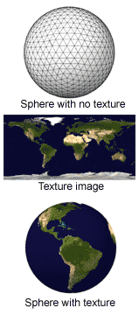
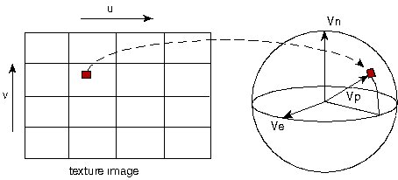
Texture Mapping Example
Texture mapping example: painting a world map texture image onto a globe object.
Notes:
Data independence of pixels provides an opportunity for parallelism

Slide 15
Anti-Aliasing Example
Triangle Geometry
Aliased
Anti-Aliased

Slide 16
Programmable Vertex and Pixel Processors
3D Application or Game
3D API Commands
CPU
3D API: OpenGL or Direct3D
CPU – GPU Boundary
GPU Command & Data Stream
Assembled Polygons, Lines, and Points
GPU
Pixel Location Stream
Vertex Index Stream
Pixel Updates
GPU Front End
Primitive Assembly
Rasterization & Interpolation
Raster Ops
Framebuffer
Pre-transformed Vertices
Transformed Vertices
Rasterized Pre-transformed Fragments
Transformed Fragments
Programmable Vertex Processor
Programmable Fragment Processor
An example of separate vertex processor and fragment processor in a programmable graphics pipeline

Slide 17
GeForce 8800 GPU
2006 – Mapped the separate programmable graphics stages to an array of unified processors
Logical graphics pipeline visits processors three times with fixed-function graphics logic between visits
Load balancing possible; different rendering algorithms present different loads among the programmable stages
Dynamically allocated from unified processors
Functionality of vertex and pixel shaders identical to the programmer
geometry shader to process all vertices of a primitive instead of vertices in isolation

Slide 18
Unified Graphics Pipeline GeForce 8800
Host
Data Assembler
Setup / Rstr / ZCull
Vtx Thread Issue
Geom Thread Issue
Pixel Thread Issue
SP
SP
SP
SP
SP
SP
SP
SP
SP
SP
SP
SP
SP
SP
SP
SP
Thread Processor
TF
L1
TF
L1
TF
L1
TF
L1
TF
L1
TF
L1
TF
L1
TF
L1
L2
L2
L2
L2
L2
L2
FB
FB
FB
FB
FB
FB
Notes:
Graphics problem turns into firing off thousands of threads

Slide 19
What is (Historical) GPGPU ?
General Purpose computation using GPU and graphics API in applications other than 3D graphics
GPU accelerates critical path of application
Data parallel algorithms leverage GPU attributes
Large data arrays, streaming throughput
Fine-grain SIMD parallelism
Low-latency floating point (FP) computation
Applications – see http://gpgpu.org
Game effects (FX) physics, image processing
Physical modeling, computational engineering, matrix algebra, convolution, correlation, sorting

Slide 20
Previous GPGPU Constraints
Dealing with graphics API
Working with the corner cases of the graphics API
Addressing modes
Limited texture size/dimension
Shader capabilities
Limited outputs
Instruction sets
Lack of Integer & bit ops
Communication limited
Between pixels
Scatter a[i] = p
per thread
per Shader
per Context
Input Registers
Fragment Program
Texture
Constants
Temp Registers
Output Registers
FB Memory
Notes:
Around DirectX9; programmer cast computation into native graphics operations; e.g. take physics problem and map it into a graphics processing rendering problem. Shader paints color onto a pixel; all it does, if you have a shader everything looks like a pixel

Slide 21
Tesla GPU
NVIDIA developed a more general purpose GPU
Can programming it like a regular processor
Must explicitly declare the data parallel parts of the workload
Shader processors → fully programming processors with instruction memory, cache, sequencing logic
Memory load/store instructions with random byte addressing capability
Parallel programming model primitives; threads, barrier synchronization, atomic operations

Slide 22
CUDA
“Compute Unified Device Architecture”
General purpose programming model
User kicks off batches of threads on the GPU
GPU = dedicated super-threaded, massively data parallel co-processor
Targeted software stack
Compute oriented drivers, language, and tools
Driver for loading computation programs into GPU
Standalone Driver - Optimized for computation
Interface designed for compute – graphics-free API
Data sharing with OpenGL buffer objects
Guaranteed maximum download & readback speeds
Explicit GPU memory management

Slide 23
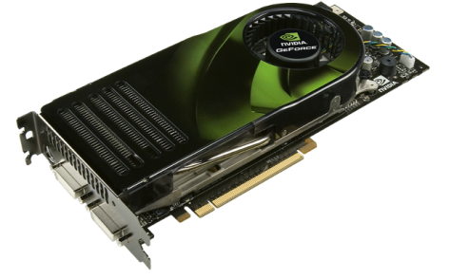
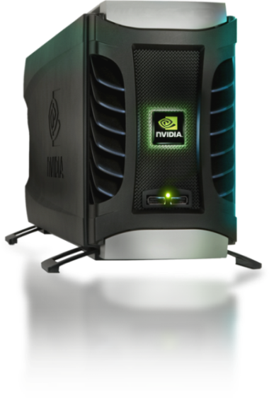
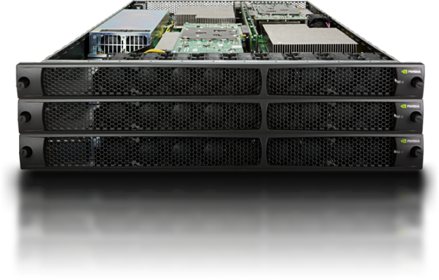
Parallel Computing on a GPU
8-series GPUs deliver 25 to 200+ GFLOPS on compiled parallel C applications
Available in laptops, desktops, and clusters
GPU parallelism is doubling every year
Programming model scales transparently
Programmable in C with CUDA tools
Multithreaded SPMD model uses application data parallelism and thread parallelism
GeForce 8800
Tesla D870
Tesla S870

Slide 24
Overview
CUDA programming model – basic concepts and data types
CUDA application programming interface - basic
Simple examples to illustrate basic concepts and functionalities
Performance features will be covered later

Slide 25
CUDA – C with no shader limitations!
Integrated host+device app C program
Serial or modestly parallel parts in host C code
Highly parallel parts in device SPMD/SIMT kernel C code
Serial Code (host)‏
Parallel Kernel (device)‏
KernelA<<< nBlk, nTid >>>(args);
. . .
Serial Code (host)‏
Parallel Kernel (device)‏
KernelB<<< nBlk, nTid >>>(args);
. . .
Notes:
Sequential part often overlapped with parallel part

Slide 26
CUDA Devices and Threads
A compute device
Is a coprocessor to the CPU or host
Has its own DRAM (device memory)‏
Runs many threads in parallel
Is typically a GPU but can also be another type of parallel processing device
Data-parallel portions of an application are expressed as device kernels which run on many threads
Differences between GPU and CPU threads
GPU threads are extremely lightweight
Very little creation overhead
GPU needs 1000s of threads for full efficiency
Multi-core CPU needs only a few
Notes:
MCUDA tool can be used to utilize multicore CPU’s instead of GPU
Very small time to create GPU threads; done in hardware in a few cycles

Slide 27
G80 CUDA mode – A Device Example
Processors execute computing threads
New operating mode/HW interface for computing
Host
Input Assembler
Thread Execution Manager
Parallel Data Cache
Parallel Data Cache
Parallel Data Cache
Parallel Data Cache
Parallel Data Cache
Parallel Data Cache
Parallel Data Cache
Parallel Data Cache
Texture
Texture
Texture
Texture
Texture
Texture
Texture
Texture
Texture
Load/store
Load/store
Load/store
Load/store
Load/store
Load/store
Global Memory

Slide 28
Extended C
Type Qualifiers
global, device, shared, local, host
Keywords
threadIdx, blockIdx
Intrinsics
__syncthreads
Runtime API
Memory, symbol, execution management
Function launch
__device__ float filter[N];
__global__ void convolve (float *image) {
__shared__ float region[M];
...
region[threadIdx] = image[i];
__syncthreads()
...
image[j] = result;
}
// Allocate GPU memory
void *myimage = cudaMalloc(bytes)
// 100 blocks, 10 threads per block
convolve<<<100, 10>>> (myimage);

Slide 29
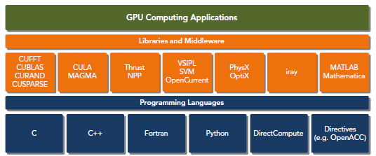
CUDA Platform

Slide 30
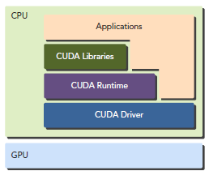
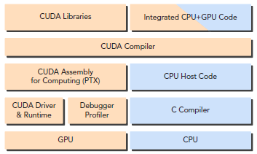
CUDA Platform

Slide 31
Arrays of Parallel Threads
A CUDA kernel is executed by an array of threads
All threads run the same code (SPMD)‏
Each thread has an ID that it uses to compute memory addresses and make control decisions
threadID
0
1
2
3
4
5
6
7
…
float x = input[threadID];
float y = func(x);
output[threadID] = y;
…

Slide 32
Thread Blocks: Scalable Cooperation
Divide monolithic thread array into multiple blocks
Threads within a block cooperate via shared memory, atomic operations and barrier synchronization
Threads in different blocks cannot cooperate
Up to 65535 blocks, 512 threads/block
Thread Block 0
Thread Block 1
Thread Block N - 1
threadID
0
1
2
3
4
5
6
7
0
1
2
3
4
5
6
7
0
1
2
3
4
5
6
7
…
float x = input[threadID];
float y = func(x);
output[threadID] = y;
…
…
float x = input[threadID];
float y = func(x);
output[threadID] = y;
…
…
float x = input[threadID];
float y = func(x);
output[threadID] = y;
…
…
Notes:
Analogy to street addresses

Slide 33
Block IDs and Thread IDs
We launch a “grid” of “blocks” of “threads”
Each thread uses IDs to decide what data to work on
Block ID: 1D, 2D, or 3D
Usually 1D or 2D
Thread ID: 1D, 2D, or 3D
Simplifies memory addressing when processing multidimensional data
Image processing
Solving PDEs on volumes
…

Slide 34
CUDA Memory Model Overview
Global memory
Main means of communicating R/W Data between host and device
Contents visible to all threads
Long latency access
We will focus on global memory for now
Constant and texture memory will come later
Grid
Block (0, 0)‏
Block (1, 0)‏
Shared Memory
Shared Memory
Registers
Registers
Registers
Registers
Thread (0, 0)‏
Thread (1, 0)‏
Thread (0, 0)‏
Thread (1, 0)‏
Host
Global Memory

Slide 35
CUDA Device Memory Allocation
cudaMalloc()
Allocates object in the device Global Memory
Requires two parameters
Address of a pointer to the allocated object
Size of allocated object
cudaFree()
Frees object from device Global Memory
Pointer to freed object
Grid
Block (0, 0)‏
Block (1, 0)‏
Shared Memory
Shared Memory
Registers
Registers
Registers
Registers
Thread (0, 0)‏
Thread (1, 0)‏
Thread (0, 0)‏
Thread (1, 0)‏
Host
Global
Memory
DON’T use a CPU pointer in a GPU function !

Slide 36
CUDA Device Memory Allocation (cont.)‏
Code example:
Allocate a 64 * 64 single precision float array
Attach the allocated storage to Md
“d” is often used to indicate a device data structure
TILE_WIDTH = 64;
float* Md;
int size = TILE_WIDTH * TILE_WIDTH * sizeof(float);
cudaMalloc((void**)&Md, size);
cudaFree(Md);

Slide 37
CUDA Host-Device Data Transfer
cudaMemcpy()
memory data transfer
Requires four parameters
Pointer to destination
Pointer to source
Number of bytes copied
Type of transfer
Host to Host
Host to Device
Device to Host
Device to Device
Non-blocking/asynchronous transfer
Grid
Block (0, 0)‏
Block (1, 0)‏
Shared Memory
Shared Memory
Registers
Registers
Registers
Registers
Thread (0, 0)‏
Thread (1, 0)‏
Thread (0, 0)‏
Thread (1, 0)‏
Host
Global
Memory

Slide 38
CUDA Host-Device Data Transfer (cont.)
Code example:
Transfer a 64 * 64 single precision float array
M is in host memory and Md is in device memory
cudaMemcpyHostToDevice and cudaMemcpyDeviceToHost are symbolic constants
cudaMemcpy(Md, M, size, cudaMemcpyHostToDevice);
cudaMemcpy(M, Md, size, cudaMemcpyDeviceToHost);

Slide 39
CUDA Keywords

Slide 40
CUDA Function Declarations
Executed on the:
Only callable from the:
__device__ float DeviceFunc()‏
device
device
__global__ void KernelFunc()‏
device
host
__host__ float HostFunc()‏
host
host
__global__ defines a kernel function
Must return void

Slide 41
CUDA Function Declarations (cont.)‏
__device__ functions cannot have their address taken
For functions executed on the device:
No recursion
No static variable declarations inside the function
No variable number of arguments

Slide 42
Calling a Kernel Function – Thread Creation
A kernel function must be called with an execution configuration:
__global__ void KernelFunc(...);
dim3 DimGrid(100, 50); // 5000 thread blocks
dim3 DimBlock(4, 8, 8); // 256 threads per block
size_t SharedMemBytes = 64; // 64 bytes of shared memory
KernelFunc<<< DimGrid, DimBlock, SharedMemBytes >>>(...);
Any call to a kernel function is asynchronous from CUDA 1.0 on, explicit synch needed for blocking

Slide 43
Next Time
Code example

