Slide 1
Instruction-Level Parallelism Dynamic Scheduling
CS448

Slide 2
Dynamic Scheduling
Static Scheduling – Compiler rearranging instructions to reduce stalls
Dynamic Scheduling – Hardware rearranges instruction stream to reduce stalls
Possible to account for dependencies that are only known at run time - e. g. memory reference
Simplifies the compiler
Code built for one pipeline in mind could also run efficiently on a different pipeline
minimizes the need for speculative slot filling - NP hard
Once a common tactic with supercomputers and mainframes but was too expensive for single-chip
Now fits on a desktop PC’s

Slide 3
Dynamic Scheduling
Dependencies that are close together stall the entire pipeline
DIVD F0, F2, F4
ADDD F10, F0, F8
SUBD F12, F8, F14
The ADD needs the DIV to finish, so there is a stall… which also stalls the SUBD
Looong stall for DIV
But the SUBD is independent so there is no reason why we shouldn’t execute it
Or is there?
Precise Interrupts - Ignore for now
Compiler could rearrange instructions, but so could the hardware

Slide 4
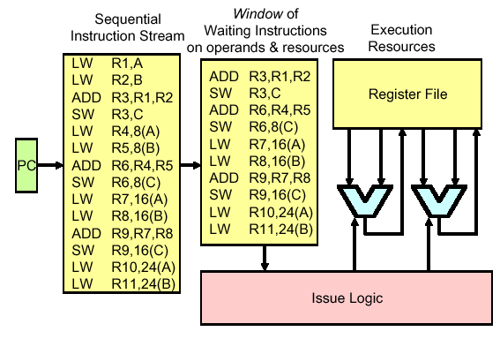
Dynamic Scheduling
It would be desirable to decode instructions into the pipe in order but then let them stall individually while waiting for operands before issue to execution units.
Dynamic Scheduling – Out of Order Issue / Execution
Scoreboarding

Slide 5
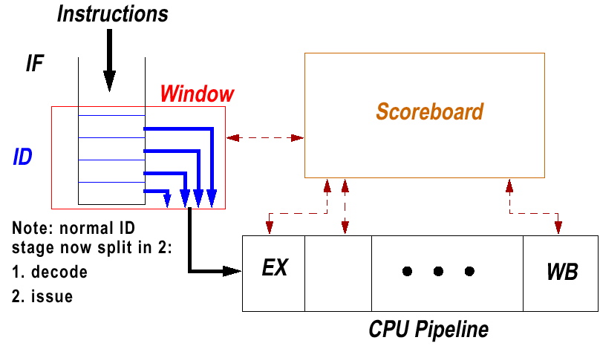
Scoreboarding
Split ID stage into two:
Issue (Decode, check for Structural hazards)
Read Operands (Wait until no data hazards, read operands)

Slide 6
Scoreboard Overview
Consider another example:
DIVD F0, F2, F4
ADDD F10, F0, F8 ; RAW Hazard
SUBD F8, F8, F14 ; WAR Hazard
Note:
We may still have to stall in the Scoreboard
SUBD wouldn’t have to wait if we had a different register other than F8
MIPS Pipeline changes again
Ignore MEM and IF stages for now to focus on the scoreboard

Slide 7
Scoreboard and the CDC
Introduced on CDC 6600
4 Floating Point Units, 5 Memory, 7 Integer Units
Load/Store architecture
Results
70 to 150% improvement
Good since this cost over $1 million
Recall this is an old machine with no cache, pipelining, primitive compilers
Fastest machine of the time
Back today in IBM, Sun machines, similar concepts in Intel chips

Slide 8
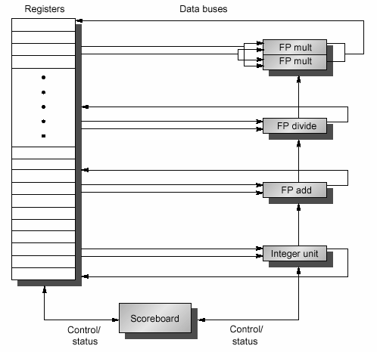
MIPS Scoreboard
Two MULT units
Note: Need a lot
more buses

Slide 9
New Pipeline Steps
Ignoring IF, and MEM
Issue
If functional unit free and no other active instruction has the same destination register, issue the instruction to the functional unit
Stall for WAW hazards or structural hazards
Nothing out of order yet
Read Operands
Monitor source operands, if available for an active instruction, then send to the functional unit to execute
Instructions get out of order at this step, dynamic RAW resolution
Execution
Starts when operands ready, notifies scoreboard when done
Write Result
Stall for WAR hazards before writing result back to register file
IF
EX
WB

Slide 10
Scoreboard Data Structure
Instruction Status
Indicates which of the four steps the instruction is in (Issue, Read Operands, Execute Complete, Write Result)
The capacity of the instruction status is the window size
Functional Unit Status
Busy : Yes/No indicates if busy or not
Op: Operation to perform, e.g. Add or Subtract
F_{i} : Destination Register
F_{j}, F_{k} : Source Registers
Q_{j}, Q_{k} : Functional Units producing source register j, k
R_{j}, R_{k} : Yes/No indicates if source j or k is ready or not, set to NO after operands are read
Register Result Status
For each register, indicates the Functional Unit that will write to it
Blank means nothing will write to it
Note overlap of this info with Q/F fields, but indexed by register, not instr

Slide 11
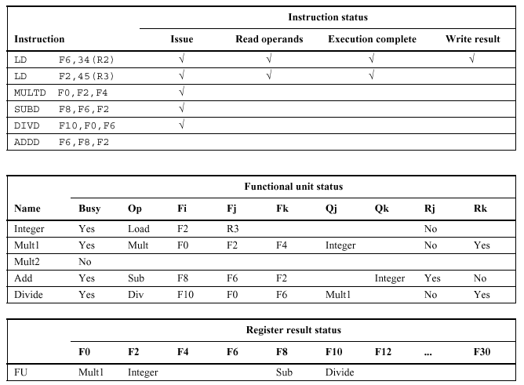
Example Scoreboard

Slide 12
Scoreboard Example
Assume the following EX latencies
FP Add = 2 clock cycles
FP Mult = 10 clock cycles
FP Div = 40 clock cycles
Assume entire code fragment (basic block) fits in the window
Also assume the code fragment is already loaded
Issue Rules
Issue maximum 1 instruction per cycle
Clearing hazards will depend on the pipeline structure

Slide 13
MIPS Scoreboarding Rules
Issue
If FU not busy (no structural hazards) and no result pending for destination register (no WAW hazards) then
Assign FU entry
Set operand source in scoreboard, indicate if ready or not
Read Operands
If source1 and source2 are both “ready” (no RAW hazards) then
Set ready=No for both, read registers, and start EX
Execute
Notify scoreboard when complete
Writeback
If none of the functional units needs to use our result register and has yet to read it (no WAR hazards) then
Set ready=Yes for any functional unit sources waiting for this FU
write the register file, clear the FU status, and clear our destination’s register result pending entry.
Stages must stall for hazards

Slide 14
Scoreboard – Cycle 1
Instr | Issue | Read Operands | Exec Complete | Write Result
LD F6, 34(R2) | 1
LD F2, 45(R3)
MULTD F0, F2, F4
SUBD F8, F6, F2
DIVD, F10, F0, F6
ADDD F6, F8, F2
IS
Name | Busy | Op | Fi | Fj | Fk | Qj | Qk | Rj | Rk
Integer | Yes | LD | F6 |  | R2 |  |  |  | Yes
Mult1
Mult2
Add
Divide
FS
 | F0 | F2 | F4 | F6 | F8 | F10 | F12 | … | F30
FU |  |  |  | Int
RRS

Slide 15
Scoreboard – Cycle 2
Instr | Issue | Read Operands | Exec Complete | Write Result
LD F6, 34(R2) | 1 | 2
LD F2, 45(R3)
MULTD F0, F2, F4
SUBD F8, F6, F2
DIVD, F10, F0, F6
ADDD F6, F8, F2
IS
Name | Busy | Op | Fi | Fj | Fk | Qj | Qk | Rj | Rk
Integer | Yes | LD | F6 |  | R2 |  |  |  | Yes
Mult1
Mult2
Add
Divide
FS
 | F0 | F2 | F4 | F6 | F8 | F10 | F12 | … | F30
FU |  |  |  | Int
Issue 2nd LD?
RRS

Slide 16
Scoreboard – Cycle 3
Instr | Issue | Read Operands | Exec Complete | Write Result
LD F6, 34(R2) | 1 | 2 | 3
LD F2, 45(R3)
MULTD F0, F2, F4
SUBD F8, F6, F2
DIVD, F10, F0, F6
ADDD F6, F8, F2
IS
Name | Busy | Op | Fi | Fj | Fk | Qj | Qk | Rj | Rk
Integer | Yes | LD | F6 |  | R2 |  |  |  | No
Mult1
Mult2
Add
Divide
FS
 | F0 | F2 | F4 | F6 | F8 | F10 | F12 | … | F30
FU |  |  |  | Int
Issue Mult?
RRS

Slide 17
Scoreboard – Cycle 4
Instr | Issue | Read Operands | Exec Complete | Write Result
LD F6, 34(R2) | 1 | 2 | 3 | 4
LD F2, 45(R3)
MULTD F0, F2, F4
SUBD F8, F6, F2
DIVD, F10, F0, F6
ADDD F6, F8, F2
IS
Name | Busy | Op | Fi | Fj | Fk | Qj | Qk | Rj | Rk
Integer | Yes | LD | F6 |  | R2 |  |  |  | No
Mult1
Mult2
Add
Divide
FS
 | F0 | F2 | F4 | F6 | F8 | F10 | F12 | … | F30
FU
RRS

Slide 18
Scoreboard – Cycle 5
Instr | Issue | Read Operands | Exec Complete | Write Result
LD F6, 34(R2) | 1 | 2 | 3 | 4
LD F2, 45(R3) | 5
MULTD F0, F2, F4
SUBD F8, F6, F2
DIVD, F10, F0, F6
ADDD F6, F8, F2
IS
Name | Busy | Op | Fi | Fj | Fk | Qj | Qk | Rj | Rk
Integer | Yes | LD | F2 |  | R3 |  |  |  | Yes
Mult1
Mult2
Add
Divide
FS
 | F0 | F2 | F4 | F6 | F8 | F10 | F12 | … | F30
FU |  | Int
RRS

Slide 19
Scoreboard – Cycle 6
Instr | Issue | Read Operands | Exec Complete | Write Result
LD F6, 34(R2) | 1 | 2 | 3 | 4
LD F2, 45(R3) | 5 | 6
MULTD F0, F2, F4 | 6
SUBD F8, F6, F2
DIVD, F10, F0, F6
ADDD F6, F8, F2
IS
Name | Busy | Op | Fi | Fj | Fk | Qj | Qk | Rj | Rk
Integer | Yes | LD | F2 |  | R3 |  |  |  | Yes
Mult1 | Yes | Mult | F0 | F2 | F4 | Int |  | No | Yes
Mult2
Add
Divide
FS
 | F0 | F2 | F4 | F6 | F8 | F10 | F12 | … | F30
FU | Mul | Int
RRS

Slide 20
Scoreboard – Cycle 7
Instr | Issue | Read Operands | Exec Complete | Write Result
LD F6, 34(R2) | 1 | 2 | 3 | 4
LD F2, 45(R3) | 5 | 6 | 7
MULTD F0, F2, F4 | 6
SUBD F8, F6, F2 | 7
DIVD, F10, F0, F6
ADDD F6, F8, F2
IS
Name | Busy | Op | Fi | Fj | Fk | Qj | Qk | Rj | Rk
Integer | Yes | LD | F2 |  | R3 |  |  |  | No
Mult1 | Yes | Mult | F0 | F2 | F4 | Int |  | No | Yes
Mult2
Add | Yes | Sub | F8 | F6 | F2 |  | Int | Yes | No
Divide
FS
 | F0 | F2 | F4 | F6 | F8 | F10 | F12 | … | F30
FU | Mul | Int |  |  | Add
Read Mult operands?
RRS

Slide 21
Scoreboard – Cycle 8a
Instr | Issue | Read Operands | Exec Complete | Write Result
LD F6, 34(R2) | 1 | 2 | 3 | 4
LD F2, 45(R3) | 5 | 6 | 7
MULTD F0, F2, F4 | 6
SUBD F8, F6, F2 | 7
DIVD, F10, F0, F6 | 8
ADDD F6, F8, F2
IS
Name | Busy | Op | Fi | Fj | Fk | Qj | Qk | Rj | Rk
Integer | Yes | LD | F2 |  | R3 |  |  |  | No
Mult1 | Yes | Mult | F0 | F2 | F4 | Int |  | No | Yes
Mult2
Add | Yes | Sub | F8 | F6 | F2 |  | Int | Yes | No
Divide | Yes | Div | F10 | F0 | F6 | Mul1 |  | No | Yes
FS
 | F0 | F2 | F4 | F6 | F8 | F10 | F12 | … | F30
FU | Mul | Int |  |  | Add | Div
Issue first
RRS

Slide 22
Scoreboard – Cycle 8b
Instr | Issue | Read Operands | Exec Complete | Write Result
LD F6, 34(R2) | 1 | 2 | 3 | 4
LD F2, 45(R3) | 5 | 6 | 7 | 8
MULTD F0, F2, F4 | 6
SUBD F8, F6, F2 | 7
DIVD, F10, F0, F6 | 8
ADDD F6, F8, F2
IS
Name | Busy | Op | Fi | Fj | Fk | Qj | Qk | Rj | Rk
Integer | Yes | LD | F2 |  | R3 |  |  |  | No
Mult1 | Yes | Mult | F0 | F2 | F4 |  |  | Yes | Yes
Mult2
Add | Yes | Sub | F8 | F6 | F2 |  |  | Yes | Yes
Divide | Yes | Div | F10 | F0 | F6 | Mul1 |  | No | Yes
FS
 | F0 | F2 | F4 | F6 | F8 | F10 | F12 | … | F30
FU | Mul |  |  |  | Add | Div
Write result
RRS

Slide 23
Scoreboard – Cycle 9
Instr | Issue | Read Operands | Exec Complete | Write Result
LD F6, 34(R2) | 1 | 2 | 3 | 4
LD F2, 45(R3) | 5 | 6 | 7 | 8
MULTD F0, F2, F4 | 6 | 9
SUBD F8, F6, F2 | 7 | 9
DIVD, F10, F0, F6 | 8
ADDD F6, F8, F2
IS
Name | Busy | Op | Fi | Fj | Fk | Qj | Qk | Rj | Rk
Integer | No
Mult1 | Yes | Mult | F0 | F2 | F4 |  |  | Yes | Yes
Mult2
Add | Yes | Sub | F8 | F6 | F2 |  |  | Yes | Yes
Divide | Yes | Div | F10 | F0 | F6 | Mul1 |  | No | Yes
FS
 | F0 | F2 | F4 | F6 | F8 | F10 | F12 | … | F30
FU | Mul |  |  |  | Add | Div
Issue ADD?
RRS

Slide 24
Scoreboard – Cycle 10
Instr | Issue | Read Operands | Exec Complete | Write Result
LD F6, 34(R2) | 1 | 2 | 3 | 4
LD F2, 45(R3) | 5 | 6 | 7 | 8
MULTD F0, F2, F4 | 6 | 9
SUBD F8, F6, F2 | 7 | 9
DIVD, F10, F0, F6 | 8
ADDD F6, F8, F2
IS
Name | Busy | Op | Fi | Fj | Fk | Qj | Qk | Rj | Rk
Integer | No
Mult1 | Yes | Mult | F0 | F2 | F4 |  |  | No | No
Mult2
Add | Yes | Sub | F8 | F6 | F2 |  |  | No | No
Divide | Yes | Div | F10 | F0 | F6 | Mul1 |  | No | Yes
FS
 | F0 | F2 | F4 | F6 | F8 | F10 | F12 | … | F30
FU | Mul |  |  |  | Add | Div
Exec MULT, ADD
RRS

Slide 25
Scoreboard – Cycle 11
Instr | Issue | Read Operands | Exec Complete | Write Result
LD F6, 34(R2) | 1 | 2 | 3 | 4
LD F2, 45(R3) | 5 | 6 | 7 | 8
MULTD F0, F2, F4 | 6 | 9
SUBD F8, F6, F2 | 7 | 9 | 11
DIVD, F10, F0, F6 | 8
ADDD F6, F8, F2
IS
Name | Busy | Op | Fi | Fj | Fk | Qj | Qk | Rj | Rk
Integer | No
Mult1 | Yes | Mult | F0 | F2 | F4 |  |  | No | No
Mult2
Add | Yes | Sub | F8 | F6 | F2 |  |  | No | No
Divide | Yes | Div | F10 | F0 | F6 | Mul1 |  | No | Yes
FS
 | F0 | F2 | F4 | F6 | F8 | F10 | F12 | … | F30
FU | Mul |  |  |  | Add | Div
RRS

Slide 26
Scoreboard – Cycle 12
Instr | Issue | Read Operands | Exec Complete | Write Result
LD F6, 34(R2) | 1 | 2 | 3 | 4
LD F2, 45(R3) | 5 | 6 | 7 | 8
MULTD F0, F2, F4 | 6 | 9
SUBD F8, F6, F2 | 7 | 9 | 11 | 12
DIVD, F10, F0, F6 | 8
ADDD F6, F8, F2
IS
Name | Busy | Op | Fi | Fj | Fk | Qj | Qk | Rj | Rk
Integer | No
Mult1 | Yes | Mult | F0 | F2 | F4 |  |  | No | No
Mult2
Add | Yes | Sub | F8 | F6 | F2 |  |  | No | No
Divide | Yes | Div | F10 | F0 | F6 | Mul1 |  | No | Yes
FS
 | F0 | F2 | F4 | F6 | F8 | F10 | F12 | … | F30
FU | Mul |  |  |  |  | Div
Read opnds DIVD?
RRS

Slide 27
Scoreboard – Cycle 13
Instr | Issue | Read Operands | Exec Complete | Write Result
LD F6, 34(R2) | 1 | 2 | 3 | 4
LD F2, 45(R3) | 5 | 6 | 7 | 8
MULTD F0, F2, F4 | 6 | 9
SUBD F8, F6, F2 | 7 | 9 | 11 | 12
DIVD, F10, F0, F6 | 8
ADDD F6, F8, F2 | 13
IS
Name | Busy | Op | Fi | Fj | Fk | Qj | Qk | Rj | Rk
Integer | No
Mult1 | Yes | Mult | F0 | F2 | F4 |  |  | No | No
Mult2
Add | Yes | Add | F6 | F8 | F2 |  |  | Yes | Yes
Divide | Yes | Div | F10 | F0 | F6 | Mul1 |  | No | Yes
FS
 | F0 | F2 | F4 | F6 | F8 | F10 | F12 | … | F30
FU | Mul |  |  | Add |  | Div
RRS

Slide 28
Scoreboard – Cycle 14
Instr | Issue | Read Operands | Exec Complete | Write Result
LD F6, 34(R2) | 1 | 2 | 3 | 4
LD F2, 45(R3) | 5 | 6 | 7 | 8
MULTD F0, F2, F4 | 6 | 9
SUBD F8, F6, F2 | 7 | 9 | 11 | 12
DIVD, F10, F0, F6 | 8
ADDD F6, F8, F2 | 13 | 14
IS
Name | Busy | Op | Fi | Fj | Fk | Qj | Qk | Rj | Rk
Integer | No
Mult1 | Yes | Mult | F0 | F2 | F4 |  |  | No | No
Mult2
Add | Yes | Add | F6 | F8 | F2 |  |  | Yes | Yes
Divide | Yes | Div | F10 | F0 | F6 | Mul1 |  | No | Yes
FS
 | F0 | F2 | F4 | F6 | F8 | F10 | F12 | … | F30
FU | Mul |  |  | Add |  | Div
RRS

Slide 29
Scoreboard – Cycle 15
Instr | Issue | Read Operands | Exec Complete | Write Result
LD F6, 34(R2) | 1 | 2 | 3 | 4
LD F2, 45(R3) | 5 | 6 | 7 | 8
MULTD F0, F2, F4 | 6 | 9
SUBD F8, F6, F2 | 7 | 9 | 11 | 12
DIVD, F10, F0, F6 | 8
ADDD F6, F8, F2 | 13 | 14
IS
Name | Busy | Op | Fi | Fj | Fk | Qj | Qk | Rj | Rk
Integer | No
Mult1 | Yes | Mult | F0 | F2 | F4 |  |  | No | No
Mult2
Add | Yes | Add | F6 | F8 | F2 |  |  | No | No
Divide | Yes | Div | F10 | F0 | F6 | Mul1 |  | No | Yes
FS
 | F0 | F2 | F4 | F6 | F8 | F10 | F12 | … | F30
FU | Mul |  |  | Add |  | Div
Start EX on ADD
RRS

Slide 30
Scoreboard – Cycle 16
Instr | Issue | Read Operands | Exec Complete | Write Result
LD F6, 34(R2) | 1 | 2 | 3 | 4
LD F2, 45(R3) | 5 | 6 | 7 | 8
MULTD F0, F2, F4 | 6 | 9
SUBD F8, F6, F2 | 7 | 9 | 11 | 12
DIVD, F10, F0, F6 | 8
ADDD F6, F8, F2 | 13 | 14 | 16
IS
Name | Busy | Op | Fi | Fj | Fk | Qj | Qk | Rj | Rk
Integer | No
Mult1 | Yes | Mult | F0 | F2 | F4 |  |  | No | No
Mult2
Add | Yes | Add | F6 | F8 | F2 |  |  | No | No
Divide | Yes | Div | F10 | F0 | F6 | Mul1 |  | No | Yes
FS
 | F0 | F2 | F4 | F6 | F8 | F10 | F12 | … | F30
FU | Mul |  |  | Add |  | Div
RRS

Slide 31
Scoreboard – Cycle 17
Instr | Issue | Read Operands | Exec Complete | Write Result
LD F6, 34(R2) | 1 | 2 | 3 | 4
LD F2, 45(R3) | 5 | 6 | 7 | 8
MULTD F0, F2, F4 | 6 | 9
SUBD F8, F6, F2 | 7 | 9 | 11 | 12
DIVD, F10, F0, F6 | 8
ADDD F6, F8, F2 | 13 | 14 | 16
IS
Name | Busy | Op | Fi | Fj | Fk | Qj | Qk | Rj | Rk
Integer | No
Mult1 | Yes | Mult | F0 | F2 | F4 |  |  | No | No
Mult2
Add | Yes | Add | F6 | F8 | F2 |  |  | No | No
Divide | Yes | Div | F10 | F0 | F6 | Mul1 |  | No | Yes
FS
 | F0 | F2 | F4 | F6 | F8 | F10 | F12 | … | F30
FU | Mul |  |  | Add |  | Div
Write Result Add?
RRS

Slide 32
Scoreboard – Cycle 19
Instr | Issue | Read Operands | Exec Complete | Write Result
LD F6, 34(R2) | 1 | 2 | 3 | 4
LD F2, 45(R3) | 5 | 6 | 7 | 8
MULTD F0, F2, F4 | 6 | 9 | 19
SUBD F8, F6, F2 | 7 | 9 | 11 | 12
DIVD, F10, F0, F6 | 8
ADDD F6, F8, F2 | 13 | 14 | 16
IS
Name | Busy | Op | Fi | Fj | Fk | Qj | Qk | Rj | Rk
Integer | No
Mult1 | Yes | Mult | F0 | F2 | F4 |  |  | No | No
Mult2
Add | Yes | Add | F6 | F8 | F2 |  |  | No | No
Divide | Yes | Div | F10 | F0 | F6 | Mul1 |  | No | Yes
FS
 | F0 | F2 | F4 | F6 | F8 | F10 | F12 | … | F30
FU | Mul |  |  | Add |  | Div
RRS

Slide 33
Scoreboard – Cycle 20
Instr | Issue | Read Operands | Exec Complete | Write Result
LD F6, 34(R2) | 1 | 2 | 3 | 4
LD F2, 45(R3) | 5 | 6 | 7 | 8
MULTD F0, F2, F4 | 6 | 9 | 19 | 20
SUBD F8, F6, F2 | 7 | 9 | 11 | 12
DIVD, F10, F0, F6 | 8
ADDD F6, F8, F2 | 13 | 14 | 16
IS
Name | Busy | Op | Fi | Fj | Fk | Qj | Qk | Rj | Rk
Integer | No
Mult1 | Yes | Mult | F0 | F2 | F4 |  |  | No | No
Mult2
Add | Yes | Add | F6 | F8 | F2 |  |  | No | No
Divide | Yes | Div | F10 | F0 | F6 | Mul1 |  | Yes | Yes
FS
 | F0 | F2 | F4 | F6 | F8 | F10 | F12 | … | F30
FU |  |  |  | Add |  | Div
RRS

Slide 34
Scoreboard – Cycle 21
Instr | Issue | Read Operands | Exec Complete | Write Result
LD F6, 34(R2) | 1 | 2 | 3 | 4
LD F2, 45(R3) | 5 | 6 | 7 | 8
MULTD F0, F2, F4 | 6 | 9 | 19 | 20
SUBD F8, F6, F2 | 7 | 9 | 11 | 12
DIVD, F10, F0, F6 | 8 | 21
ADDD F6, F8, F2 | 13 | 14 | 16
IS
Name | Busy | Op | Fi | Fj | Fk | Qj | Qk | Rj | Rk
Integer | No
Mult1 | No
Mult2
Add | Yes | Add | F6 | F8 | F2 |  |  | No | No
Divide | Yes | Div | F10 | F0 | F6 |  |  | Yes | Yes
FS
 | F0 | F2 | F4 | F6 | F8 | F10 | F12 | … | F30
FU |  |  |  | Add |  | Div
RRS

Slide 35
Scoreboard – Cycle 22
Instr | Issue | Read Operands | Exec Complete | Write Result
LD F6, 34(R2) | 1 | 2 | 3 | 4
LD F2, 45(R3) | 5 | 6 | 7 | 8
MULTD F0, F2, F4 | 6 | 9 | 19 | 20
SUBD F8, F6, F2 | 7 | 9 | 11 | 12
DIVD, F10, F0, F6 | 8 | 21
ADDD F6, F8, F2 | 13 | 14 | 16 | 22
IS
Name | Busy | Op | Fi | Fj | Fk | Qj | Qk | Rj | Rk
Integer | No
Mult1 | No
Mult2
Add | Yes | Add | F6 | F8 | F2 |  |  | No | No
Divide | Yes | Div | F10 | F0 | F6 |  |  | Yes | Yes
FS
 | F0 | F2 | F4 | F6 | F8 | F10 | F12 | … | F30
FU |  |  |  |  |  | Div
Safe to write
RRS

Slide 36
Scoreboard – Cycle 61
Instr | Issue | Read Operands | Exec Complete | Write Result
LD F6, 34(R2) | 1 | 2 | 3 | 4
LD F2, 45(R3) | 5 | 6 | 7 | 8
MULTD F0, F2, F4 | 6 | 9 | 19 | 20
SUBD F8, F6, F2 | 7 | 9 | 11 | 12
DIVD, F10, F0, F6 | 8 | 21 | 61
ADDD F6, F8, F2 | 13 | 14 | 16 | 22
IS
Name | Busy | Op | Fi | Fj | Fk | Qj | Qk | Rj | Rk
Integer | No
Mult1 | No
Mult2
Add | No
Divide | Yes | Div | F10 | F0 | F6 |  |  | Yes | Yes
FS
 | F0 | F2 | F4 | F6 | F8 | F10 | F12 | … | F30
FU |  |  |  |  |  | Div
RRS

Slide 37
Scoreboard – Cycle 62
Instr | Issue | Read Operands | Exec Complete | Write Result
LD F6, 34(R2) | 1 | 2 | 3 | 4
LD F2, 45(R3) | 5 | 6 | 7 | 8
MULTD F0, F2, F4 | 6 | 9 | 19 | 20
SUBD F8, F6, F2 | 7 | 9 | 11 | 12
DIVD, F10, F0, F6 | 8 | 21 | 61 | 62
ADDD F6, F8, F2 | 13 | 14 | 16 | 22
IS
Name | Busy | Op | Fi | Fj | Fk | Qj | Qk | Rj | Rk
Integer | No
Mult1 | No
Mult2
Add | No
Divide | Yes | Div | F10 | F0 | F6 |  |  | Yes | Yes
FS
 | F0 | F2 | F4 | F6 | F8 | F10 | F12 | … | F30
FU
RRS

Slide 38
Instr | Issue | Read Operands | Exec Complete | Write Result
LD F2, 0(R1)
ADDD F6, F2, F4
MULTD F8, F6, F0
LD F10, -8(R1)
ADDD, F12, F10, F4
MULTD F14, F12,F0
IS
Name | Busy | Op | Fi | Fj | Fk | Qj | Qk | Rj | Rk
Integer
Integer
Mult
Add
Add
Divide
FS
 | F0 | F2 | F4 | F6 | F8 | F10 | F12 | … | F30
FU
RRS

Slide 39
Instr | Issue | Read Operands | Exec Complete | Write Result
LD F2, 0(R1) | 1 | 2 | 3 | 4
ADDD F6, F2, F4 | 2 | 5 | 7 | 8
MULTD F8, F6, F0 | 3 | 9 | 19 | 20
LD F10, -8(R1) | 4 | 5 | 6 | 7
ADDD, F12, F10, F4 | 5 | 8 | 10 | 11
MULTD F14, F12,F0 | 21 | 22 | 32 | 33
Name | Busy | Op | Fi | Fj | Fk | Qj | Qk | Rj | Rk
Integer | Y | Load | F2 | R1 |  |  |  | Yes
Integer | Y | Load | F10 | R1 |  |  |  | Yes
Mult | Y | Mult | F8 | F6 | F0 | Add1 |  | Yes | Yes
Add | Y | Add | F6 | F2 | F4 | Int1 |  | Yes | Yes
Add | Y | Add | F12 | F10 | F4 | Int2 |  | No | Yes
Divide
 | F0 | F2 | F4 | F6 | F8 | F10 | F12 | F14 | F30
FU |  |  |  |  | Mult1 | Int2 | Add2

Slide 40
Instr | Issue | Read Operands | Exec Complete | Write Result
DIVD F10, F8, F2
ADDD F4, F10, F2
LD F2, 8(R0)
ADDD F6, F0, F12
IS
Name | Busy | Op | Fi | Fj | Fk | Qj | Qk | Rj | Rk
Int1
Int2
Mult
Add
Divide
FS
 | F0 | F2 | F4 | F6 | F8 | F10 | F12 | … | F30
FU
RRS

Slide 41
Scoreboarding Comments
Could improve a bit with forwarding
Improve by one cycle for forwarded data
Whats Missing
Control Hazards, i.e. branches
Dynamic Branch Prediction
Speculative Execution
Limitations
Note we had to wait for a register to be read before writing
Could be avoided with Register Renaming
Amount of ILP limited by RAW hazards
Some estimate the amount of parallelism typically ~2
Window Size
Number and Type of Functional Units, Lots of Buses
Big increase in cost and complexity!

Slide 42
Static Scheduling Revisited
Scoreboarding stalled for WAR and WAW hazards
Consider the fragment
DIVD F1, F2, F3 ; slow
SUBD F2, F3, F4 ; must wait for DIV to read, WAR
SD 0(R1), F2
There is a WAR antidependence on F2 between the DIV and the SUB.
By “renaming” F2 and subsequent uses of it we avoid the hazard
DIVD F1, F2, F3 ; slow
SUBD F5, F3, F4 ; Free to start anytime
SD 0(R1), F5
Reduces stalls for some pipelines, but uses additional registers

Slide 43
Dynamic Scheduling
Same idea as before, but in hardware, not software
Every time you write to a register number, allocate a new physical register from a pool of virtual registers. Results in multiple copies of each register, one for each new value written to it.
Implementation implications:
Need more physical registers than register addresses
Keep a pool of unassigned physical registers, and allocate one when a register is written
All uses to the original register number must be remapped to the new physical register
When a register is written, all previous physical registers allocated for it can be freed as soon as all previous instructions that use it have completed
Can eliminate stalls for WAR and WAW hazards

Slide 44
Register Renaming Idea
Initial mappings:
F1 → V1
F2 → V2
F3 → V3
F4 → V4
DIVD F1, F2, F3 F1 → V5
SUBD F2, F3, F4 F2 → V6
ADDD F1, F3, F2 F1 → V7
Becomes
DIVD V5, V2, V3
SUBD V6, V3, V4
ADDD V7, V3, V6 Note V6 here not V2

Slide 45
Tomasulo’s Algorithm
Uses register renaming
Idea:
When opcode, operands, and functional unit is available, execute the instruction, data-centric
Replace the Functional Unit Status table with reservation stations for each functional unit
The reservation station stores operand values as they become available, or the name of a reservation station that will provide the result. This means that the original register number is no longer needed, and is now “renamed” as a reservation station
Each result is broadcast to any reservation station that needs it
Instructions can now be issued even if there are structural hazards or WAR/WAW hazards.

Slide 46
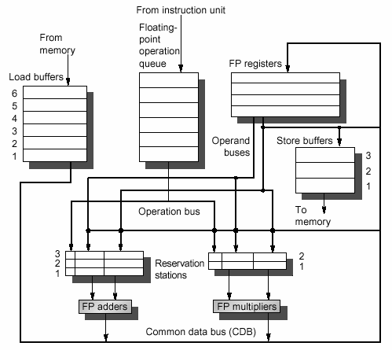
MIPS FP via Tomasulo
Tags
Notes:
Need more reservation stations than actual registers

Slide 47
Tomasulo vs. Scoreboarding
Tomasulo’s Algorithm
Used on IBM 360
attempt to deal with long memory and FP latencies
360 permitted register to memory ALU instructions
vs. CDC scoreboard
hazard detection and interlocks are distributed
Each functional unit has reservation stations to control execution
Reservation stations act as interlocks until data available
Results passed directly to functional units rather than through the registers (with renamed registers) multicast on CDB (common data bus)
Dataflow centric
no WAR or WAW hazards exist - rename instead
Scoreboard was control centric

Slide 48
Tomasulo - Central Idea
To speed up the 360 we can
Add more functional units, but they wouldn’t be heavily used
Replicating registers is cheaper and increases utilization
Helped on 360 which had only 6 FP registers (similar to x86)
Outcome
each execution unit fed by multiple reservation stations
Execution units used pipelining
Instruction issue to reservation stations is in-order, but reservation stations would execute upon acquiring all source operands → out of order execution
reservation stations contain virtual registers that remove WAW and WAR induced stalls

Slide 49
Dynamic Scheduling
Both Scoreboarding and Tomasulo’s algorithm were early approaches, but the ideas are still used today
Scoreboarding - CDC 6600 (1964)
Tomasulo - IBM 360/ 91 (1967)
Both methods are used today
UltraSparc
Pentium/Itanium
More transistors dedicated to ILP in the original Pentium than in the entire 486

