Slide 1
GUI Bloopers
Basic Principles

Slide 2
What is a GUI Blooper?
“Bloopers” are mistakes that software developers frequently make when designing graphical user interfaces
  Not just specific examples but mistakes that developers make over and over
  Goal is to give examples of mistakes AND help designers and developers learn to produce better GUIs

Slide 3
Basic Principle 1
Focus on the users and their tasks, not on the technology
This means you should answer these questions:
  For whom is the software being designed?
  What is the software for?
  What problems do the users have now?
  What skills and knowledge do the users have?
  How do users conceptualize the data?
  What are the users’ preferred ways of working?

Slide 4
Basic Principle 1
Requires collaboration with the user
“Software should be designed neither for users nor by them, but rather with them.”
We covered most of these items in the software engineering class

Slide 5
Basic Principle 2
Consider function first, presentation later
We’ve said that you should make a GUI mock-up before coding, isn’t this contradictory?
  No, function means determining the requirements and basic functions of the software. It doesn’t mean writing actual code functions.
  Before GUI layout we must decide what data the users can create, view, or manipulate.
    Conceptual Model

Slide 6
Basic Principle 3
Conform to the user’s view of the task
Software user interfaces should be designed from the user’s point of view
  Obviously this requires that you know what the user’s point of view is (Basic Principle 1)
  Strive for naturalness
    E.g. in chess, drag and drop piece or enter coordinates?
  Don’t impose arbitrary restrictions
    E.g. maximum of 255 entries
  Use user’s vocabulary, not your own
  Keep program internals inside the program
    Includes error messages

Slide 7
Basic Principle 4
Design for the common case
Ever create a new “object” in a program and find yourself having to change its default properties all the time?
Strive to make common tasks easy
Sensible defaults, templates or “canned” solutions, wizards, customizability

Slide 8
Basic Principle 5
Don’t distract users from their goals
People are good at multi-tasking, but not for problem solving and stuff we don’t do all the time. Software shouldn’t distract users from their own tasks and goals.
  E.g. hard to find functions, confusing terminology
Operate in the background, not the foreground of user’s consciousness.

Slide 9
Basic Principle 6
Facilitate Learning
Software is often hard to learn, some of the blame may be from “inside-out” thinking, the idea that users will actually know how to operate the software
  Clear to developers but may not be clear to users

Slide 10


Basic Principle 6
Example: Graphical Ambiguity
  With lots of icons it is difficult to make them meaningful
  What does this mean?
Antenna for a transmit function, not a martini glass with a stick

Slide 11
Basic Principle 7
Deliver information, not just data
E.g. comparative chart vs. list of data values
Don’t treat the data like information, focus on the important data and extract necessary information from it

Slide 12
Basic Principle 7
The screen belongs to the user
  Don’t take over the screen, researchers discovered it is usually a bad idea for software to unilaterally move controls and data around on the screen
    Jump or “warp” the mouse to new positions
    Move something to the mouse location
    Reposition windows
    Automatically rearrange data for the user
  Controlling the mouse for the user violates the hand-eye coordination a user has with the machine

Slide 13
Basic Principle 7
Preserve “Display Inertia”
When software changes a display to show the effect of a user’s actions, it should try to minimize what it changes
  Small local changes should produce small, local changes on the display
  Attempt to keep as much of the display unchanged as possible
Helps the user retain context, minimizes disruption
Examples of poor display inertia:
  Forcing entire page to refresh
  Scrolling to a different position in the browser

Slide 14
Basic Principle 8
Design for responsiveness
A software application’s ability to keep up with users and not make them wait
  The most important factor in determining user satisfaction
  Users hate waiting more than anything else
Desire for speed is perceived, not actual
  A responsive interface that shows progress in computing a result is perceived as faster than one that displays nothing (system pauses) until the result is done

Slide 15
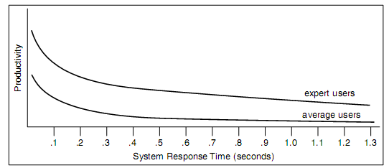
Basic Principle 8
Systems can be slow in terms of performance but still responsive
  Might queue requests but never lock-up or force users to wait for the system to catch up
Examples of poor responsiveness
  Delayed feedback for button-press or mouse click
  Operations that block activity
  No visual feedback as to how long a lengthy operation will take
  Jerky animation
Effect of response time on user productivity

Slide 16
Basic Principle 8
Designing for responsiveness
  Acknowledge user actions instantly, even if returning the answer will take time
  Let users know when it is busy and when it isn’t
  Free users to do other things while waiting for something to finish
  Animate movement smoothly
  Allow users to abort lengthy operations
  Allow users to accurately judge how long something will take

Slide 17
Basic Principle 9
Try it out on users, then fix it!
Test early and often, results may surprise even experienced designers
Schedule time to correct problems found by tests
Tests have two goals
  Information on aspects of the UI that cause difficulty
  Socially it convinces developers that there are design problems that need correcting. Some developers need to see users have problems for themselves.

Slide 18
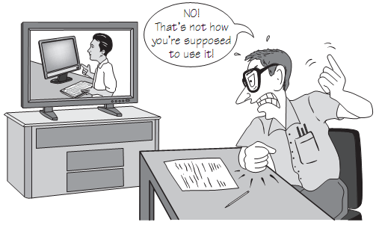
Developer watching video of usability test

Slide 19
GUI Control Bloopers
Two categories of control bloopers
  Using the wrong GUI Control
  Using a control incorrectly
Control bloopers harm usability and give customers an impression of a shoddy, unprofessional product

Slide 20
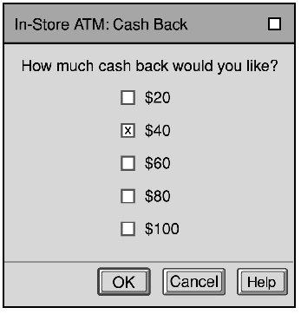

Blooper 1: Confusing checkboxes and radio buttons
Radio buttons when only one is selectable
Checkboxes when many selectable
Word: Change font, effects, subscript
and superscript

Slide 21
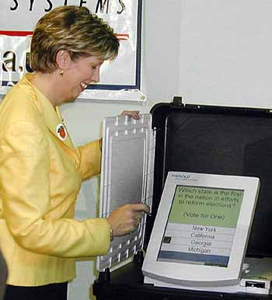
Blooper 1
Diebold/Premier AccuVote TSx operates somewhere between checkboxes and radio buttons

Slide 22

Avoiding Blooper 1
Use radio buttons
  When only one option may be selected
  In sets of at least two
  Ensure enough space is available to see all options
  The number of options is fixed and small (2-8)
Consider dropdown or scrolling menus which requires less space
Checkboxes represent ON/OFF conditions that are independent of each other

Slide 23


Blooper 2: Checkboxes for non-ON/OFF Setting
Checkboxes should be used for on/off not for a selection of items.
Instead use radio buttons.

Slide 24

Blooper 3: Command Buttons as Toggles
Saves space on the screen but toggling meaning of a button can be missed by the user
Misleads users; can’t predict by looking at them how they’ll behave, have to try them
  “Mystery Meat Navigation”
Use two buttons and disable the inactive one, or use a toggle switch style control

Slide 25
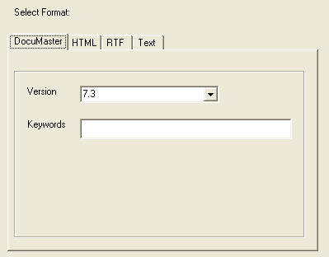
Blooper 4: Using tabs as radio buttons
Misuse of tabs is to use them as if they are radio buttons to present choices that affect what the application will do rather than just which controls are displayed
Some users will not realize the last tab selected is the one that is used – users expect tabs just for switching between panels

Slide 26
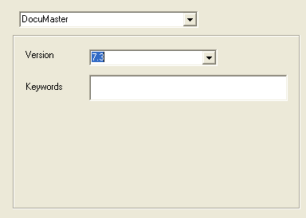
Tabs as Radio Buttons
Better design:
Tabs should be purely navigational controls, not for settings

Slide 27
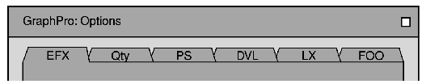
Blooper 5: Too Many Tabs
Intended to save space but too many uses more space – usually doesn’t scale beyond a handful
Never use dancing tabs; change position based upon which tab is selected
  Unavoidable with multi-rows of tabs

Slide 28


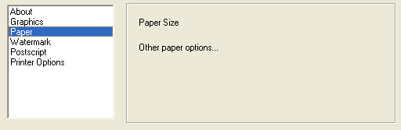
Multi-Row Tabs
Solutions: Widen panel, make tabs narrower, or use another control
instead of tabs

Slide 29
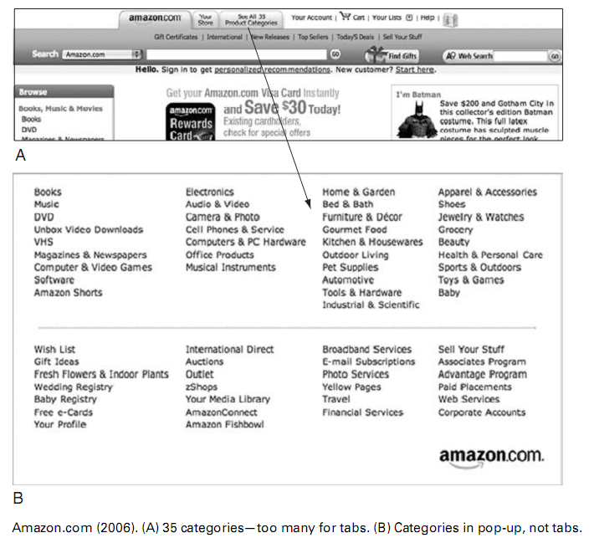
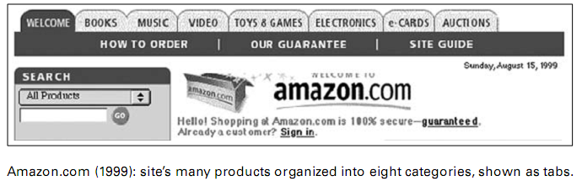
Avoiding Too Many Tabs

Slide 30
Blooper 6: Using input controls for display-only data
Don’t use input controls (textboxes, radio buttons, checkboxes, etc.) to present data users cannot change. This refers to controls that are never editable, not to ones that are temporarily inactive (grayed out).

Slide 31
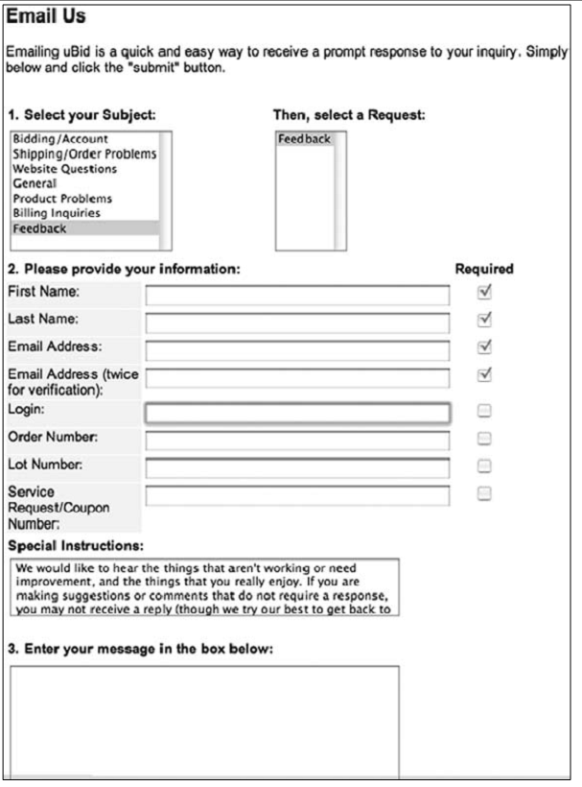
Blooper 6 Example

Slide 32
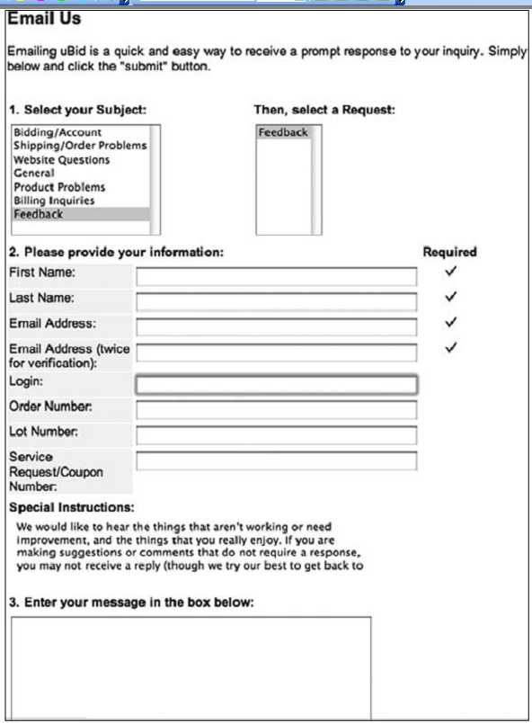
Better uBid Page

Slide 33
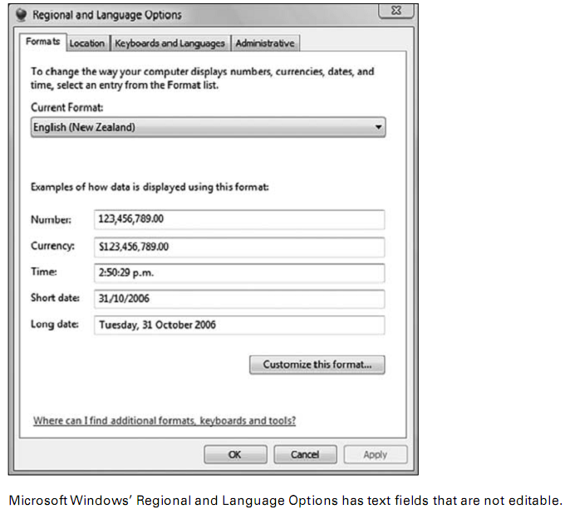
Blooper 6 Example

Slide 34
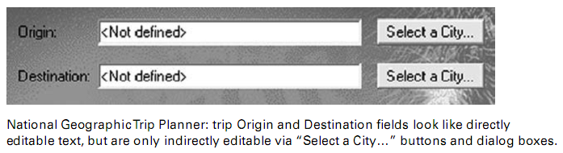
Blooper 6 Example
Avoiding Blooper 6: Use labels, don’t use controls that look like they
can be edited

Slide 35
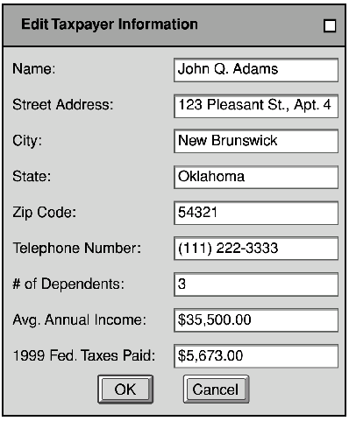
Blooper 7 : Overusing text fields for constrained input
Text fields are too unstructured for constrained data
  Dates, postal codes, volume levels, monetary amounts, etc.
  Especially occurs in paper to GUI conversion
Use structured controls to allow only valid data

Slide 36
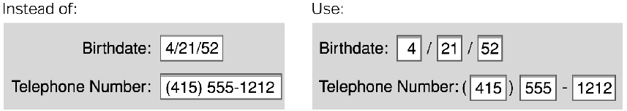
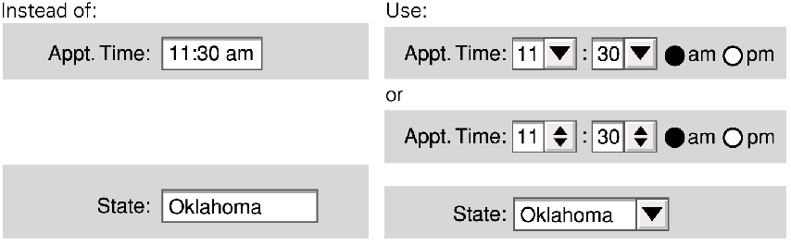
Take advantage of the GUI

Slide 37
Database Project w/Job Titles
Contractor is trying to match up titles, but getting values like:
Consiltant(Nonexempt) Consultan(Nonexempt)
Consultant (Noneexempt0
Consultant (Nonexempt(
Consultant (Nonexempt) Consultant(Nonexempt)

Slide 38
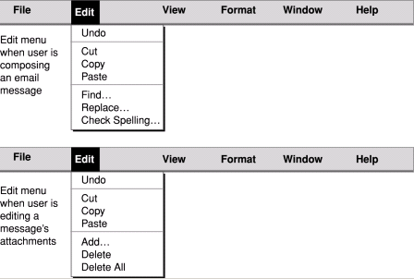
Blooper 8: Dynamic Menus
Menu item that changes depending upon the context
  Might seem to help; removes commands one shouldn’t be able to execute at that time
  But users end up wondering where commands went

Slide 39
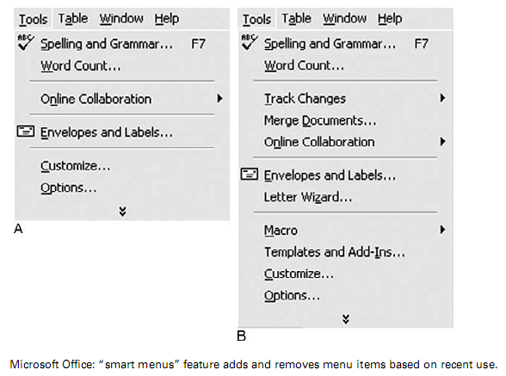
Blooper 8 Example

Slide 40
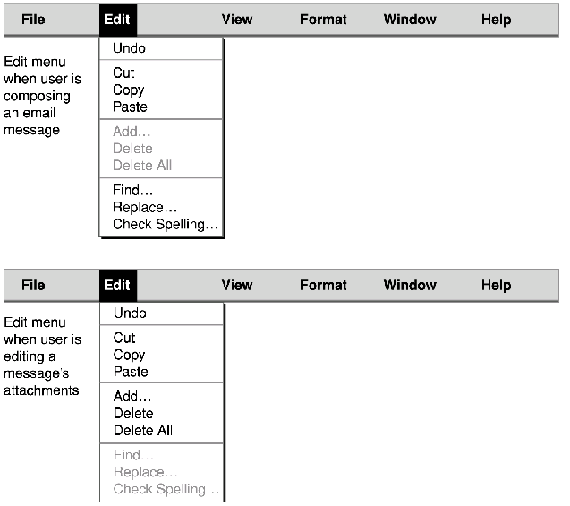
Dynamic Menus: Better
Gray out or add entirely new menu that appears/disappears

Slide 41
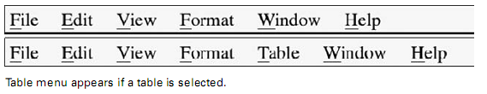
Dynamic Menus: Better
Add and remove menus, not menu items
Exception: quick lists
  E.g. recently opened files, bookmarks, opened documents

Slide 42
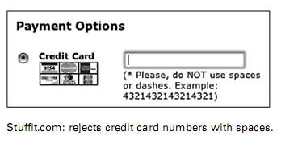
Blooper 9 : Intolerant Data Fields
To be friendly and helpful your text fields should tolerate reasonable variations in what people type
  E.g. filter out spaces (common w/cut and paste), dashes, period, tab, etc.

Slide 43
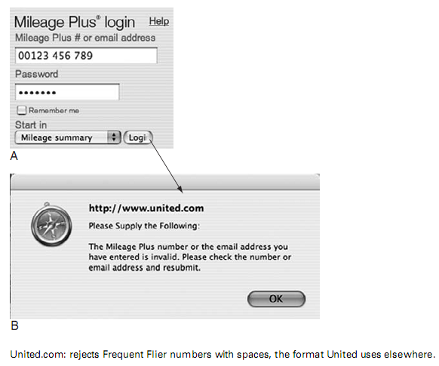
Blooper 9 Example

Slide 44
Avoiding Blooper 9
Match field length to data
  Visible length suggests how much to type
Accept common formats
Beware of rejecting legitimate data
Make case irrelevant
Provide a pattern (e.g. draw dashes in QP-00-3412)
Structure text fields
  Use pull-down menus or combo-boxes

Slide 45
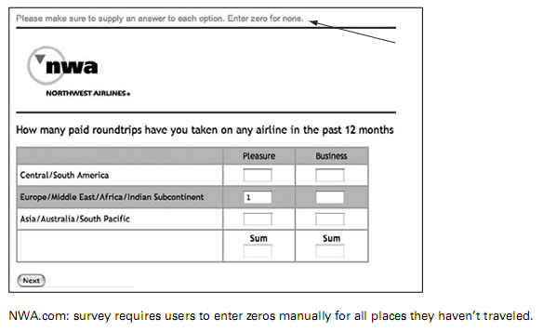
Blooper 10 : Input fields and controls with no default
Defaults should be set up with the most likely values; users only need to scan the settings, change a few, and proceed

Slide 46
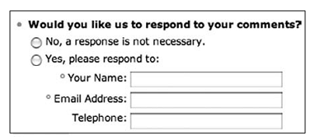
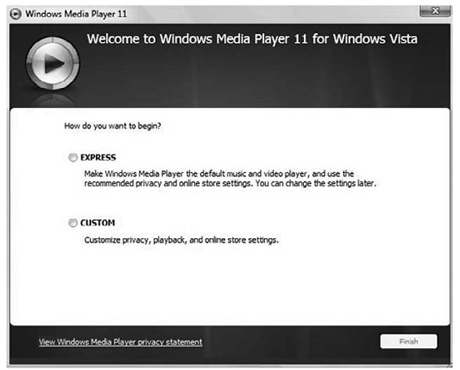
Blooper 10 Examples
Radio buttons with no default values

Slide 47
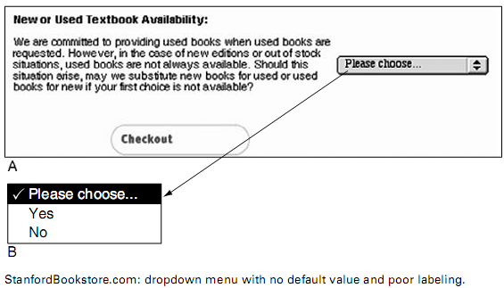
Blooper 10 Examples
Drop-down menu with no default and poor labeling

Slide 48
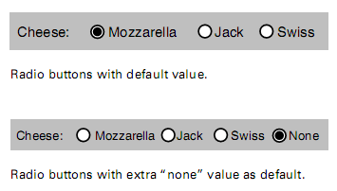
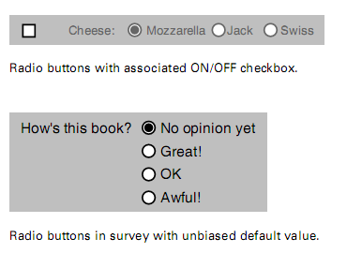
Avoiding Blooper 10
Use likely default values
Always add initial value for radio buttons, or “None” as an explicit choice

Slide 49
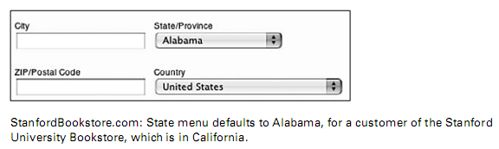
Blooper 11 : Poor Defaults
A default value that is unlikely to be what users want is more harmful than no default value

Slide 50
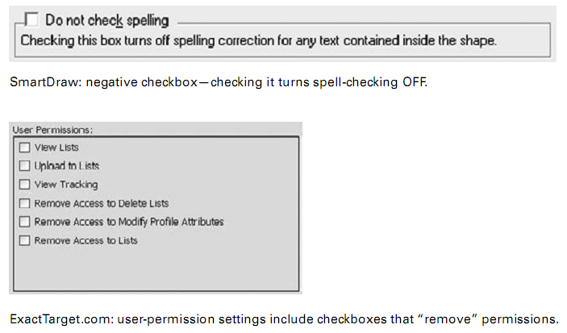
Blooper 12: Negative Checkboxes
Negative checkboxes turn a feature or attribute OFF when checked and ON when unchecked

Slide 51
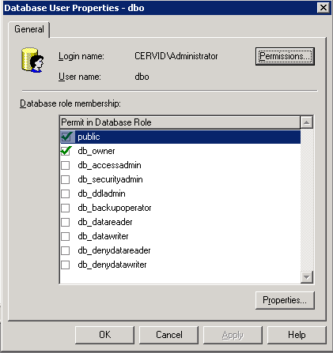
Blooper 12 Example
SQL Server Enterprise Manager
  Deny or Allow access
Avoiding Blooper 12
  All checkboxes should be positive

