Slide 1
Chapter 1 :: Introduction
Programming Language Pragmatics
Michael L. Scott

Slide 2
Programming Languages
What programming languages can you name?
Which do you know?

Slide 3
Introduction
Why are there so many programming languages?
  evolution -- we've learned better ways of doing things over time
  socio-economic factors: proprietary interests, commercial advantage
  orientation toward special purposes
  orientation toward special hardware
  diverse ideas about what is pleasant to use

Slide 4
Introduction
What makes a language successful?
  easy to learn (BASIC, Pascal, LOGO, Scheme, Alice)
  easy to express things, easy use once fluent, "powerful” (C, Common Lisp, APL, Algol-68, Perl)
  easy to implement (BASIC, Forth)
  possible to compile to very good (fast/small) code (Fortran)
  backing of a powerful sponsor (COBOL, PL/1, Ada, Visual Basic, C#)
  wide dissemination at minimal cost (Pascal, Turing, Java, Alice)

Slide 5
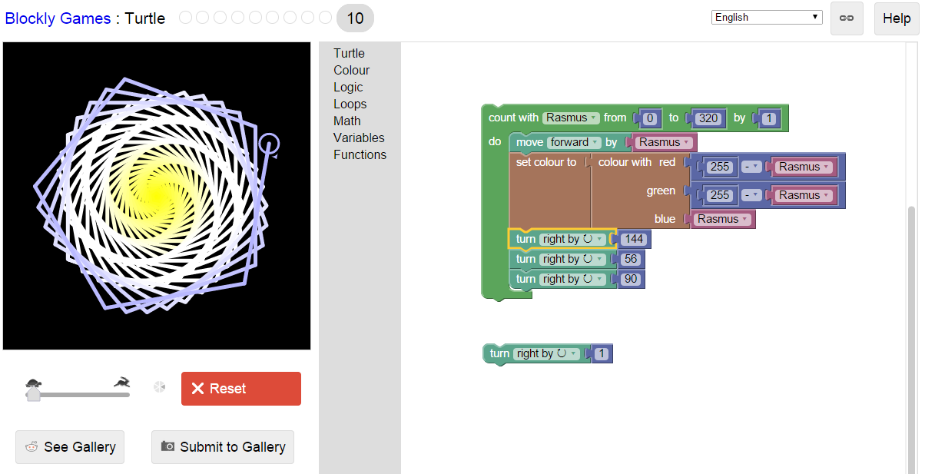
Blockly Screenshot

Slide 6
Introduction
Why do we have programming languages? What is a language for?
  way of thinking -- way of expressing algorithms
  languages from the programmer’s point of view
  abstraction of virtual machine -- way of specifying what you want the hardware to do without getting down into the bits
  languages from the implementor’s point of view

Slide 7
Why study programming languages?
Help you choose a language.
  C vs. Modula-3 vs. C++ for systems programming
  Fortran vs. APL vs. Ada for numerical computations
  Ada vs. Modula-2 for embedded systems
  Common Lisp vs. Scheme vs. ML for symbolic data manipulation
  Java vs. C/CORBA for networked PC programs

Slide 8
Why study programming languages?
Make it easier to learn new languages some languages are similar; easy to walk down family tree
  concepts have even more similarity; if you think in terms of iteration, recursion, abstraction (for example), you will find it easier to assimilate the syntax and semantic details of a new language than if you try to pick it up in a vacuum. Think of an analogy to human languages: good grasp of grammar makes it easier to pick up new languages (at least Indo-European).

Slide 9
Why study programming languages?
Help you make better use of whatever language you use
  understand obscure features:
    In C, help you understand unions, arrays & pointers, separate compilation, varargs, catch and throw
    In Common Lisp, help you understand first-class functions/closures, streams, catch and throw, symbol internals

Slide 10
Why study programming languages?
Help you make better use of whatever language you use (2)
  understand implementation costs: choose between alternative ways of doing things, based on knowledge of what will be done underneath:
      use simple arithmetic e.g.(use x*x instead of x**2)
      use C pointers or Pascal "with" statement to factor address calculations
      avoid call by value with large data items in Pascal
      avoid the use of call by name in Algol 60
      choose between computation and table lookup (e.g. for cardinality operator in C or C++)

Slide 11
Why study programming languages?
Help you make better use of whatever language you use (3)
  figure out how to do things in languages that don't support them explicitly:
    lack of suitable control structures in Fortran
    use comments and programmer discipline for control structures
    lack of recursion in Fortran, CSP, etc
    write a recursive algorithm then use mechanical recursion elimination (even for things that aren't quite tail recursive)

Slide 12
Why study programming languages?
Help you make better use of whatever language you use (4)
  figure out how to do things in languages that don't support them explicitly:
      lack of named constants and enumerations in Fortran
      use variables that are initialized once, then never changed
      lack of modules in C and Pascal use comments and programmer discipline
      lack of iterators in just about everything fake them with (member?) functions

Slide 13
Language Categories
Two common language groups
  Imperative
    von Neumann (Fortran, Pascal, Basic, C)
    object-oriented (Smalltalk, Eiffel, C++, Java)
    scripting languages (Perl, Python, JavaScript, PHP)
  Declarative
    functional (Scheme, ML, pure Lisp, FP)
    logic, constraint-based (Prolog, VisiCalc, RPG)

Slide 14
Imperative languages
Imperative languages, particularly the von Neumann languages, predominate
  They will occupy the bulk of our attention
We also plan to spend time on functional, logic languages

Slide 15
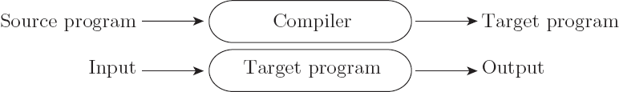
Compilation vs. Interpretation
Compilation vs. interpretation
  not opposites
  not a clear-cut distinction
Pure Compilation
  The compiler translates the high-level source program into an equivalent target program (typically in machine language), and then goes away:

Slide 16

Compilation vs. Interpretation
Pure Interpretation
  Interpreter stays around for the execution of the program
  Interpreter is the locus of control during execution

Slide 17
Compilation vs. Interpretation
Interpretation:
  Greater flexibility
  Better diagnostics (error messages)
Compilation
  Better performance

Slide 18
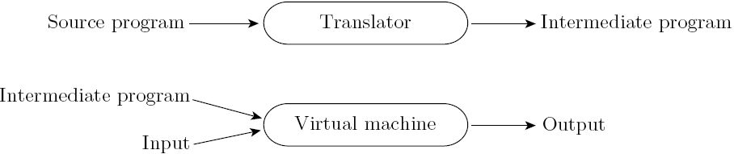
Compilation vs. Interpretation
Common case is compilation or simple pre-processing, followed by interpretation
Most language implementations include a mixture of both compilation and interpretation

Slide 19
Compilation vs. Interpretation
Note that compilation does NOT have to produce machine language for some sort of hardware
Compilation is translation from one language into another, with full analysis of the meaning of the input
Compilation entails semantic understanding of what is being processed; pre-processing does not
A pre-processor will often let errors through. A compiler hides further steps; a pre-processor does not

Slide 20
Compilation vs. Interpretation
Many compiled languages have interpreted pieces, e.g., formats in Fortran or C
Most use “virtual instructions”
  set operations in Pascal
  string manipulation in Basic
Some compilers produce nothing but virtual instructions, e.g., Pascal P-code, Java byte code, Microsoft COM+

Slide 21
Compilation vs. Interpretation
Implementation strategies:
  Preprocessor
    Removes comments and white space
    Groups characters into tokens (keywords, identifiers, numbers, symbols)
    Expands abbreviations in the style of a macro assembler
    Identifies higher-level syntactic structures (loops, subroutines)

Slide 22
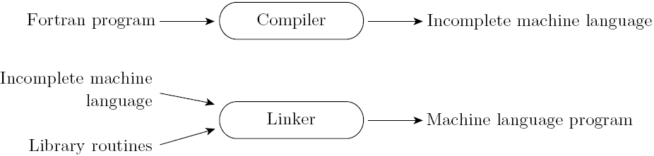
Compilation vs. Interpretation
Implementation strategies:
  Library of Routines and Linking
    Compiler uses a linker program to merge the appropriate library of subroutines (e.g., math functions such as sin, cos, log, etc.) into the final program:

Slide 23
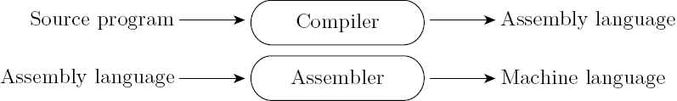
Compilation vs. Interpretation
Implementation strategies:
  Post-compilation Assembly
    Facilitates debugging (assembly language easier for people to read)
    Isolates the compiler from changes in the format of machine language files (only assembler must be changed, is shared by many compilers)

Slide 24
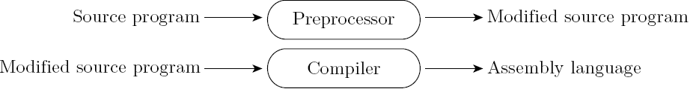
Compilation vs. Interpretation
Implementation strategies:
  The C Preprocessor (conditional compilation)
    Preprocessor deletes portions of code, which allows several versions of a program to be built from the same source

Slide 25
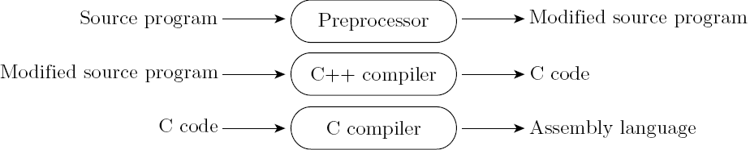
Compilation vs. Interpretation
Implementation strategies:
  Source-to-Source Translation (C++)
    C++ implementations based on the early AT&T compiler generated an intermediate program in C, instead of an assembly language:

Slide 26
Compilation vs. Interpretation
Implementation strategies:
  Bootstrapping
Early Pascal compilers built around a set of tools that included:
  A Pascal compiler, written in Pascal, that would generate output in P-code, a simple stack-based language
  A Pascal compiler already translated into P-code
  A P-code interpreter, written in Pascal
Compiler.p
We have to write this
Compiler.pcode
P-code interpreter translated to C
Interpreter.exe
Interpreter.p

Slide 27
Pascal Interpeter
Interpreter.exe
Compiler.pcode
Program.p
Program.pcode
Interpreter.exe
Output of Program.p

Slide 28
Bootstrap compiler
Modify Compiler.p to compile to native code instead of P-code, then
use the compiler to compile itself
Compiler.p to x86
run via Interpreter
X86 Compiler.exe
Compiler.p
Program.p
Program.exe

Slide 29
Compilation vs. Interpretation
Implementation strategies:
  Compilation of Interpreted Languages
    The compiler generates code that makes assumptions about decisions that won’t be finalized until runtime. If these assumptions are valid, the code runs very fast. If not, a dynamic check will revert to the interpreter.

Slide 30
Compilation vs. Interpretation
Implementation strategies:
  Dynamic and Just-in-Time Compilation
    In some cases a programming system may deliberately delay compilation until the last possible moment.
      Lisp or Prolog invoke the compiler on the fly, to translate newly created source into machine language, or to optimize the code for a particular input set.
      The Java language definition defines a machine-independent intermediate form known as byte code. Byte code is the standard format for distribution of Java programs.
      The main C# compiler produces .NET Common Language Runtime (CLR), which is then translated into machine code immediately prior to execution.

Slide 31
Compilation vs. Interpretation
Compilers exist for some interpreted languages, but they aren't pure:
  selective compilation of compilable pieces and extra-sophisticated pre-processing of remaining source.
  Interpretation of parts of code, at least, is still necessary for reasons above.
Unconventional compilers
  text formatters
  silicon compilers
  query language processors

Slide 32
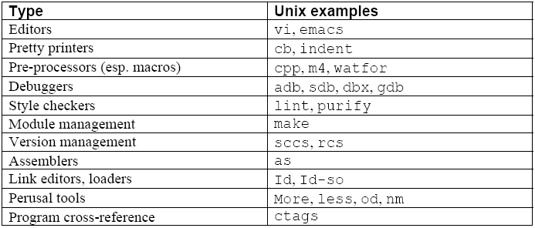
Programming Environment Tools
Tools; Integrated in an Integrated Development Environment (IDE)

Slide 33
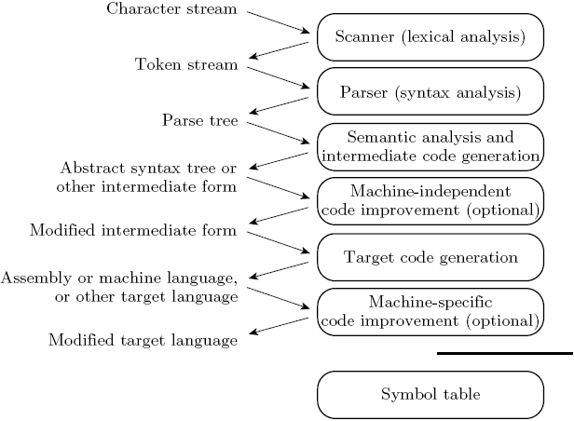
An Overview of Compilation
Phases of Compilation

Slide 34
An Overview of Compilation
Scanning:
  divides the program into "tokens", which are the smallest meaningful units; this saves time, since character-by-character processing is slow
  we can tune the scanner better if its job is simple; it also saves complexity (lots of it) for later stages
  you can design a parser to take characters instead of tokens as input, but it isn't pretty
  scanning is recognition of a regular language, e.g., via DFA (deterministic finite automaton)

Slide 35
An Overview of Compilation
Parsing is recognition of a context-free language, e.g., via Pushdown Automaton (PDA)
  Parsing discovers the "context free" structure of the program
  Informally, it finds the structure you can describe with syntax diagrams (the "circles and arrows" in a Pascal manual)

Slide 36
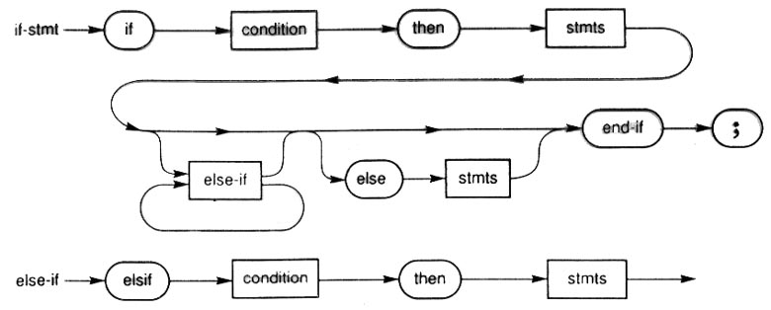
Pascal “Railroad” diagram

Slide 37
An Overview of Compilation
Semantic analysis is the discovery of meaning in the program
  The compiler actually does what is called STATIC semantic analysis. That's the meaning that can be figured out at compile time
  Some things (e.g., array subscript out of bounds) can't be figured out until run time. Things like that are part of the program's DYNAMIC semantics

Slide 38
An Overview of Compilation
Intermediate form (IF) done after semantic analysis (if the program passes all checks)
  IFs are often chosen for machine independence, ease of optimization, or compactness (these are somewhat contradictory)
  They often resemble machine code for some imaginary idealized machine; e.g. a stack machine, or a machine with arbitrarily many registers
  Many compilers actually move the code through more than one IF

Slide 39
An Overview of Compilation
Optimization takes an intermediate-code program and produces another one that does the same thing faster, or in less space
  The term is a misnomer; we just improve code
  The optimization phase is optional
Code generation phase produces assembly language or (sometime) relocatable machine language

Slide 40
An Overview of Compilation
Certain machine-specific optimizations (use of special instructions or addressing modes, etc.) may be performed during or after target code generation
Symbol table: all phases rely on a symbol table that keeps track of all the identifiers in the program and what the compiler knows about them
  This symbol table may be retained (in some form) for use by a debugger, even after compilation has completed

Slide 41
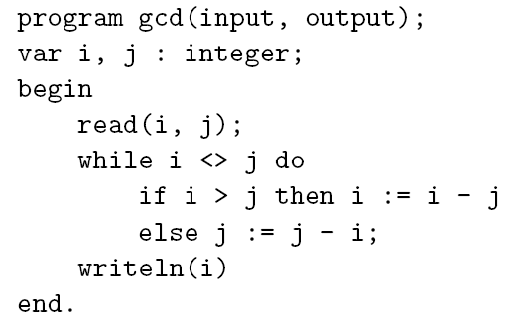
An Overview of Compilation
Lexical and Syntax Analysis
  GCD Program (Pascal)

Slide 42
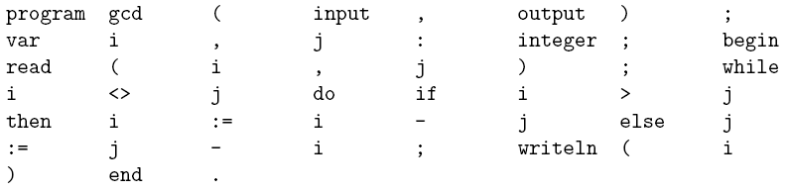
An Overview of Compilation
Lexical and Syntax Analysis
  GCD Program Tokens
    Scanning (lexical analysis) and parsing recognize the structure of the program, groups characters into tokens, the smallest meaningful units of the program

Slide 43
An Overview of Compilation
Lexical and Syntax Analysis
  Context-Free Grammar and Parsing
    Parsing organizes tokens into a parse tree that represents higher-level constructs in terms of their constituents
    Potentially recursive rules known as context-free grammar define the ways in which these constituents combine

Slide 44
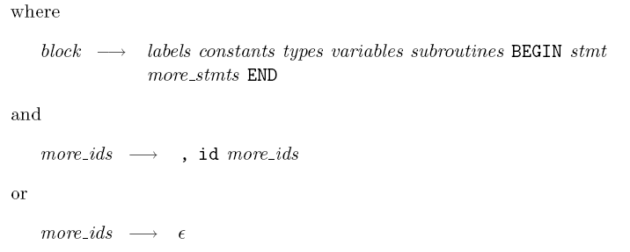
An Overview of Compilation
Context-Free Grammar and Parsing
  Example (Pascal program)

Slide 45
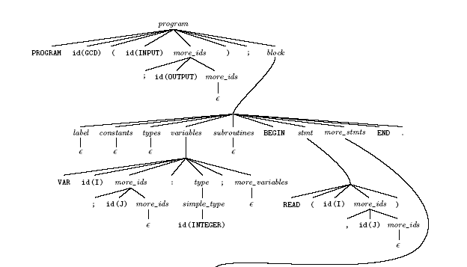
An Overview of Compilation
Context-Free Grammar and Parsing
  GCD Program Concrete Parse Tree
Next slide

Slide 46
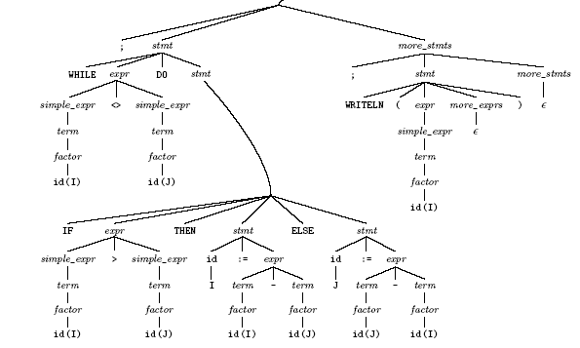
An Overview of Compilation
Context-Free Grammar and Parsing
  GCD Program Parse Tree (continued)

Slide 47
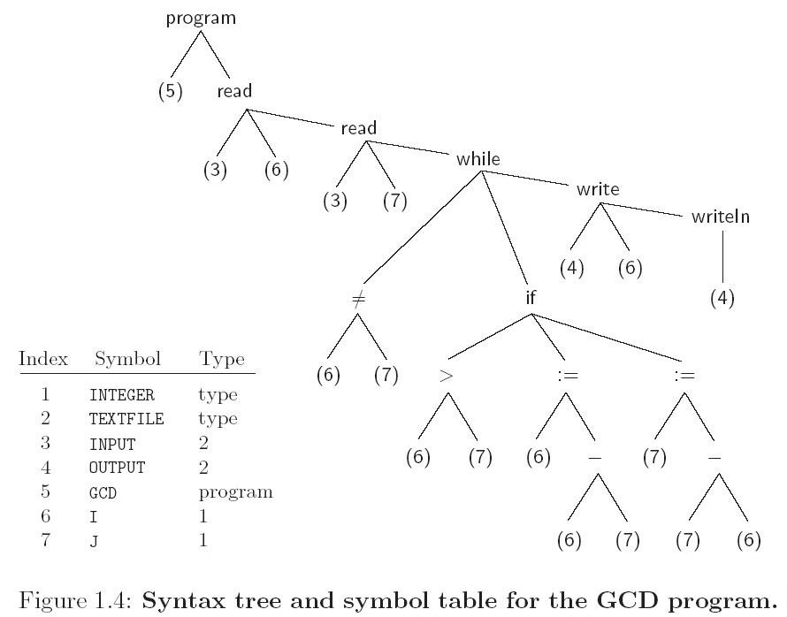
An Overview of Compilation
Syntax Tree
  GCD Program Abstract Parse Tree

Slide 48
Code Generation
Naïve MIPS assembly code fragment
addiu sp, sp, -32 # Reserve room for local vars
sw ra, 20(sp) # save return address
jal getint # read
nop
sw v0, 28(sp) # store i
jal getint # read
nop
sw v0, 24(sp) # store j
lw t6, 28(sp) # load i to t6
lw t7, 24(sp) # load j to t7
nop
beq t6, t7, D # branch if I = J
nop
A: lw t8, 28(sp) # load I
...

