Slide 1
Introduction to .NET

Slide 2
What is .NET?
Introduced in 2002, Microsoft’s architecture for applications in the Internet age
  Increased robustness over classic Windows apps
  New programming platform
  Built for the web
.NET is a platform that runs on the operating system
Split with Windows RT (will discuss later)

Slide 3
.NET
Sits on top on the OS (currently all the Windows; Linux/Unix subset also available – Mono Project)
Provides language interoperability across platforms
Strong emphasis on Web connectivity, using XML web services to connect and share data between smart client devices, servers, and developers/users
  Later versions (current 4.5) added WPF, LINQ, Parallel extensions, Metro support
Platform/language independent

Slide 4
History
Development began in 1998
Beta 1 released Oct, 2000
Beta 2 released July, 2001
Finalized in Dec, shipping in Feb 2002
Vista shipped with .NET Framework 3.0 (Runtime)

Slide 5
.NET Overview
Three main elements:
  The Framework (CLR, FCL, ASP, WinForms)
  The Products (Windows, Visual Studio, Office)
  The Services (My Services)
Framework Goals
  Improved reliability and integrated security.
  Simplified development and deployment.
  Unified API, multi-language support.
XML is the .NET “Meta-Language”.
All MS server products now .NET-enabled.

Slide 6
.NET Framework
C# VB.NET C++.NET Other
Visual
Studio
Common Language Specification
Framework Class Library
ASP.NET
Windows Forms
Web Services
Web Forms
Controls
Drawing
ASP.NET Application Services
Windows Application Services
ADO.NET
XML
Threading
IO
Network
Security
Diagnostics
Etc.
Common Language Runtime
Memory Management
Common Type System
Lifecycle Monitoring
Operating System

Slide 7
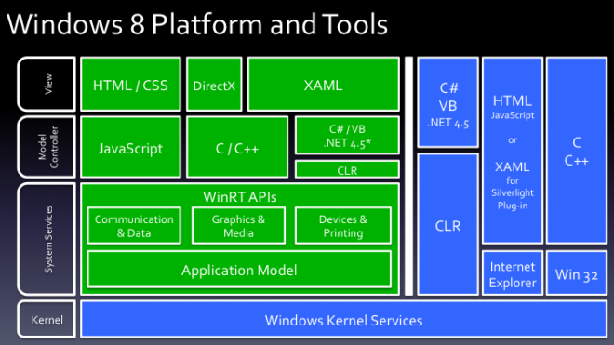
.NET 4.5 on Windows 8
Green = Metro, Blue = Desktop
http://dougseven.com/2011/09/15/a-bad-picture-is-worth-a-thousand-long-discussions/

Slide 8
Common Language Runtime
A runtime provides services to executing programs
  Standard C library, MFC, VB Runtime, JVM
CLR provided by .NET manages the execution of code and provides useful services
  Memory management, type system, etc.
  Services exposed through programming languages
    C# exposes more features of the CLR than other languages (e.g. VB.NET)

Slide 9
.NET Framework Class Library
Framework – you can call it and it can call you
Large class library
  Over 9000 classes in .NET 4
  Major components
    Base Class: Networking, security, I/O, files, etc.
    Data and XML Classes
    Web Services/UI
    Windows UI

Slide 10
Framework Libraries
Web Services
  Expose application functionalities across the Internet, in the same way as a class expose services to other classes.
  Each Web service can function as an independent entity, and can cooperate with one another.
  Data described by XML.
ASP.NET
  Replacement for the Active Server Technology.
  Web Forms provide an easy way to write interactive Web applications, much in the same way as “normal” Windows applications.

Slide 11
Framework Libraries
Provides facilities to generate Windows GUI-based client applications easily
Form-oriented
Standard GUI components
  buttons, textboxes, menus, scrollbars, etc.
Event-handling

Slide 12
Common Language Specification
CLS is a set of rules that specifies features that all languages should support
  Goal: have the .NET framework support multiple languages
  CLS is an agreement among language designers and class library designers about the features and usage conventions that can be relied upon
    Example: public names should not rely on case for uniqueness since some languages are not case sensitive
    This does not mean all languages are not case sensitive above the CLR!

Slide 13
Some .NET Languages
C#
COBOL
Eiffel
Fortran
Mercury
Pascal
Python
Ruby
SML
Perl
Smalltalk
VB.NET
VC++
F#
Scheme
….
More are under
development

Slide 14
VB.NET and C#
VB.NET introduces long sought-after features:
  Inheritance
  Parameterized Class Constructors
  Function Overloading
  Multi-Threading
  Structured Error Handling
  Creating NT Services
VB.NET not backward compatible with VB6.
C#
  Flagship, modern, object-oriented language
  Similar to C++/Java
  Considered the most powerful language of .NET

Slide 15
.NET vs. J2EE
Both are similar in many ways:
  Server- and client-side model for building enterprise applications.
  Virtual machine designed to inspect, load, and execute programs in a controlled environment.
  APIs for creating both fat- and thin-client models.
  APIs for foundation services (data access, directory, remote object calls, sockets, forms).
  Development environment for dynamic web pages.
J2 Enterprise Edition
  Language-Dependent & Platform-Independent
.NET
  Language-Independent & Platform Dependent (for the most part)

Slide 16
J2EE: Language-Specific, Platform- Independent
Person.java
Linux
Java VM
Person
bytecodes
Java VM
Deploy
Windows
Company
bytecodes
Java VM
Address
bytecodes
Android
Address.java
Company.java
Java VM

Slide 17
.NET: Language-Independent, (Mostly) Platform- Specific
Person.vb
Windows
(Visual Basic)
CLR
Person
MSIL
CLR
Deploy
Windows
Company
MSIL
CLR
Address
MSIL
Others?
Address.cs
(C#)
Company.cbl
CLR
(Cobol)

Slide 18
J2EE
The core (JVM and standard class libraries) are mature.
3-4 million Java programmers.
J2EE implementations are not entirely cross-platform.
Java’s true potential is realized only when all (or most) development is done in Java.
Changing the Java language specification has an enormous impact on the entire platform.

Slide 19
.NET
.NET built into Windows; running an executable invokes the CLR automatically instead of explicitly invoking the JVM
.NET added improvements such as native XML support, new features to CLR; spurred Java 8
About 3 million C++ developers, 3-8 million VB developers, around 1 million C# developers
Today, most development and deployment is Windows

Slide 20
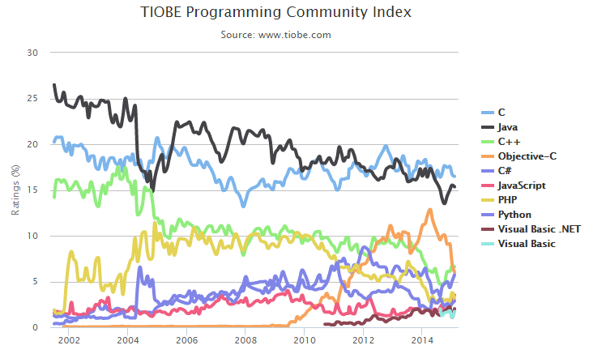
TIOBE Index, Feb 2015

Slide 21
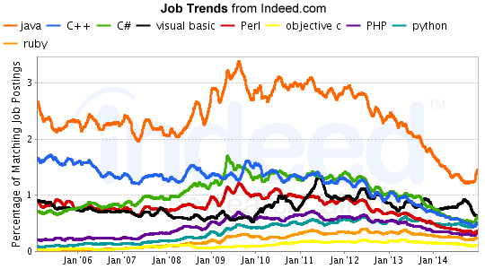
PL Job Trends - % Postings

Slide 22
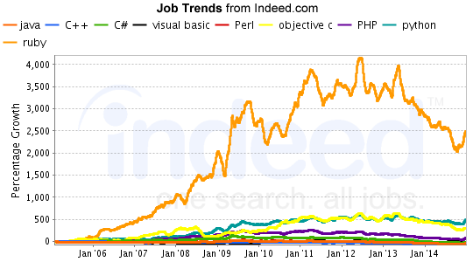
Relative Job Growth

Slide 23
Do you have to use Windows?
Open source implementations of .NET
Today there exists Xamarin’s Mono, Corel's Rotor and the Free Software Foundation's Portable .NET projects
Rotor: the Shared Source Common Language Infrastructure (SSCLI)
  Started as “Project 7” with Academic Microsoft Research
  With universities and programming language researchers, developed several languages for the CLR
Mono
  Implementation of ECMA C# and CLI for Linux
  http://www.mono-project.com

Slide 24
Mono
http://www.mono-project.com/Main_Page
Mono provides the necessary software to develop and run .NET client and server applications on Linux, Solaris, Mac OS X, Windows, and Unix.
Sponsored by Xamarin
Mono allows your existing binaries to run on Linux with copy-deployment.
Mono API coverage is limited to portions of .NET 4 and parts of .NET 4.5

Slide 25
Mono
Core: mscorlib, System, System.Security and System.XML assemblies.
  ADO.NET: System.Data and various other database providers.
  ASP.NET: WebForms and Web Services are supported. Work on WSE1/WSE2 has also started.
  Compilers: C#, VB.NET and various command line tools that are part of the SDK.
  Open Source, Unix and Gnome specific libraries.
Other components like Windows.Forms, Directory.Services, Enterprise Services and JScript are partially covered
Some other smaller and less used components do not have yet a Mono equivalent

Slide 26
Common Language Runtime
The CLR is at the core of the .NET platform - the execution engine
The CLR provides a “Managed Execution Environment”. Manages the execution of code and provides services that make development easier (like the JVM)
Code that relies on COM and the Win32 API is “Un-Managed Code” (e.g. built with Visual Studio 6.0, VB6)
Code developed for a compiler that targets this platform is referred to as “Managed Code” (e.g. code developed in VB.NET … C# allows Managed and Unmanaged)

Slide 27
Simple Application Deployment
Unlike COM, no “plumbing” code needed to connect separate components
  Components can be developed in different programming languages
Thousands of classes to reuse
Automatic garbage collection
Memory is managed
  Common bugs like memory leaks, buffer overruns are not possible (if using 100% managed code)

Slide 28
Multiple Languages
Common Type System makes interoperability seamless between languages
Class in one language can inherit from a class in another language
Exceptions can be thrown across languages
Makes it easier to learn a new .NET language since the same tools and classes are in place
Can debug across languages

Slide 29
The Common Type System
At the core of the Framework is a universal type system called the .NET Common Type System (CTS).
Everything is an object - but efficient
  Boxing and Unboxing
All types fall into two categories - Value types and Reference types.
  Value types contain actual data (cannot be null). Stored on the stack. Always initialized.
  Three kinds of value types: Primitives, structures, and enumerations.
Language compilers map keywords to the primitive types. For example, a C# “int” is mapped to System.Int32.

Slide 30
The Common Type System
Reference types are type-safe object pointers. Allocated in the “managed heap”
Four kinds of reference types: Classes, arrays, delegates, and interfaces.
  When instances of value types go out of scope, they are instantly destroyed and memory is reclaimed.
  When instances of reference types go out of scope, they are garbage collected.
Boxing = converting an instance of a value type to a reference type. Usually done implicitly through parameter passing or variable assignments.
UnBoxing = casting a reference type back into a value type variable.

Slide 31
The Common Type System
Object
String
Array
ValueType
Exception
Delegate
Class1
Primitive Types
Enum
Multicast
Delegate
Class2
Int16
Boolean
Int32
Byte
Class3
Int64
Char
Single
Currency
Double
DateTime
Decimal
TimeSpan

Slide 32
MSIL and JIT Compilation
Source code is compiled into MSIL (Microsoft Intermediate Language). Similar to Java bytecodes - CPU-independent instructions
MSIL allows for runtime type-safety and security, as well as portable execution platforms.
The MSIL architecture results in apps that run in one address space - thus much less OS overhead.
Compilers also produce “metadata” or glue that binds the code with debuggers, browsers, etc.
  Definitions of each type in your code.
  Signatures of each type’s members.
  Members that your code references.
  Other runtime data for the CLR.

Slide 33
MSIL and JIT Compilation
Metadata in the load file along with the MSIL enables code to be self-describing - no need for separate type libraries, IDL, or registry entries.
When code is executed by the CLR, a JIT compilation step occurs.
  Code is compiled method-by-method to native machine code as methods are invoked
  Results in performance slowdown when a program is first executed, but can be efficient for code that is never executed
  Subsequent invocations reuse compiled code, so no slowdown

Slide 34
Delegates
A new concept that is central to the programming model of the CLR.
Delegates are like function pointers, but are actually type-safe, secure, managed CLR objects.
The CLR guarantees that a delegate points to a valid method.
You get the benefits of function pointers without the dangers.
Each delegate is based on a single method signature.
Commonly used for callbacks.
Delegates are basis of event handlers.

Slide 35
Packaging: Modules, Types, Assemblies, and the Manifest
A “module” refers to a managed binary, such as an EXE or DLL.
Modules contain definitions of managed types, such as classes, interfaces, structures, and enumerations.
An assembly can be defined as one or more modules that make up a unit of functionality. Assemblies also can “contain” other files that make up an application, such as bitmaps and resource files.
An assembly is the the fundamental unit of deployment, version control, activation scoping, and security permissions.

Slide 36
Packaging: Modules, Types, Assemblies, and the Manifest
An assembly is a set of boundaries:
  A security boundary - the unit to which permissions are requested and granted.
  A type boundary - the scope of an assembly uniquely qualifies the types contained within.
  A reference scope boundary - specifies the types that are exposed outside the assembly.
  A version boundary - all types in an assembly are versioned together as a unit.
    Avoid multiple version problem for DLL’s

Slide 37
Packaging: Modules, Types, Assemblies, and the Manifest
An assembly contains a “manifest”, which is a catalog of component metadata containing:
  Assembly name.
  Version (major, minor, revision, build).
  Assembly file list - all files “contained” in the assembly.
  Type references - mapping the managed types included in the assembly with the files that contain them.
  Scope - private or shared.
  Referenced assemblies.
In many cases, an assembly consists of a single EXE or DLL - containing the module’s MSIL, the component metadata, and the assembly manifest. In other cases, the assembly may consist of many DLLs, with the manifest in its own file.
No MSIL code can ever be executed unless there is a manifest associated with it.

Slide 38
Differences from JVM (prior to 1.5)
220 instructions in the CLR’s instruction set
JVM provides no way of encoding type-unsafe features of typical programming languages, such as pointers
  E.g., JVM has no way to access the address of local variables for use in things like a Swap method, passing primitive variables by reference
Arithmetic
  Separate instructions for adding to generate overflow vs. no overflow
  JVM never generates overflow on integer types

Slide 39
Differences from JVM (prior to 1.5)
Branches
  Limited to 64K in JVM
Structures and Unions
  No support for these in JVM
  Union supports Variant Records
    When a field in the structure is selected from multiple possible types e.g., Struct.X could be an int or a boolean
Automatic Boxing and Unboxing

Slide 40
Differences from JVM (prior to 1.5)
Support for Tail Recursion
  Discards previous stack frame, so tail recursion can result in an infinite loop instead of stack overflow
  Faster as well (for non-infinite loop)
Supports “unmanaged” code
  Java has JNI, Java Native (code) Interface, as a way to do the same thing but not as directly

Slide 41
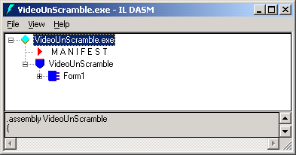
ILDASM
Can examine assemblies, assembly code with the ILDASM tool
Here is ILDASM run on VideoUnScramble.exe

Slide 42
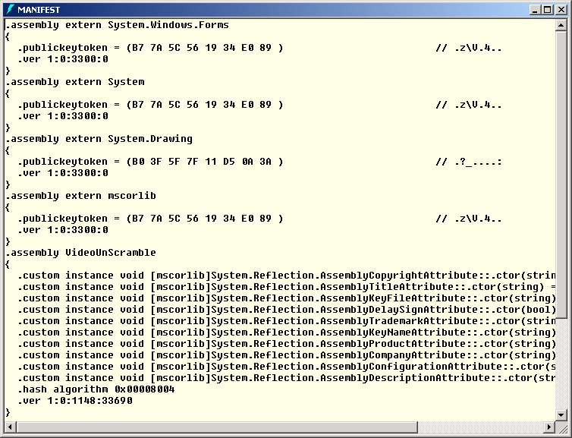
Assembly Manifest

Slide 43
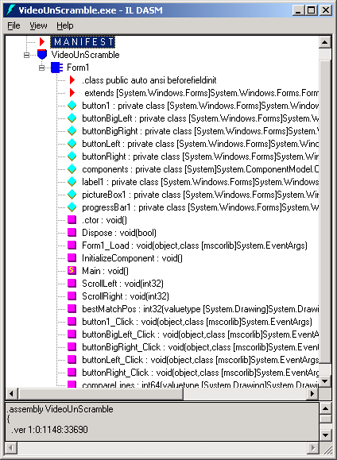
Assembly Components

Slide 44
MSIL Sample Code
IL_006e: ldloc.s V_4
IL_0070: ldloc.1
IL_0071: ldelema [System.Drawing]System.Drawing.Color
IL_0076: ldloc.0
IL_0077: ldloc.1
IL_0078: ldarg.1
IL_0079: sub
IL_007a: ldloc.2
IL_007b: callvirt instance valuetype [System.Drawing]System.Drawing.Color [System.Drawing]System.Drawing.Bitmap::GetPixel(int32, int32)
IL_0080: stobj [System.Drawing]System.Drawing.Color
IL_0085: ldloc.1
IL_0086: ldc.i4.1
IL_0087: sub
IL_0088: stloc.1
IL_0089: ldloc.1
IL_008a: ldarg.1
IL_008b: bge.s IL_006e
IL_008d: ldc.i4.0
IL_008e: stloc.1
IL_008f: br.s IL_00aa

Slide 45
Summary
Next we will study C#
C# does not exist in isolation but has a close connection with the .NET framework
.NET
  CLR is a Java-like platform, but multi-language
  Src→MSIL→JIT→Native Code
  .NET framework includes many class libraries

