Slide 1
Intel Galileo Gen 2 & Grove Seeed Starter Kit Gen 1

Slide 2
Intel Galileo Board
Platform for prototyping embedded systems, sensors, robotics, electronics hacking, Internet of Things, no soldering
$60 retail, Gen 2 board; latest version is Edison with WiFi/Bluetooth
Compatible with Arduino Uno shields (expansion boards)
Quark SoC which is a 32 bit single core single threaded Pentium CPU at 400 Mhz
Can program with Arduino “sketches” or node.js, python
  Not with ours unless put linux image on microSD card
https://software.intel.com/iot/getting-started

Slide 3

Caveats
Not 100% Arduino compatible (drivers, libraries)
No wifi module for us
No SD card
  Programs go away when unplugged
  Can’t use Intel IoT or Eclipse IDE, must use Arduino IDE
You have to install on your own machine
  Install drivers then Arduino IDE
Driver setup
  Check your COM port, it may change when you reconnect

Slide 4
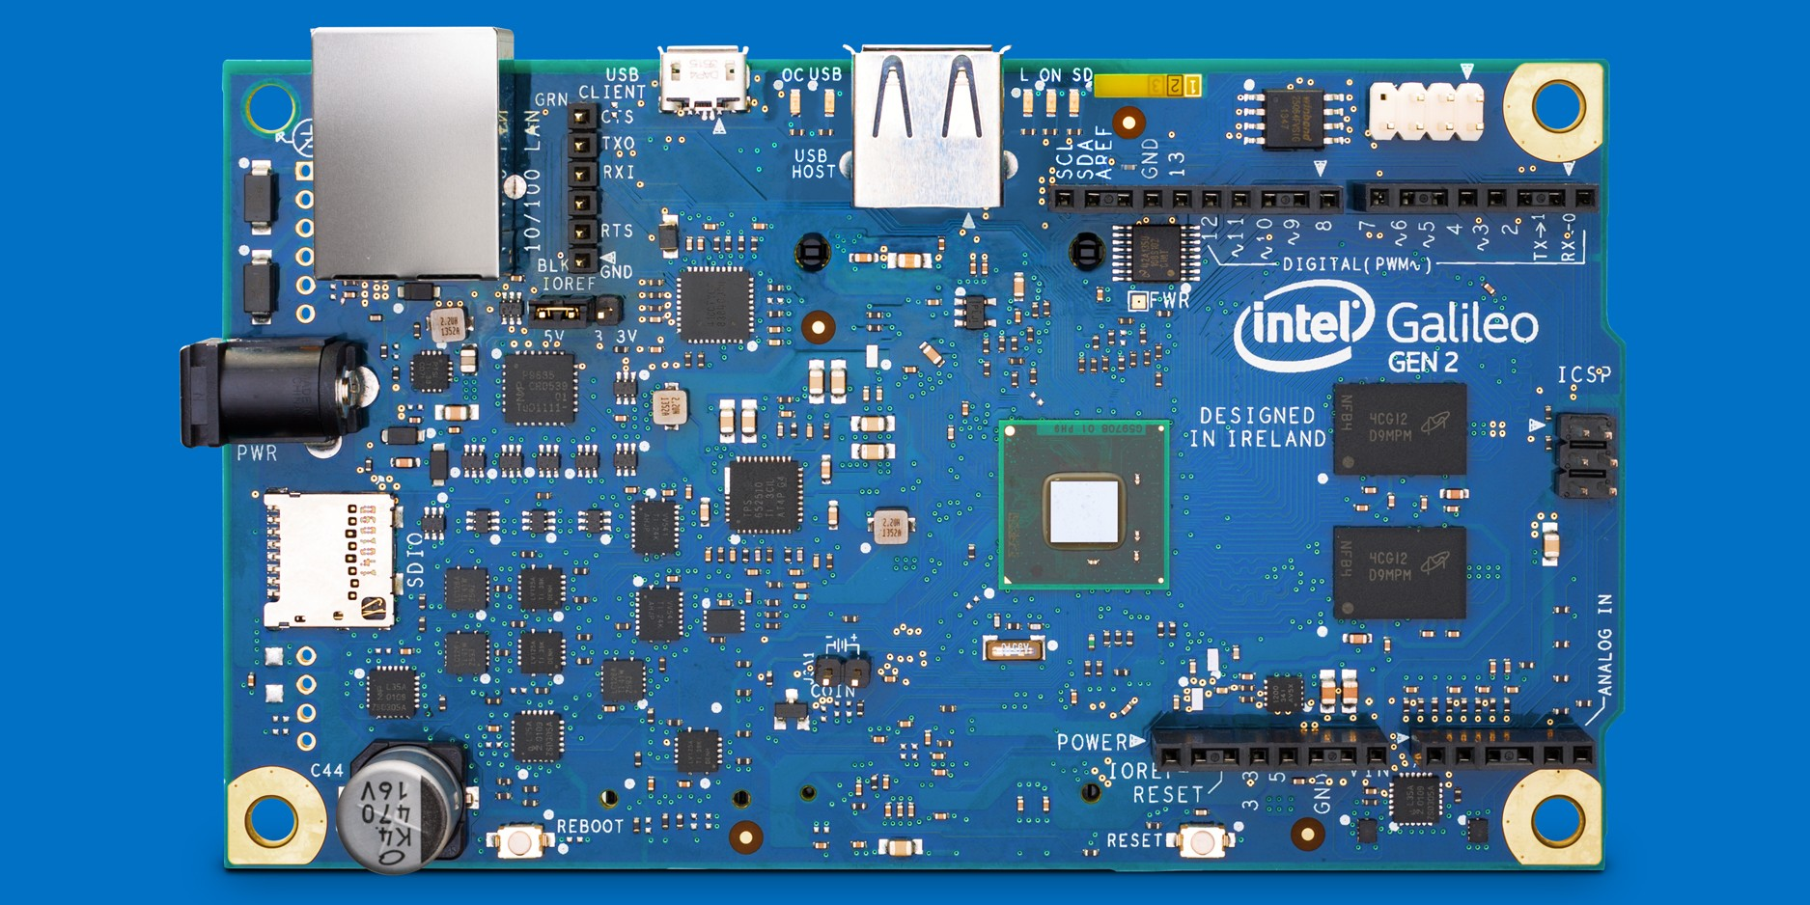
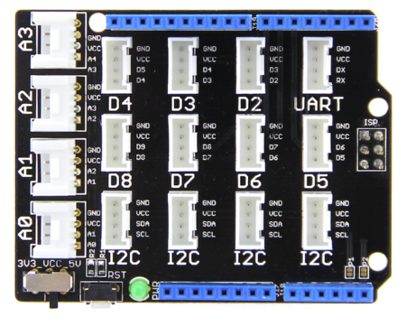
Seeed Base Shield
Galileo

Slide 5
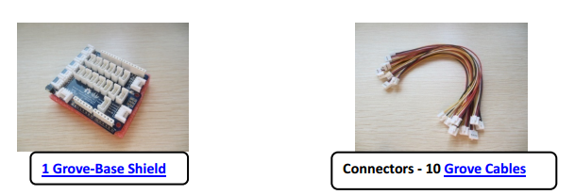
Seeed Starter Kit
See http://www.seeedstudio.com/document/Grove%20Starter%20Kit.pdf
Note that this is set up for Gen 1 so not everything works and some things look different
+ LED’s, power
connectors, microUSB

Slide 6
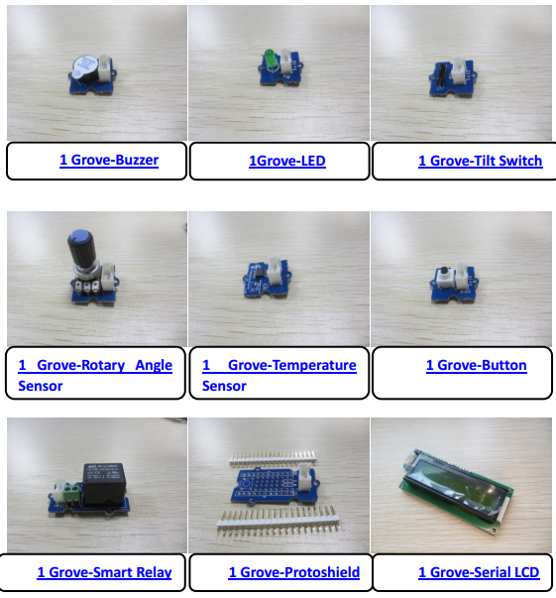
X
Touch Sensor
Mic/Sound Sensor
Light Sensor
X
X
RGB LCD Backlight

Slide 7
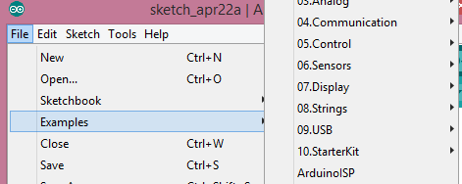
Arduino Programming
Essentially C programming
functions, int, float, arrays, while/for loops
The main thing to learn is the API for the sensors
If using a new library need to add to the libraries folder
Can walk through examples; we’ll just hit some examples

Slide 8
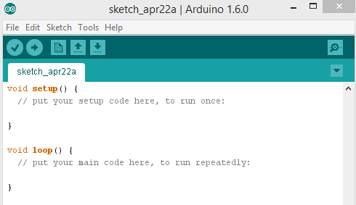
setup and loop
Special functions that are self-explanatory

Slide 9
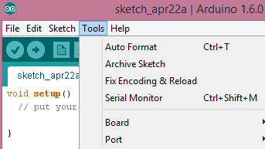
Programming
Don’t forget to set the board and port
Check port if reconnecting after power-down

Slide 10
Connecting Sensors
The base shield allows easy connection of I/O pins
for serial communication
for digital I/O
for analog I/O
I2C or inter-integrated circuit for communication between I2C devices

Slide 11
Note shared pin on adjacent sockets
If your module uses two pins they have to be separated by a socket.
If only use one digital pin each they can sit alongside each other.
Otherwise they will share a pin simultaneously.

Slide 12
Sample Programs
Buzzer
  Button on D3, Buzzer on D2
  Can replace Buzzer with LED
Musical Buzzer
  Shows a variety of programming constructs
DigitalReadSerial
  Output to serial monitor for debugging and testing purposes
AnalogReadSerial
  Analog sensor on A0
  Output values for Rotary Angle, Sound, Temperature, Touch
AnalogMusicalBuzzer
  Link analog device with musical buzzer

