Slide 1
Agile Planning

Slide 2
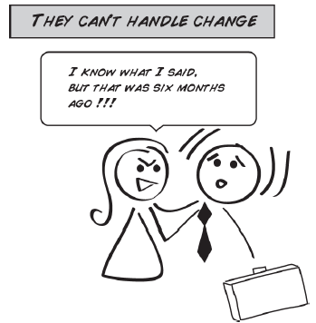
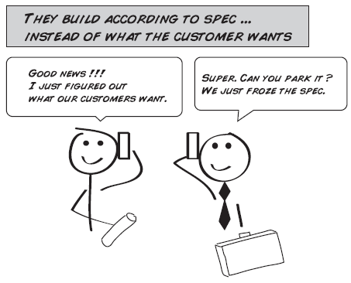
The problem with documentation
Argument: “Heavy” documentation too much for most business-style projects

Slide 3
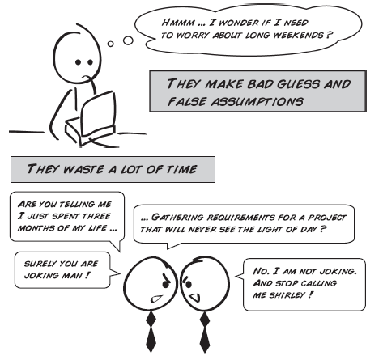
Documentation

Slide 4
English Documentation
Can be ambiguous (one reason for more formal documentation styles, e.g. ER diagram instead of English)
  The man who hunts ducks out on weekends
  Fat people eat accumulates
  We painted the wall with cracks
  “This agreement shall be effective from the date it is made and shall continue in force for a period of five (5) years from the date it is made, and thereafter for successive five (5) year terms, unless and until terminated by one year prior notice in writing by either party.”

Slide 5
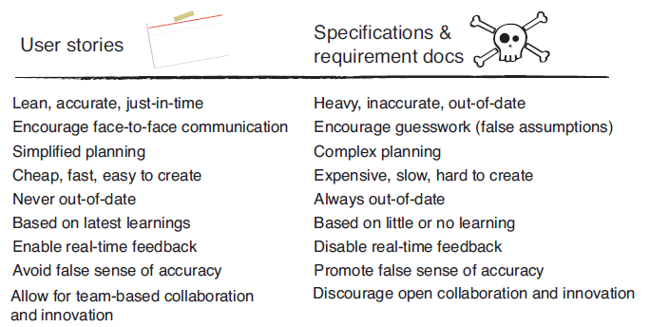
User Stories vs. Spec/Requirements

Slide 6
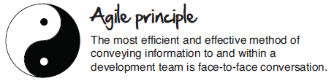

Slide 7
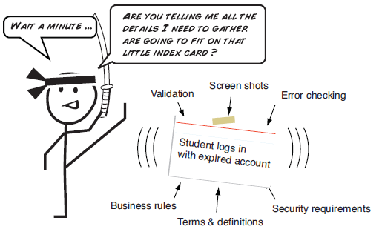
Agile User Stories
Short descriptions of feature(s) the customer would like to see in their software
Usually fits on an index card
Notes:
Promise of a conversation – if we get to it. If not, we didn’t waste our time. Details come out in the conversation.

Slide 8
Elements of Good User Stories
In language the customer understands
Cuts end-to-end through layers of the architecture
Independent of other user stories (as much as possible)
Are negotiable, tradeoffs possible
Are testable
Are small and estimable

Slide 9
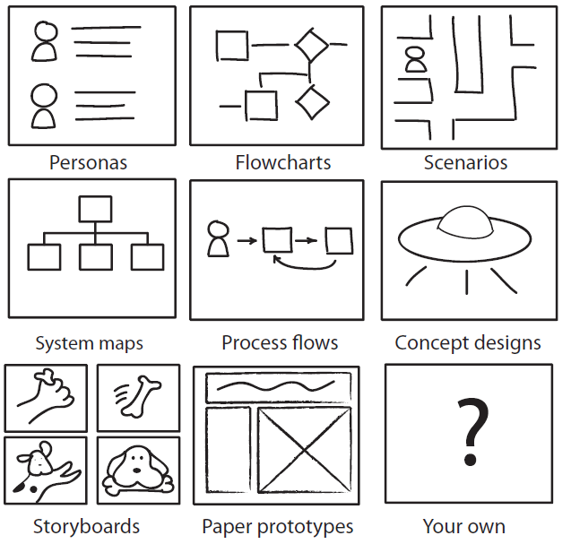
Extracting User Stories
May need to do lots of brainstorming, draw lots of pictures, model the workflow

Slide 10
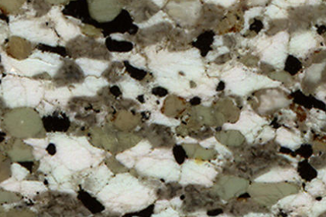
In-Class Exercise
I am the client and all of you are the development team
Help develop user stories for a thin section photomicrograph pixel counter

Slide 11
Check Stories
Check INVEST
  Independent, Negotiable, Valuable, Estimable, Small, Testable
Can something be re-cast as a constraint?
  E.g. “Must be fast” to “Must load within 2 seconds”
Scrub list, look for duplicates, consolidation or splitting of user stories

Slide 12
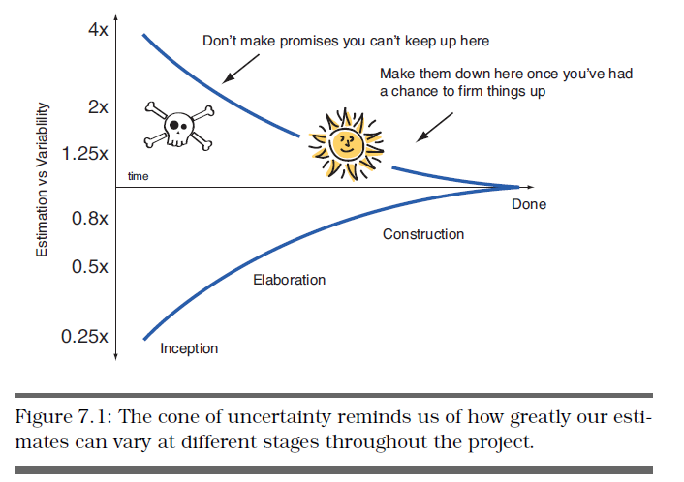
Analysis and Estimation
You now have a stack of user stories
Identify stories that require clarification
Next we want to estimate how long they will take

Slide 13
Relative Estimation
Estimate coding time required for each story, but not in actual time, but in “units”.
  Joshua Kerievsky uses NUTs: Nebulous Units of Time
  Idea is to convey the relative sizes of stories
  Tough to do because you don’t know what units represent until a few iterations are done, but they will shape up as time goes on

Slide 14
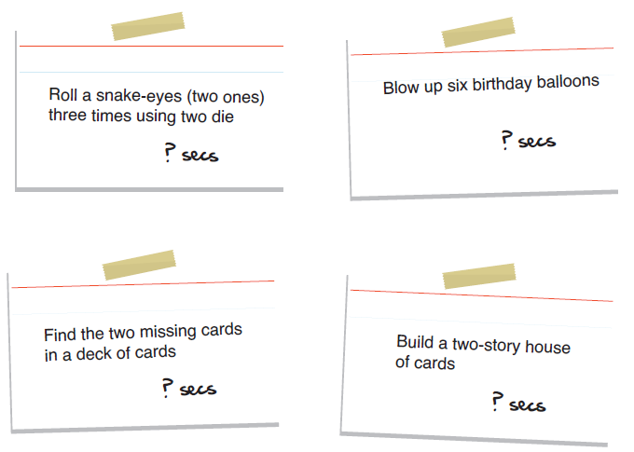
How Long?

Slide 15
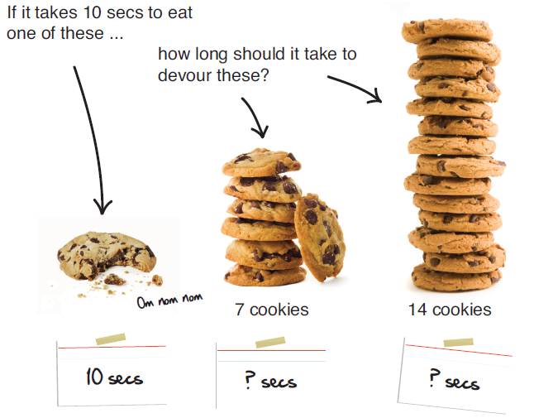
Relative Estimation

Slide 16
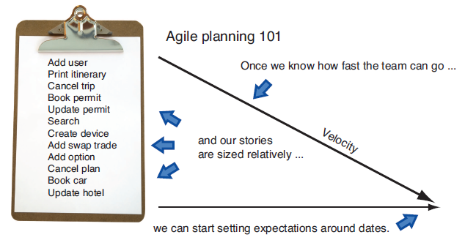
Estimation
Humans are better at relative than absolute estimation
Agile estimation is to size our stories relative to each other and keep track of time taken

Slide 17
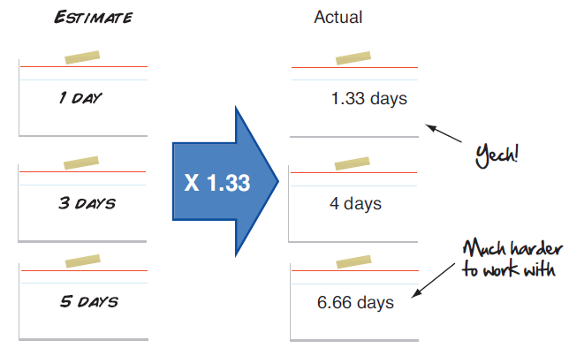
Units of Time
Say a story we estimated to take 3 days really took 4 days
We could adjust actual calendar days to “programming days” by multiplying programming days by 1.333
Endless rejiggering?
False precision?

Slide 18
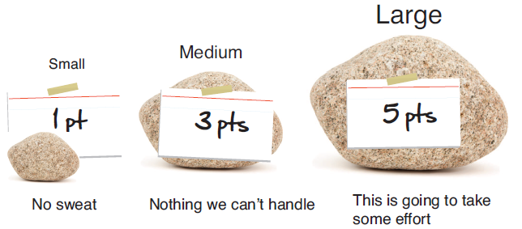
Point System
Can avoid problems by using a point system
Focus on relative sizes of the stories
  Reminds us that estimates are guesses
  Measure of pure size
  Simple

Slide 19
Estimating Stories
To estimate the user stories it may help to break them into tasks; discrete steps to complete the story
  E.g. to save a document, you may have the task of creating the GUI to initiate the task, another task for the disk operation
Brainstorm with your team for an estimate of units
Tasks aren’t shared with the client

Slide 20
In-Class Exercise
Estimate units for thin section pixel counter user stories

Slide 21
Estimating NUTS
If you have the same amount of time to devote to the project every week you don’t need to convert to person-hours; you can just use NUTS/iteration as your velocity
Go to client and say how many NUTS you estimate you can do the first week based on the perceived difficulty

Slide 22
Determining Workload
Clients are initially not happy to get estimates in terms of units
  Client: What’s a unit?
  Developers: We don’t know.
  Client: How many units can you do this week?
  Developers: We don’t know, but we can make an initial estimate, and it will get better every iteration and even within an iteration.
If you estimated 20 NUTS the first iteration but you only completed 10 NUTS then you can generate a better estimate for the second iteration
  Project spike useful here to get an initial estimate
  Project velocity = NUTS completed / iteration

Slide 23
Estimating NUTs from Person Hours
If your time varies each week estimate for the first iteration how many person-hours the group can collectively commit per week
  Allow for time when you’re not coding and not working
  Make an estimate; the next one can be better
Go to client and say how many units you can do per week
  Consider how many people you have and how many hours each person can actually work
  After the iteration is over you can make an estimate of units per hour
  E.g. if 20 person hours and you were able to do 20 units per week then 1 unit/hour

Slide 24
Client Reevaluation
Give client the user stories, estimates, and the total number of units you can do per week
Client gets to pick the stories that add up to the total number of units
Client doesn’t get to add more stories beyond the total number of units
  Important not to let the client get away with this, remind the client they can do different stories the next iteration
  Have to prioritize and drop something if another being added

Slide 25
In-Class Exercise
Estimate total units per week (optional to map from hours) for the thin section pixel counter project
Client to prioritize

Slide 26
Dealing with Disappointment
After a week perhaps you see your estimates weren’t accurate
  Usually programmers underestimate the time required
  Reassess where you are with your group and immediately go to the client so he or she can determine how you should spend your remaining time
Sometimes this is good news
  If you only got to finish 10 units and you estimated 40, then you have better data for the next iteration
  Estimates should get better each iteration; “surprises” are early, not later

Slide 27
Rinse and Repeat
Even if you didn’t complete as many stories as estimated the first iteration, the client should be happy with your honesty
As the project progresses you should get better at knowing what you can do in an iteration
Continue to keep the client informed and track where you are at all times
Client may be unhappy the product is going slowly, but it’s hard to argue with the data you are gathering and sharing

Slide 28
Communication
Use BlackBoard wiki or forum to share information with your team members
Good place to keep track of
  Meeting notes
  Issues or problems
  Assigned tasks, estimates, actual time taken
    Compare with actual time

Slide 29
Rules
The developers will be truthful in their estimates and the customers will believe these estimates
The developers will refine their estimates and the customers will refine their expectations based on the actual achievements in each iteration
During the iteration the developers will update the client as to the progress of the iteration. The client will use this information to quickly refine what is required in the current iteration.

Slide 30
Summary of Agile Planning every Iteration
Develop user stories with client
Without client, break users stories into tasks to better understand time it will take to complete
Assign NUTs to each user story
Estimate how many NUTs the group can complete in one iteration
  May require conversion from Hours to NUTs
Ask the client to prioritize user stories for the current iteration; must fit within NUTs the group can complete in the iteration!
Show client your work at the end of iteration
  Repeat with modified estimate for NUTs the group can complete

