Slide 1
Agile Planning
Dealing with Reality

Slide 2
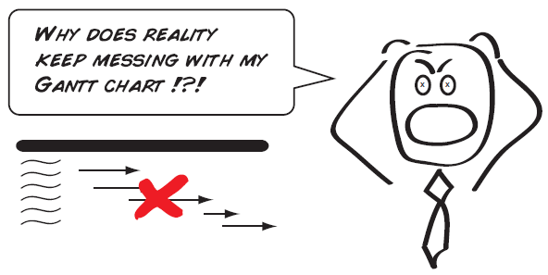
Reality
Basic agile principle – don’t expect static plans to hold, be flexible and expect changes

Slide 3
Examples of the Unexpected
Everything seems to be going well until…
Crucial teammate drops the class
Realization that you aren’t going as fast as you thought
You learn some new features that must be added halfway through
You run out of time

Slide 4
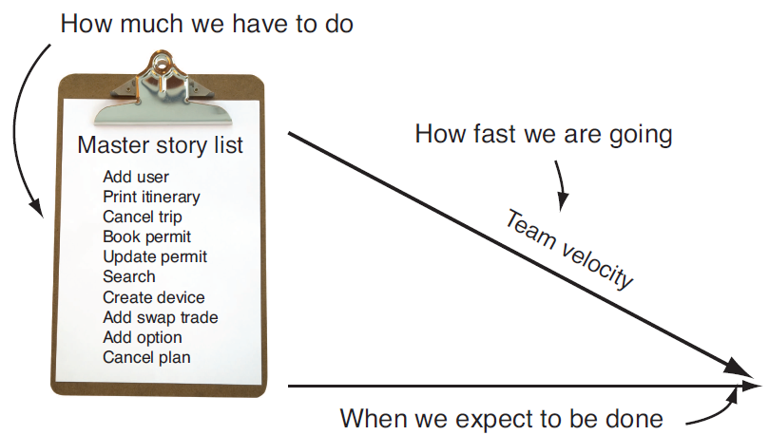
Agile Planning
These problems are addressed by measuring the speed the team is working (the project velocity) and estimating when production-ready code will be delivered

Slide 5
Iterations
Number of iterations = Number Total Units / Estimated Units Per Iteration
e.g. 100 / 10 = 10 iterations to completion
Pick iterations to deliver “MMF” – Minimal Marketable Features
Can deliver by core feature set or by date
We are approaching this one iteration at a time partly due to our fixed date at the end of the semester

Slide 6
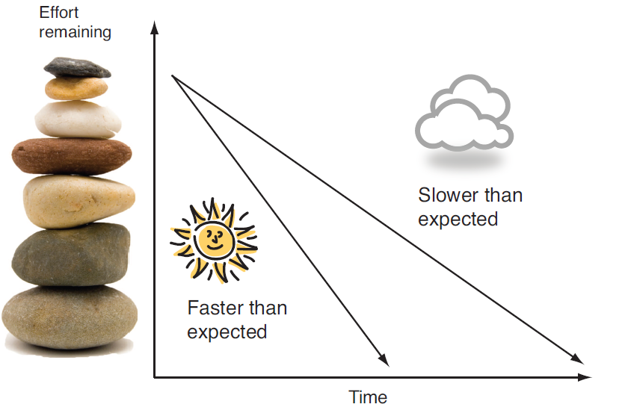
Iterations
Important to convey our estimates are guesses not hard delivery dates

Slide 7
Agile is flexible around scope
To keep deadlines agile development tends toward tradeoffs around scope
What do you do when the customer wants to add a new user story to your iteration?
What is your team’s reaction when the customer wants to add new features late in the development process?

Slide 8
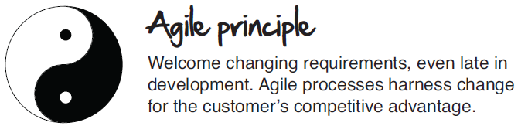
Changing Requirements
Get customers away from the mindset that they have to add everything in the requirements phase
Everyone can learn as you go instead of trying to get everything perfect up front

Slide 9
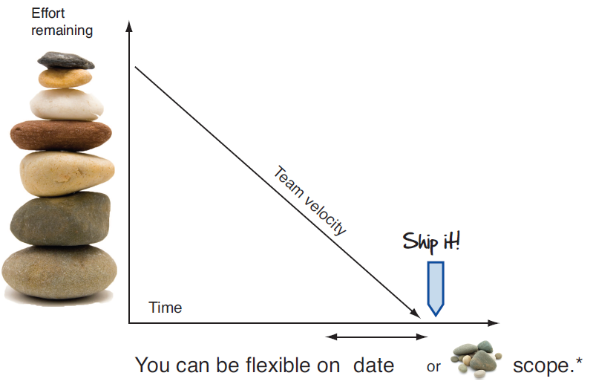
Could extend the date
But customer can’t add something and not expect something to come off for the date to remain the same
What if your customer refuses to give up on scope and wants the same date?
Notes:
Perpetuate the lie or hold fast to reality!

Slide 10
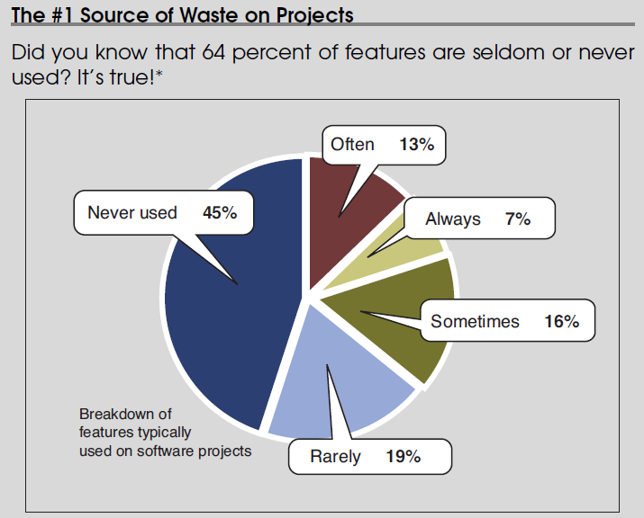
Why the client prioritizes stories
Reality ends up giving us requirements scrubbing

Slide 11
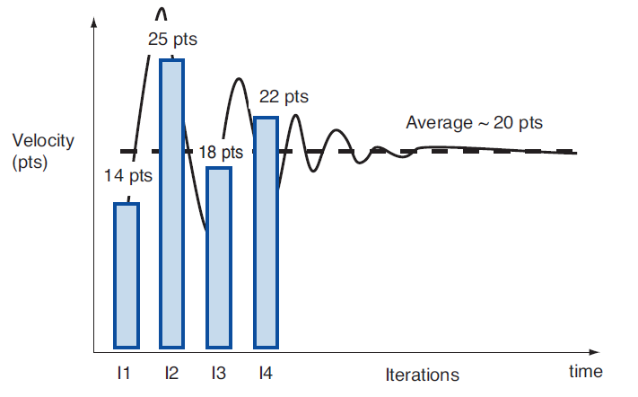
Team Velocity
Start conservative; remember we are delivering a production-level story

Slide 12
Burn-down chart
We’ve been using a simple version to show our stories and delivery date
Shows at a glance
  How much work has been done
  How much work remains
  The team’s velocity
  Our expected completion date

Slide 13
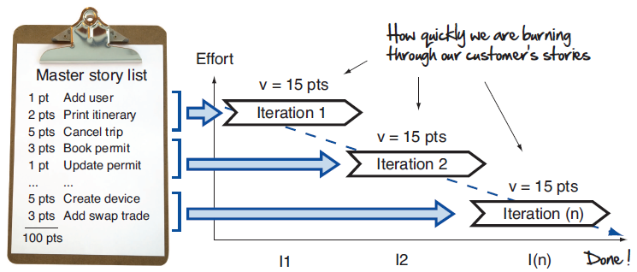
Burn-down chart

Slide 14
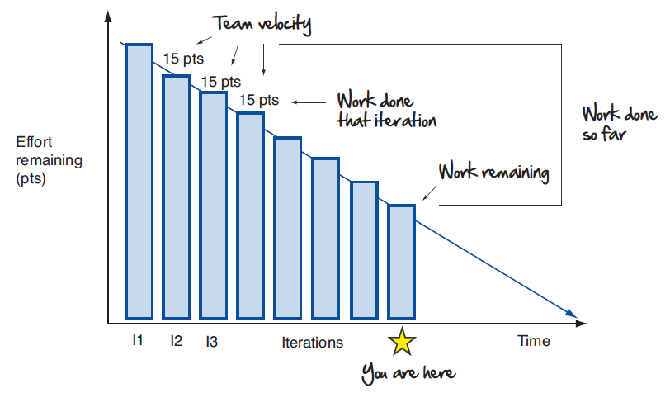
Burn-down chart

Slide 15
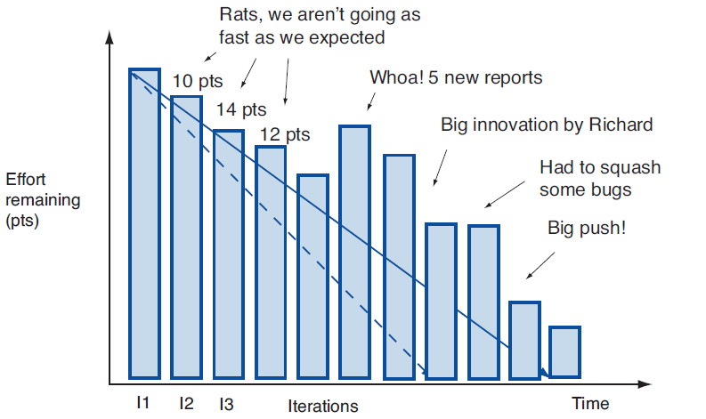
More Realistic Burn-down chart
Tells story about what happened, makes events visible and see cause/effect
Honest and open with customers and developers

Slide 16
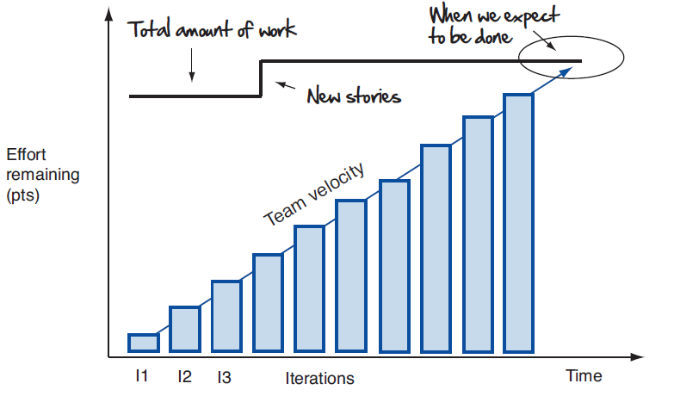
Burn-up chart
Shows added work of new user stories

Slide 17
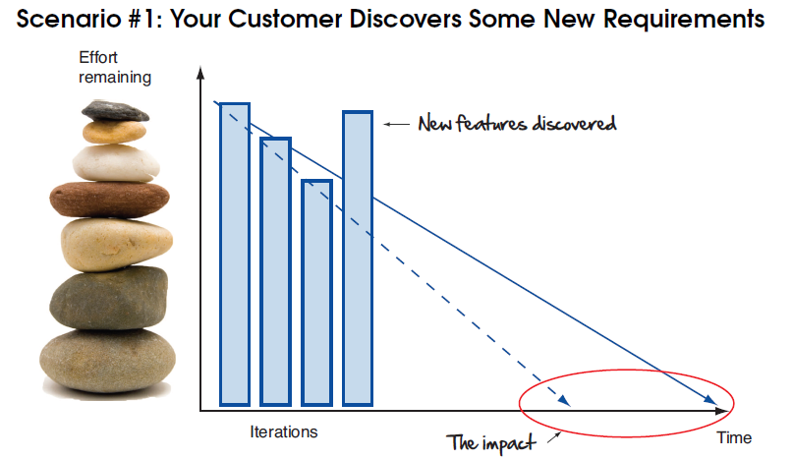
Some Scenarios
What do you do?
Notes:
Don’t get emotional, let the customer determine the tradeoffs

Slide 18
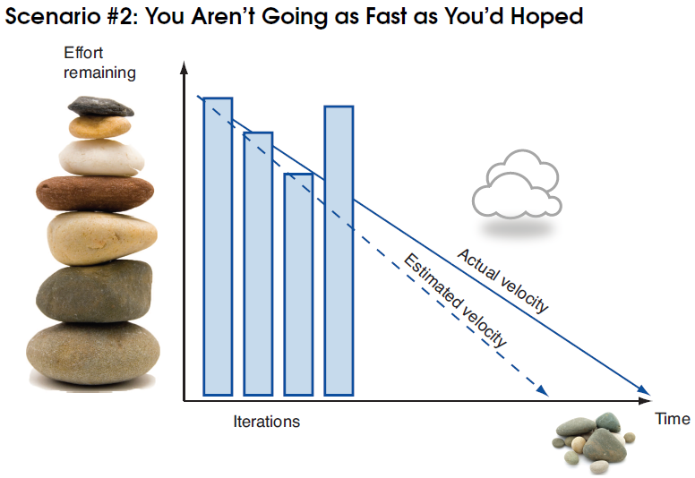

Slide 19
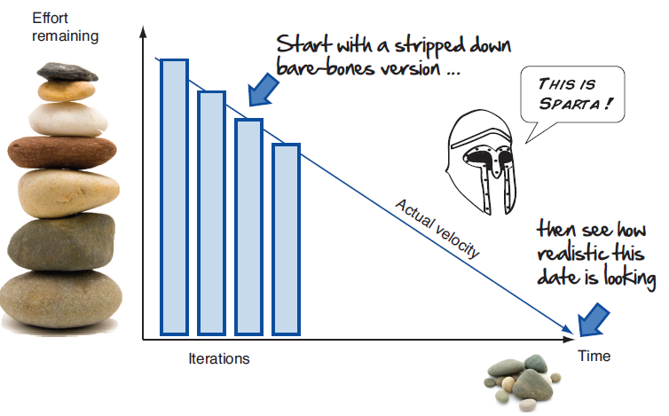
Spartan Warrior strategy for checking reality of deliverable date

Slide 20
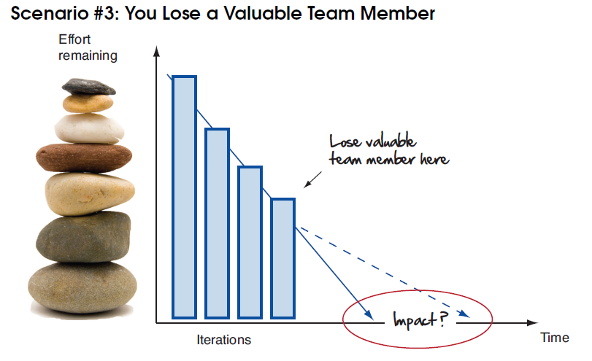
Add new team member?

Slide 21
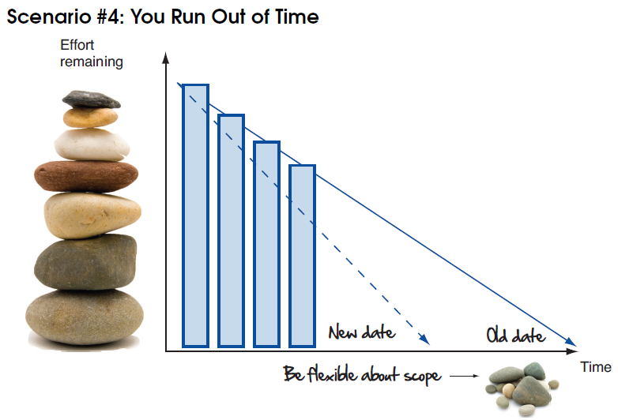
(due date pushed earlier)
Notes:
Classic answer to reduce features/stories; be innovative, try to work with customer, perhaps go to the spartan stories

Slide 22
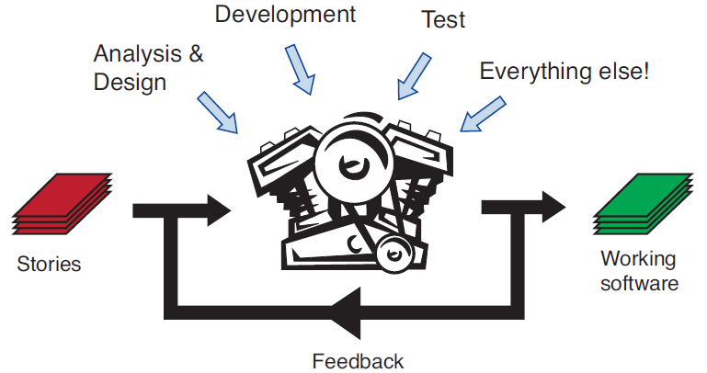
Focusing on an Agile Iteration
Goal is to produce production software for user stories within a short iteration but we have more to do than just coding

Slide 23
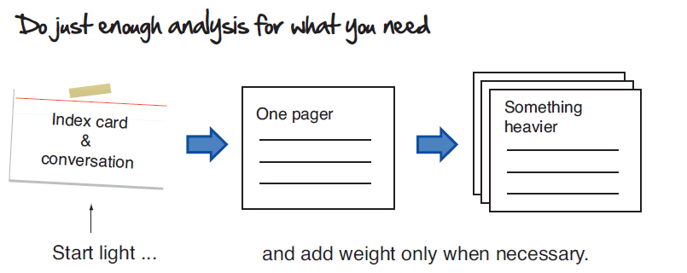
Analysis

Slide 24
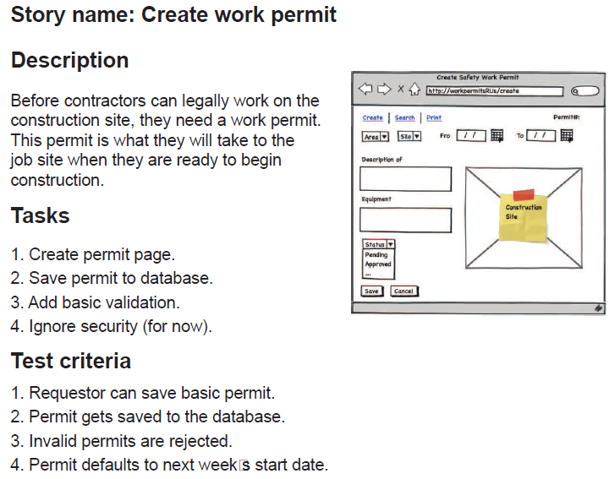
Sample One Pager

Slide 25
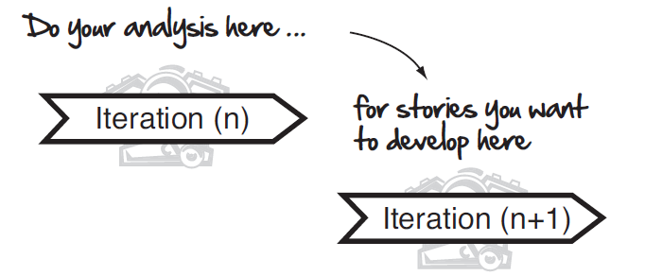
Just In Time Analysis
Analysis done with latest information
Everyone can learn as you go
Avoid rework by analysis too early

Slide 26
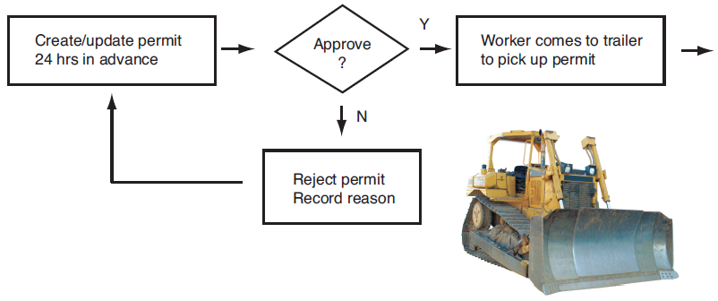
Sample Analysis Artifacts - Flowchart

Slide 27
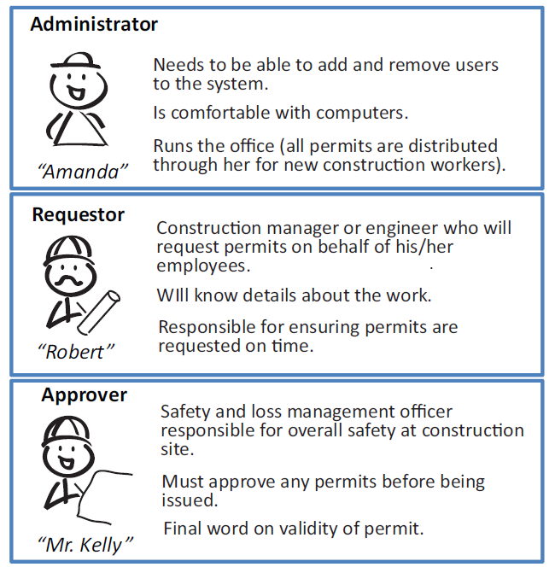
Sample Analysis Artifacts - Personas

Slide 28
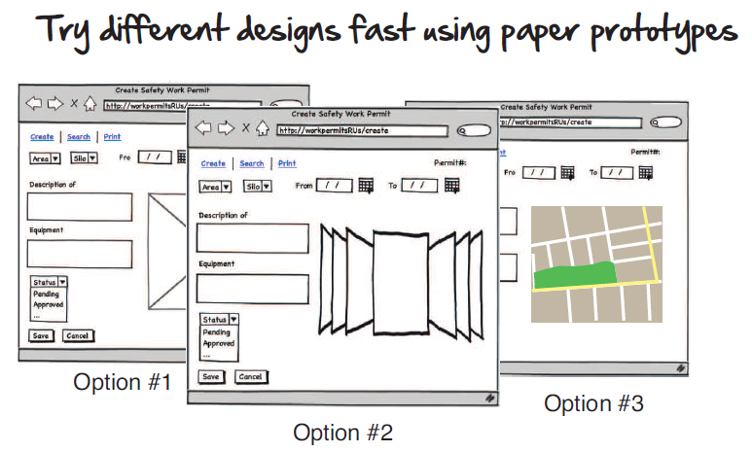
Analysis Artifacts – Paper Prototypes

Slide 29
Analysis Artifacts – Acceptance Tests
How do we know if this thing is working?
Create work permit from Requestor interface, should be visible from Admin and Approver interfaces
Create work permit, save, identical permit should be retrievable after logout and login
….

Slide 30
Development and Testing
We’ll have more to say about this later

Slide 31
Other Iteration Activities
Make sure the work for the next iteration is ready (user story planning meeting)
Get feedback on the last iteration’s stories (showcase with customer)
Plan for actually doing the work for next iteration (iteration planning)
Continuously look for areas of improvement (mini retrospective)

Slide 32
Story Planning Meeting
Is the next batch of user stories ready to go?
Have we done our homework?
Showcase
Demo project and features completed
Make it fun
Get feedback

Slide 33
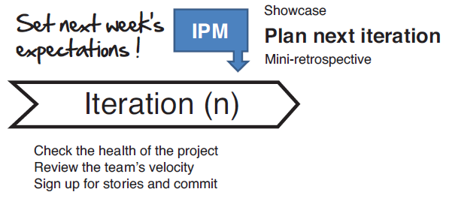
Iteration Planning Meeting
Use burn-down chart

Slide 34
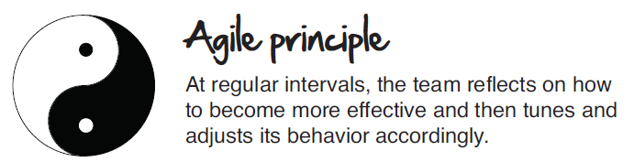
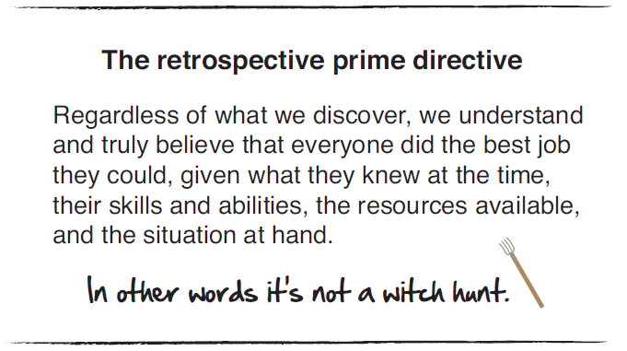
Mini Retrospective
In 10-15 minutes, where are you lagging and where are you kicking butt?

Slide 35
Constructive Feedback
Avoid pure criticism and offer a way to improve performance
Cold
  “Suzy, I noticed you did some great work on the print module last iteration, but your unit tests were really lacking.”
A little sweetness
  “Suzy, awesome work on the print module. Apply that same level of detail to your unit tests, and you are soon going to be world-class.”
Objective
  “Suzy, the print module runs great and the code is nicely organized. The unit tests didn’t cover all the functionality though and should check for error conditions as well.”

Slide 36
Do whatever works for you
All in one meeting or separate meetings?
Some activities conducted online?
Story planning meeting not needed because it happens naturally through regular interactions?
Just make sure that each iteration you show your customer working software, set expectations for the next iteration, and look for ways to improve

