Slide 1
Intellectual Property Overview
Patents, Trademarks, Copyright

Slide 2
Intellectual Property
Patent
  Inventions; processes, machines, algorithms, designs; must be novel
Copyright
  Original works of authorship; art, books, software, movies, manuals, forms
Trademark
  Identify the source of a good or service; company name or product line, logos, slogans
Trade Secret
  Any info that gives the owner some competitive benefit; could be patentable
Patents and Trademarks: http://www.uspto.gov
Copyright: http://www.copyright.gov

Slide 3
Trademarks ® TM
Identifies the source of goods or services
The only ways to acquire the exclusive right to use a mark are to
  be the first to properly use it in your trade area
  or file a federal trademark application that issues as a registration.
    A federal trademark registration gives an exclusive right to use the mark throughout the U.S. against later users of the same or confusingly similar mark for similar goods or services.
Can be anything!
  Words
  Sounds
  Colors
  Images
Servicemark ® SM
  Identifies the services of a business or provider

Slide 4



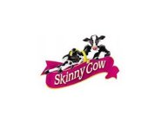
Trademark Examples
http://tess2.uspto.gov/
Coke
Pepsi Max
Nana’s Naturals Love, Peace & Hairgrease
Pentium
Don’t Leave Home Without It
Tomahawk
Skinny Cow
Amazon.com

Slide 5
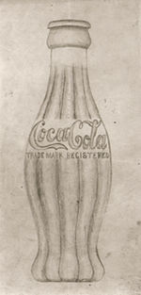
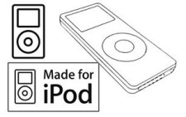
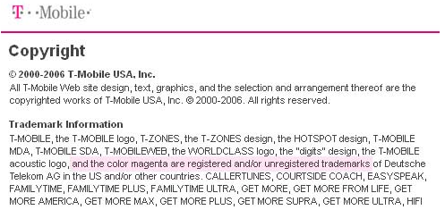

Trademarks can be…
Shape of a bottle
Shape of a device or package
Colors
Sounds

Slide 6
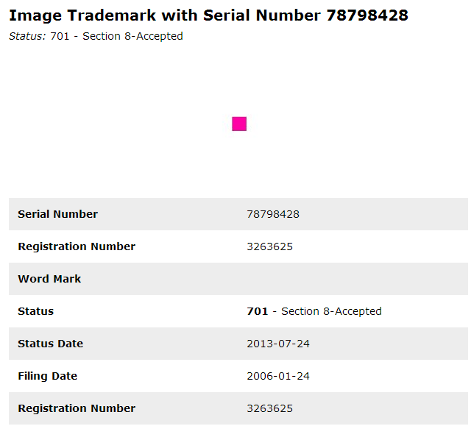

Slide 7
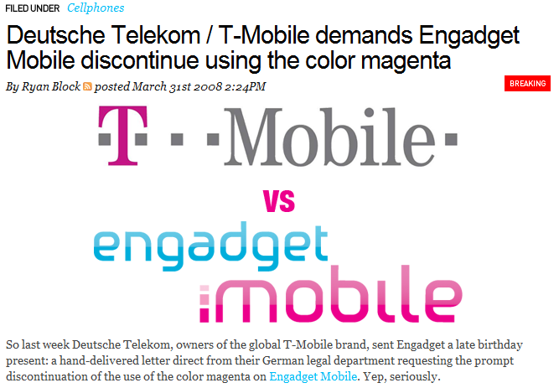

Slide 8
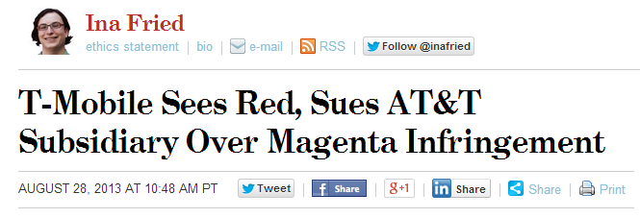
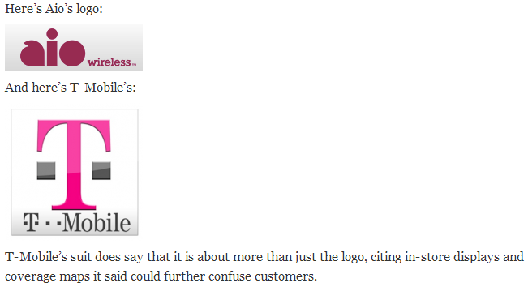

Slide 9
Trademark Strength
Fanciful
  Pentium, Exxon
Arbitrary
  Apple Computer, Camel Cigarettes
Suggestive
  Roach Motel, 7-Eleven
  Die Hard Batteries, Mustang Auto
Merely Descriptive
  Beer Nuts, Vision Center
Generic
  bran flakes, cola, aspirin, heroin, yo-yo, zipper
Strong
Weak

Slide 10
Misconceptions
Registration of the mark as a trademark or service mark does not necessarily mean it is permissible to use the mark everywhere.
  Depends on business area
  e.g. Capone’s Pizza (two in Anchorage; many in Chicago?)
Your name and company are not automatically trademarked and are not entitled to be trademarked.

Slide 11
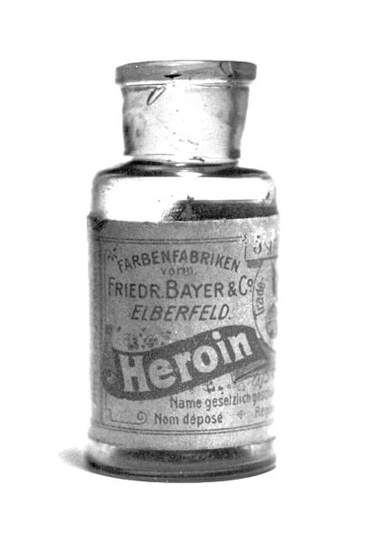
Maintaining a Trademark
Use of the mark
Renew registration every 10 years
Police the mark
Losing a Trademark
  Not using the mark in commerce
  Not policing third-party use of infringing marks so they become generic terms
  Freeware, aspirin, heroin, thermos, zipper, trampoline, popsicle, thermos, jumbotron, xerox
Notes:
1982 Fluegelman developed PC-Talk as trademarked “Freeware”; gave rise to Shareware since term couldn’t be used; disappeared 1985

Slide 12
Trade Secret
A trade secret is any secret information used by a business that gives it a competitive advantage
  The secret must be documented and kept confidential; you can’t protect it if you don’t know what it is
Trade secret case must:
  Prove a trade secret existed
  Defendant learned of the trade secret through a confidential relationship
  Defendant disclosed the trade secret without authorization
  Defendant profited from or plaintiff damaged by disclosure of the trade secret
Trade secrets are protected without any procedural formalities – no registration needed

Slide 13
Copyright
Copyright protects original works of authorship fixed in any tangible medium of expression, now known or later developed, from which they can be perceived, reproduced, or otherwise communicated, either directly or with the aid of a machine or device.
  “Tangible medium” includes any stable reproducible medium (e.g. paper) or saved computer software
Copyright protects the expression of an idea but not the actual idea itself
No requirement for novelty or uniqueness but must be original authored work

Slide 14
Copyright Examples
Books
Buildings
Drawings
Software
Advertisements
Website content
Movies
Plays
Photographs
Sound
Music
Maps
Rules
Games

Slide 15
Securing Protection
Copyright protection is secured automatically upon creation. You don’t have to do anything special to have your work copyrighted.
No publication or registration is required.
  Unless you go to litigation
  File with Copyright Office
  No complex examination like patents or trademarks
Notice
  Not required
  This is the © 2014-2015

Slide 16
Length of Copyright
Life Plus 70: In the U.S., copyright subsists from creation and endures the full life of the author plus 70 years after the author’s death.
95 Years from Publication: If the author is not natural person, then copyright endures 95 years from publication or 120 years from creation, whichever expires first.

Slide 17
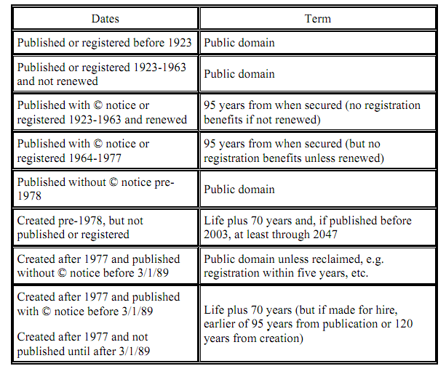
From http://images.jw.com/com/publications/351.pdf
Notes:
Extension from lobbying by Disney; expires in 2018?

Slide 18
Fair Use
The Fair Use doctrine gives a right to copy in the areas of criticism, news reporting, parody, teaching, etc.
Factors considered
  the purpose and character of the use
  the nature of the copyrighted work
  the amount and substantiality of the portion used
  the effect on the market for or the copyrighted work
Generally a short excerpt and almost always attributed; should not harm the commercial value of the work

Slide 19
Software Licenses
Related to copyright
All software not in the public domain is subject to licensing; contract stipulating allowable use of the software
Violating the license typically means copyright infringement
Source code license
  Proprietary / Open Source
  GNU General Public License – free/copyleft license, source code must be made available to modify

Slide 20
MIT License
Copyright (C) <year> by <copyright holders>
Permission is hereby granted, free of charge, to any person obtaining a copy
of this software and associated documentation files (the "Software"), to deal
in the Software without restriction, including without limitation the rights
to use, copy, modify, merge, publish, distribute, sublicense, and/or sell
copies of the Software, and to permit persons to whom the Software is
furnished to do so, subject to the following conditions:
The above copyright notice and this permission notice shall be included in
all copies or substantial portions of the Software.
THE SOFTWARE IS PROVIDED "AS IS", WITHOUT WARRANTY OF ANY KIND, EXPRESS OR
IMPLIED, INCLUDING BUT NOT LIMITED TO THE WARRANTIES OF MERCHANTABILITY,
FITNESS FOR A PARTICULAR PURPOSE AND NONINFRINGEMENT. IN NO EVENT SHALL THE
AUTHORS OR COPYRIGHT HOLDERS BE LIABLE FOR ANY CLAIM, DAMAGES OR OTHER
LIABILITY, WHETHER IN AN ACTION OF CONTRACT, TORT OR OTHERWISE, ARISING FROM,
OUT OF OR IN CONNECTION WITH THE SOFTWARE OR THE USE OR OTHER DEALINGS IN
THE SOFTWARE.

Slide 21
Ethics and Copyright
You’re working on a project for work and use Google to find some code that is exactly what you are looking for!
Can you or should you use it?
What if the code is posted on a site like stackoverflow.com?

Slide 22
Copyright Myths
If it doesn’t have a copyright notice then it is not copyrighted
If I don’t charge for it, it’s not a violation
If it’s posted on the web then it’s in the public domain
If you don’t defend the copyright you lose it
Derivative work avoids the copyright issue

Slide 23
Patents
A patent is a temporary government-granted monopoly right on something made by an inventor.
  Patent holders receive exclusive rights to make, use, or sell an invention, design, or plant.
Purpose
  Encourage development and disclosure of new inventions; remedy for fear someone will copy your invention so you get the monopoly for a short time
Patents can be licensed and companies can collect them to retaliate if sued for infringement
Expensive ($5K-$15K) and time-consuming process (years)

Slide 24
Types of Patents
Plant Patents
  Creating new varieties of plants
Utility Patents
  Invention; protects processes, machines, articles, compositions. Includes software patents (e.g. MP3 compression), business patents (e.g. Priceline model)
  20 years
Design Patents
  Ornamental characteristics
  14 years

Slide 25
Patentable
To be patentable the invention must be:
  New – not prior art
  Useful
  Not obvious
Can be:
  A process
  A machine
  A composition of parts
  A manufacturing process
You must compare your invention to the relevant prior art to determine if it warrants a patent application

Slide 26
Misconception
A patent does not entitle its owner to “practice” (i.e., “make” or“ build”) the invention. It entitles the owner to exclude others from making, using, selling, offering to sell, and importing the claimed invention.
Example
  Al patents a chair with a back and 4 legs
  Bob patents a rocking chair
  Al’s patent covers Bob’s if it has a back and 4 legs so Al can prevent Bob from making/selling a rocking chair
  Bob can prevent Al from making/selling a rocking chair
  The two might cross-license their patents

Slide 27
Provisional vs. Non-Provisional
Provisional
  Establishes a filing date but is a placeholder that preserves an invention for one year. Includes a cover sheet, partial description, diagram.
Non-Provisional
  Begins the examination process with detailed description, specifications, drawings, declaration

Slide 28
One Year Bar
You can publicly disclose your invention and have up to a year to file a patent in the US; after that you can be barred from getting a patent
Not all foreign patents allow the one year period so most patent attorneys recommend filing at the same time disclosure is made

Slide 29
Controversial: Software Patents
1983, Unisys patent of Lempel-Ziv-Welch compression scheme
  Used in GIF image format; popular 1987-1994; promoted by CompuServe, apparently unaware of the patent
  1994: CompuServe and Unisys announced developers must pay a license fee to use the image format
  Expired in 2003
  Helped lead to PNG and alternate compression formats not based on LZW

Slide 30
Amazon 1-Click Patent
1999 Patented feature that a customer can click once to check out a shopping cart using previously stored information instead of having to re-type their information
Challenged and re-examined 2007-2010; reconfirmed in 2010 with some changes
1999: Filed patent infringement lawsuit against B&N “Express Lane”
  B&N added a second click; settled in 2002
2000: Licensed to Apple

