Slide 1
CS 470 Project Final Presentation
Dmitry Korobov
April 13, 2009

Slide 2
Overview
GUI interface for the robot
Atomic Actions Panel
Script generator for complex actions
Sensors Panel
Robot’s module

Slide 3
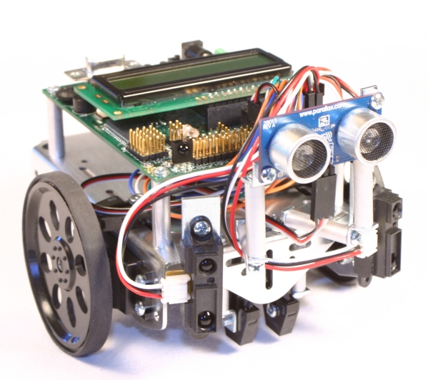
IntelliBrain™ 2 Robotics Controller
14.7 MHz Atmel ATmega128 CPU
132K RAM
128K Flash
16x2 LCD Display
Buzzer
Infrared range sensor
Sonar
Camera
Bluetooth or 115.2K RS232 comm ports

Slide 4
Software
RoboJDE™Java™ robotics development environment
Netbeans
HyperTerminal

Slide 5
Robot’s Module
14 classes running as separate threads
1 main thread with pointers to other objects
Classes represent hardware elements as state machines that are modified by the main thread

Slide 6
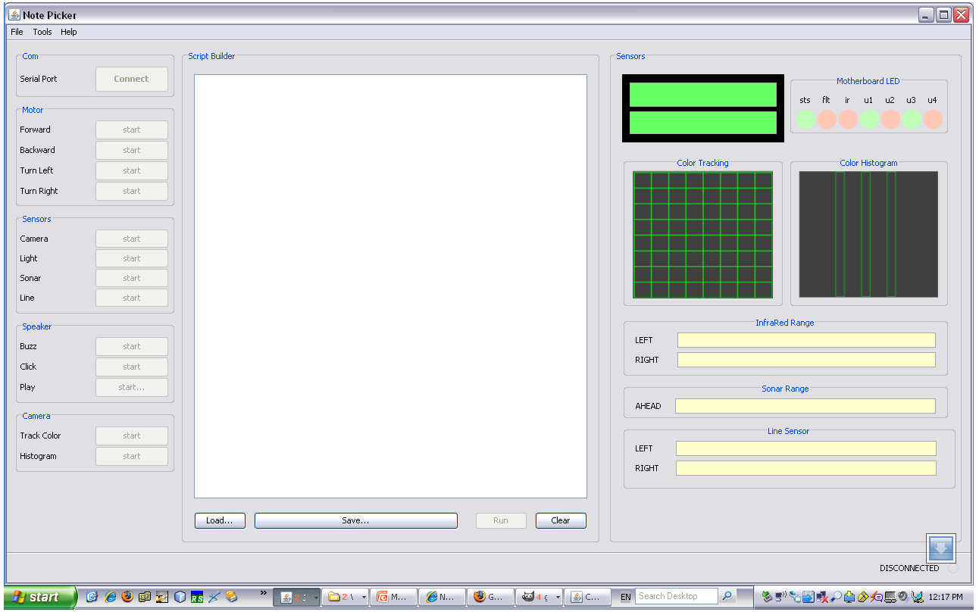
Robot’s GUI

Slide 7
Communication
Serial connection over bluetooth @ 115200
7 byte commands with 18 bytes of data
Syntax: r i i 0 t 0 0 d 0 0 0 0 0 0 0 0 … ‘\r’
Commands are buffered in a resizable queue

Slide 8
Script Interpretation Example
if camera center color == green
move forward
end if
if light 2 ≤ 10
move stop
end if

Slide 9
Script Interpretation Example
if camera center color == green
SEND: c o i 0 t 0 0 d ‘\r’
SEND: c c i 0 t 0 0 d ‘\r’
RECEIVE: c c i 0 t 0 0 d 128 0 0 ‘\r’
move forward
SEND: m f i 0 t 0 0 d ‘\r’
end if
if light 2 ≤ 10
SEND: r i i 0 t 0 0 d ‘\r’
SEND: r i i 1 t 0 0 d ‘\r’
RECEIVE: r i i 0 t 0 0 d 9 . 7 E 0 ‘\r’
RECEIVE: r i i 1 t 0 0 d 9 . 9 E 0 ‘\r’
move stop
SEND: m s i 0 t 0 0 d ‘\r’
end if

Slide 10
Schedule
Task | Duration (days) | Start | End
Requirements | 6 | 01/19/09 | 01/25/09
Design | 11 | 02/02/09 | 02/13/09
Graphical interface | 7 | 02/14/09 | 02/21/09
Script builder | 10 | 02/21/09 | 03/03/09
Sensors | 7 | 03/04/09 | 03/11/09
Search algorithm | 21 | 03/12/09 | 04/02/09
Testing | 7 | 04/03/09 | 04/10/09
Writeup and Demo | 7 | 04/11/09 | 04/18/09

