Slide 1
CAHDRE Mentor / Mentee and Project Database
Mathew Bergt
University of Alaska Anchorage

Slide 2
Client Overview
Project serves Center for Addressing Health Disparities through Research and Education (CAHDRE)
  CAHDRE spreads information regarding health disparities in Alaska
  Encourages students to pursue health related careers
  Mentorship program for individuals interested in health careers and research

Slide 3
Goal
Current system: Mentees / mentors express interest using web form on CAHDRE website
  Forms must be reviewed manually
Prototype website
  Database driven
  UI features:
    Mentor and mentee accounts and profiles
    Collaborative projects
    Search for mentors, mentees, and projects
Project goal:
  Implement changes to existing prototype to increase ease of use for UI
  Provide functionality for data collection

Slide 4
Project Requirements
Modifications to the existing prototype:
  Dynamic administrator accounts
  Tag clouds which search for mentors and mentees by health area (biomedical research, nursing, social work, etc.)
    Displays list of mentors or mentees with the specified tag in their profile
  Search for mentors and mentees by clicking graphical icons related to various health areas
  Generate monthly usage report
    New and total number of mentors and mentees
    New and total number of projects
    Page hits by IP and total page hits
  Search results should be paginated and sortable
  Streamline process of adding mentees to projects
    Requires mentor to add mentee by typing username
    Instead, mentors should be able to browse and select mentees from pop-up list
  Feedback form displayed to users after some number of logins
    Provide feedback about functionality of website

Slide 5
Final Product

Slide 6
Administrator and Project Creator Interfaces
Functionality to add / remove / view administrators and project researchers
Uses jQuery plugins
  Auto-suggest
  Tablesorter

Slide 7
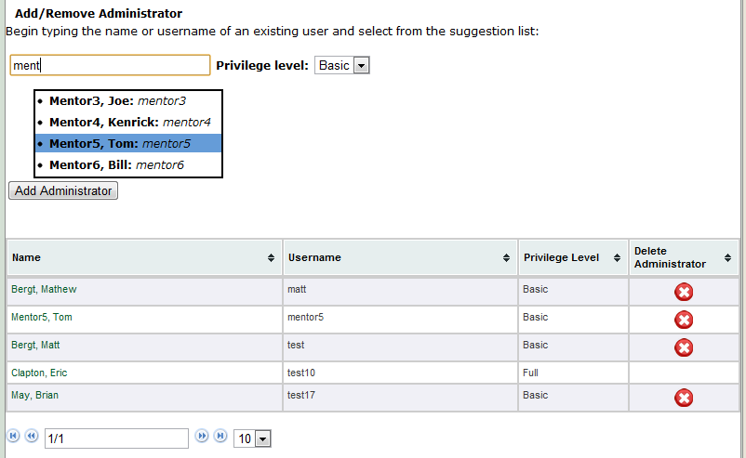
Administrator Interface

Slide 8
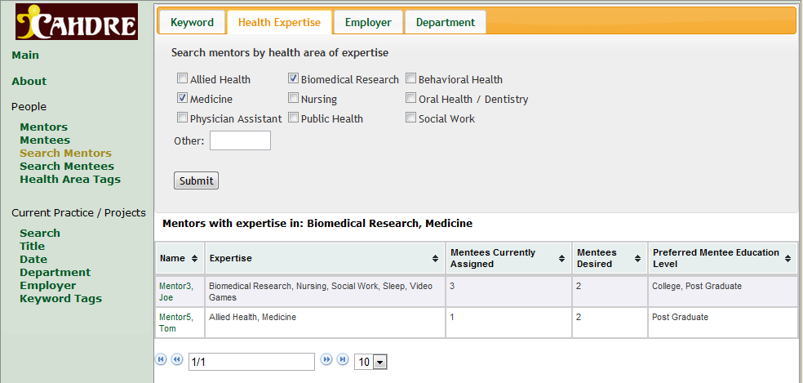
Search Result Modifications
Search results tabbed, sorted, paginated
Uses jQuery plugins
  Tablesorter
  Tabs

Slide 9

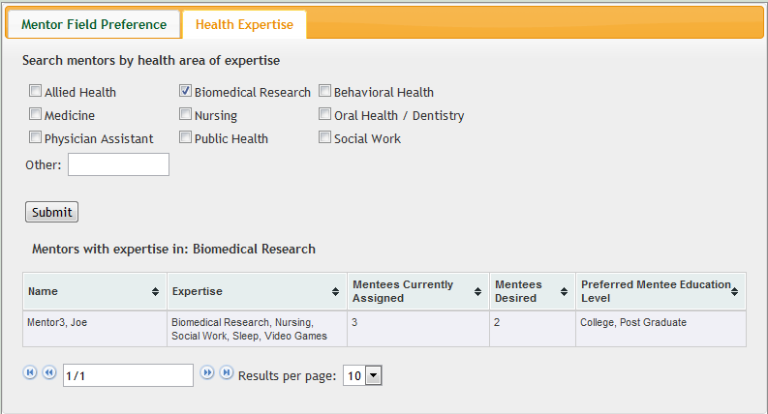

Tag Cloud and Icon Search

Slide 10
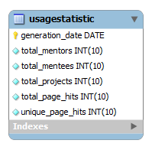
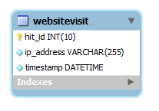
Monthly Usage Report
Generated a specified day each month
  Cron job scheduler will automatically run script
  Emailed to administrator(s)
  Calculates:
    Total and monthly users and projects
    Total and monthly page hits and total unique page hits (by IP)

Slide 11
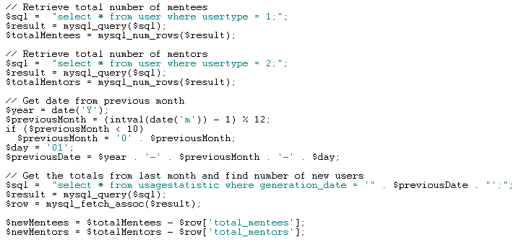
Code Excerpt – Usage Statistics

Slide 12
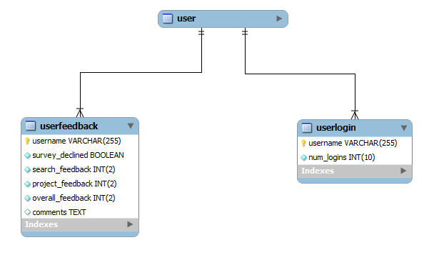
User Feedback Form
Displayed after some specified number of logins
Simple form gathering feedback from users
  Rate search, project, and overall site functionality
  Comments

Slide 13
Schedule
Project fell somewhat behind schedule
  Getting jQuery plugins to work took more time than expected
  Understanding structure of existing website
  Other classes and work interfered with planned schedule
Attempted to use prototyping
  Met with Dr. Mock once to show prototype
  Rapidly devolved into “code-like-hell” as semester progressed

Slide 14
Activity Breakdown
Activity | Estimated Time | Approximate Actual Time
Implementation | 26.4 hours | 80 hours
Design | 16 hours | 6 hours
Write-Up | 7.2 hours | 3 hours (without final write-up)
Testing | 19.2 hours | 8 hours
Requirements | 4 hours | 4 hours
Presentation | 7.2 hours | 4 hours
TOTAL | 80 hours | 105 hours

Slide 15
Future Modifications
Heavy refactoring of existing code
  Numerous instances of duplicate code in different scripts
    Create generalized functions to display data, access database
  Database queries and views combined in scripts
    Perhaps use model view controller pattern
Further development of report generation
  Add functionality to view usage statistics to administrator interface
  Include graphs, charts, more detailed statistics

Slide 16
Summary
Modified existing website to manage user accounts, improve search usability, and generate usage reports
Learned a good deal about PHP and jQuery
Got to apply my skills to a real-world application
Would like to continue with web-development projects
  Learn a more object-oriented language
  Write my own jQuery plugins

